Slide 1
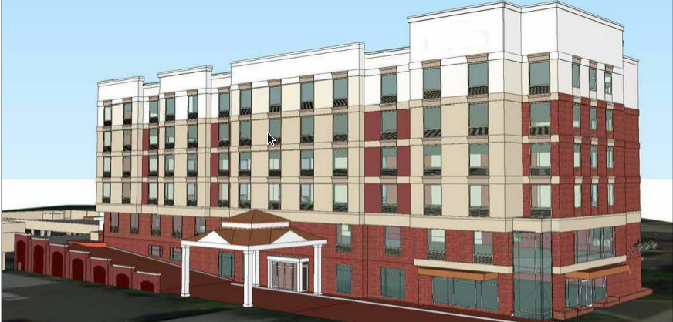
Mountain Hotel
Urban Virginia
Benjamin Borden
Structural Option
Faculty Advisor:
Professor Kevin Parfitt
Senior Thesis 2013

Slide 2
Mountain Hotel
Introduction
Existing Structural Systems
Thesis Proposal
Concrete Redesign
Glazing Evaluation
Conclusions
Questions/Comments
Presentation Outline

Slide 3
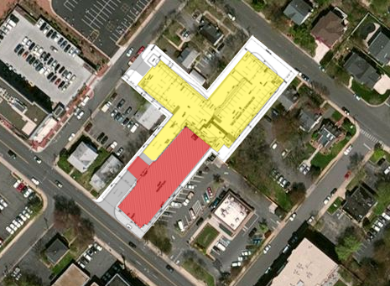
Mountain Hotel
Introduction
Existing Structural Systems
Thesis Proposal
Concrete Redesign
Glazing Evaluation
Conclusions
Questions/Comments
Building Introduction
Site Map
Hotel and Conference Center
Located in an urban center in Virginia
121,000 square feet
Height – 62ft to Roof
Project Delivery Method: Design Build
Current Status: Under Permit Review
N

Slide 4
Mountain Hotel
Introduction
Existing Structural Systems
Thesis Proposal
Concrete Redesign
Glazing Evaluation
Conclusions
Questions/Comments
Building Introduction
Site Map
Owner: Withheld
Architect: Enviro Architects
Civil Engineer: Walter L. Phillips inc.
Structural Engineer: Alliance Engineers
MEP: Epic Consultants
N

Slide 5
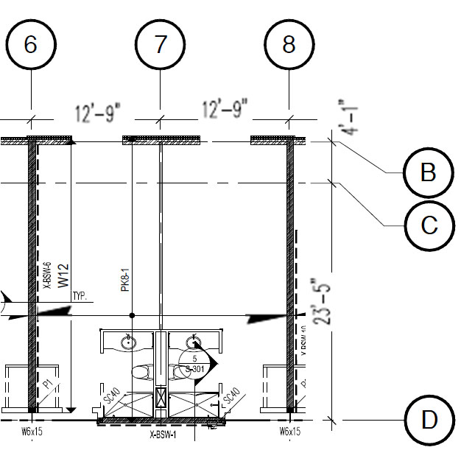
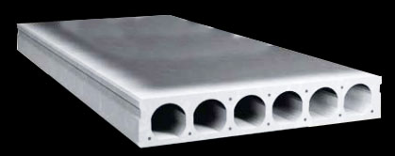
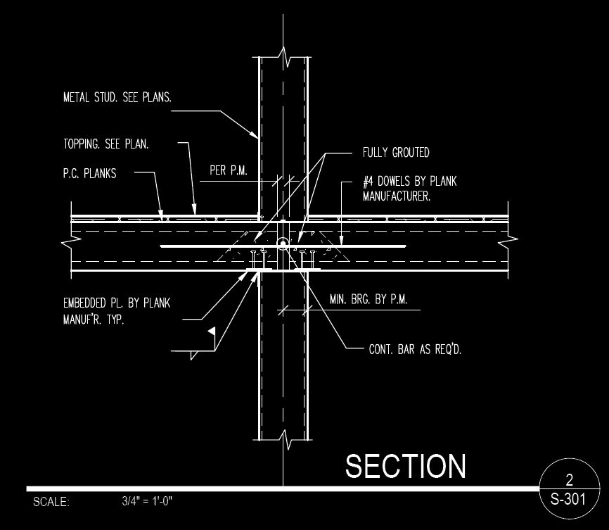
Mountain Hotel
Introduction
Existing Structural Systems
Thesis Proposal
Concrete Redesign
Glazing Evaluation
Conclusions
Questions/Comments
Gravity System
Typical Bay
Source: http://www.oldcastleprecast.com/
4”-8”x4’ precast hollow core planks resting on light gage steel stud bearing walls at every other column line

Slide 6
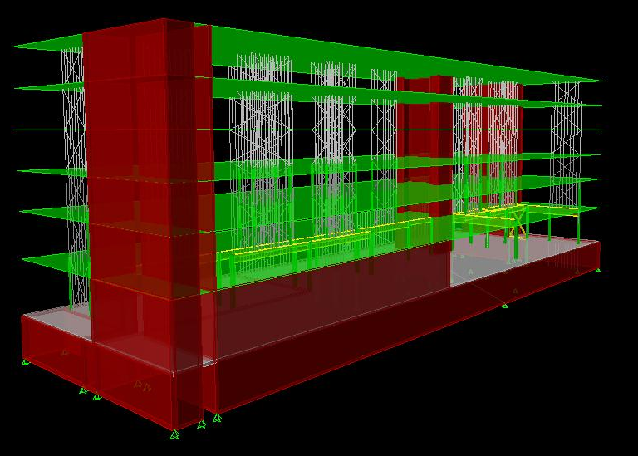
Mountain Hotel
Introduction
Existing Structural Systems
Thesis Proposal
Concrete Redesign
Glazing Evaluation
Conclusions
Questions/Comments
Lateral System
Three lateral elements resist the lateral forces in the Mountain Hotel
Flat Strap Braces
Specially Reinforced Masonry Shear Walls
Concrete Foundation Walls

Slide 7
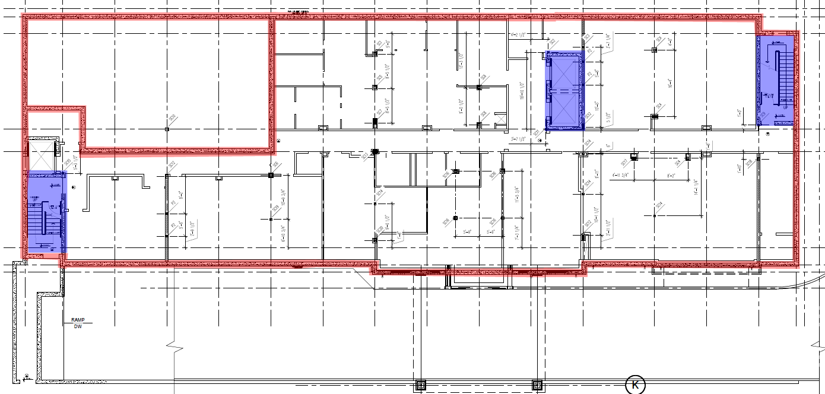
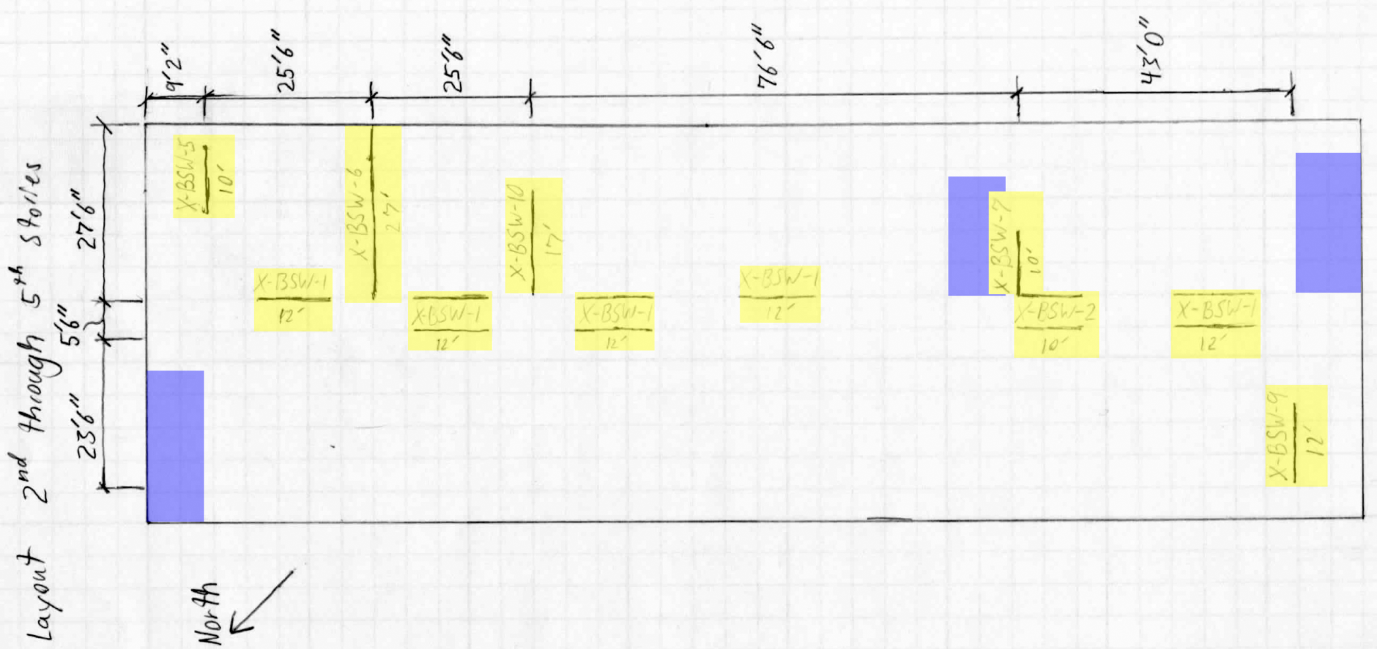
Mountain Hotel
Introduction
Existing Structural Systems
Thesis Proposal
Concrete Redesign
Glazing Evaluation
Conclusions
Questions/Comments
Lateral System
Basement plan showing location of Concrete Foundation walls in red, and location of Specially Reinforced Masonry Shear Walls surrounding stair and elevator bays in blue.
Typical upper story layout of lateral elements with light gage flat strap bracing walls shown in yellow
ETABS model of the existing lateral system

Slide 8
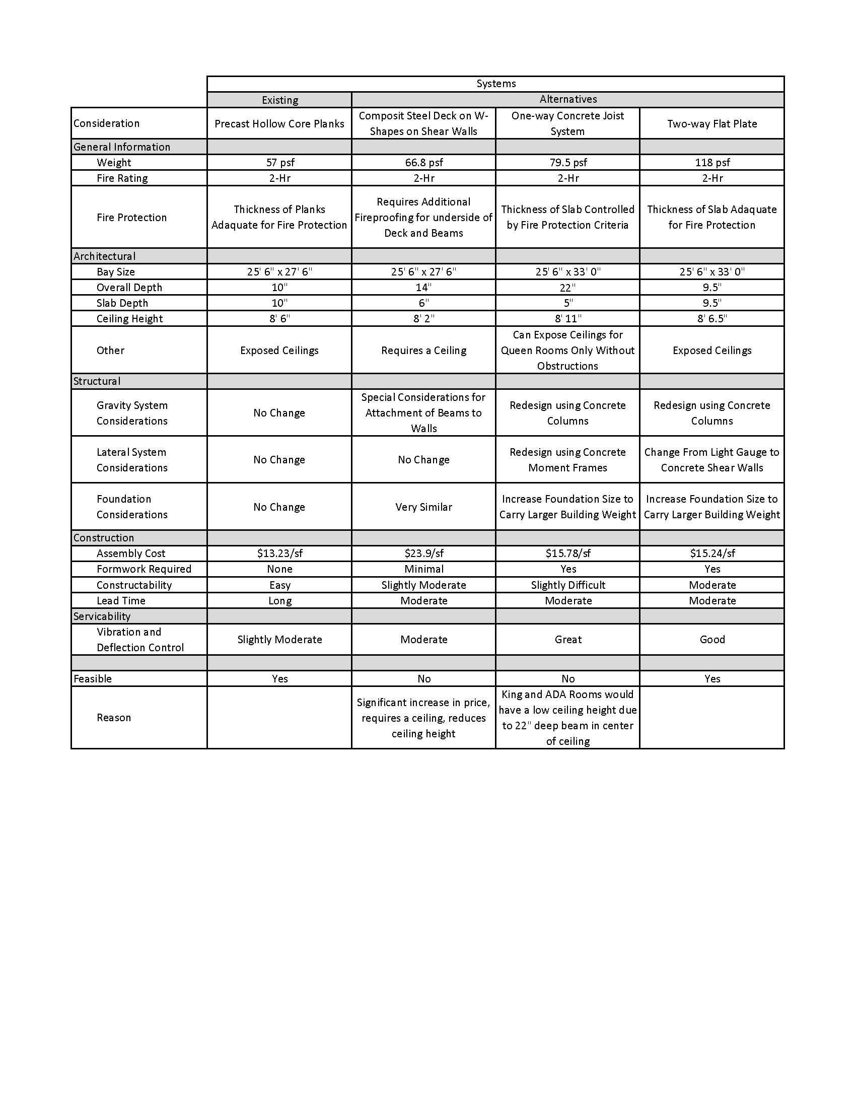
Mountain Hotel
Introduction
Existing Structural Systems
Thesis Proposal
Concrete Redesign
Glazing Evaluation
Conclusions
Questions/Comments
Existing Structure
Lateral system more than adequate
Existing floor system most efficient compared to several alternatives

Slide 9
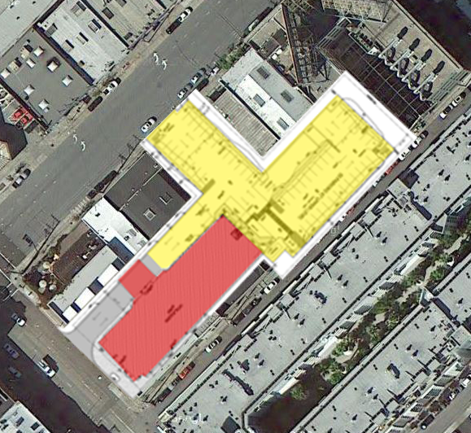
Mountain Hotel
Introduction
Existing Structural Systems
Thesis Proposal
Concrete Redesign
Glazing Evaluation
Conclusions
Questions/Comments
Problem Statement
New Site
Interest in expanding knowledge on the seismic design of reinforced concrete
N
New scenario created
The owner of the Mountain Hotel would like to evaluate the use of existing design parameters for a reinforced concrete design able to be occupied immediately after a seismic event in San Francisco

Slide 10
Mountain Hotel
Introduction
Existing Structural Systems
Thesis Proposal
Concrete Redesign
Glazing Evaluation
Conclusions
Questions/Comments
Proposed Solution
Redesign the structure of the Mountain Hotel to reinforced concrete.
Using a Flat Slab floor system
Concrete Columns for Gravity Loading
Specially Reinforced Concrete Shear Walls for lateral resistance
Design the lateral system such that the drift is less then the recommended limit in ASCE 41-06.
Create an ETABS model of the lateral system and evaluate including torsional P-Delta effects.
MAE coursework was used to accomplish all of the above tasks.

Slide 11
Mountain Hotel
Introduction
Existing Structural Systems
Thesis Proposal
Concrete Redesign
Glazing Evaluation
Conclusions
Questions/Comments
Impact on Other Building Systems
Glazing Thermal Load Evaluation
Thermal load through existing glazing was evaluated for each location and it was to be determined what glazing would be needed to produce similar heat gain as original design.
Acoustic Sound Isolation Analysis
The acoustic properties of the two floor systems were to be analyzed to show that the new floor system meets the same standard as the existing floor system. (This analysis will not be covered in this presentation)

Slide 12
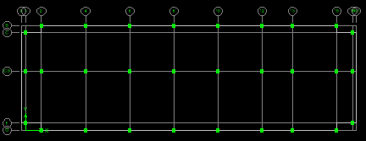
Mountain Hotel
Introduction
Existing Structural Systems
Thesis Proposal
Concrete Redesign
Glazing Evaluation
Conclusions
Questions/Comments
Gravity Redesign
Controlling Load Combination:
1.2D + 1.6L
Flat Slab Design
Bays were divided up using the existing bearing walls between the upper story hotel rooms as natural bay divisions. The decision was made to use only one central column line to eliminate the 5’ central span. This created several larger 34’ x 26’ (shown in blue) on one side, and a smaller 27’ x 26’ span (shown in red).

Slide 13
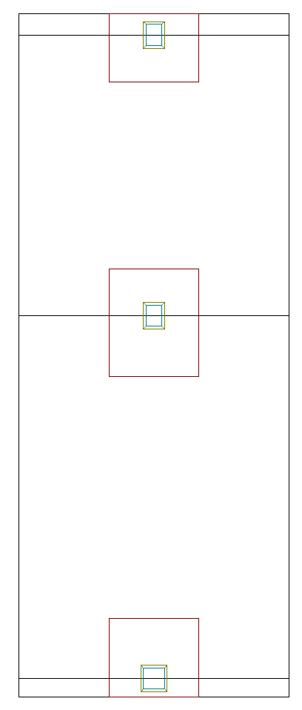
Shear capitals and some drop Panels Required
First and second floor exterior columns were enlarged to 24” x 24” to increase shear resistance.
Mountain Hotel
Introduction
Existing Structural Systems
Thesis Proposal
Concrete Redesign
Glazing Evaluation
Conclusions
Questions/Comments
Gravity Redesign
Flat Slab Design
A 24” x 18” column size for slab thickness calculation
Typical column strip sections were consider using SPSlab to determine thickness and detailing.
Inclusion of combined shear and moment not consider in hand computations.
Deflections controlled thickness to 12”

Slide 14
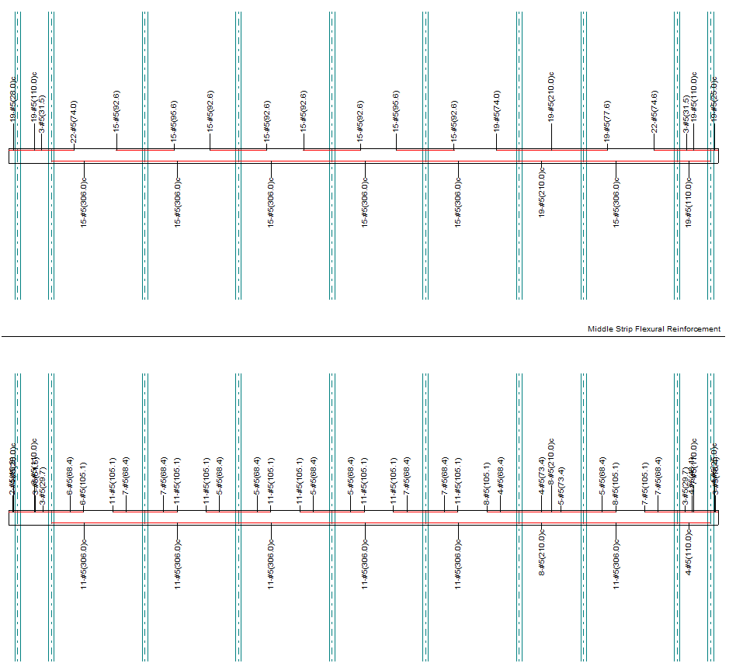
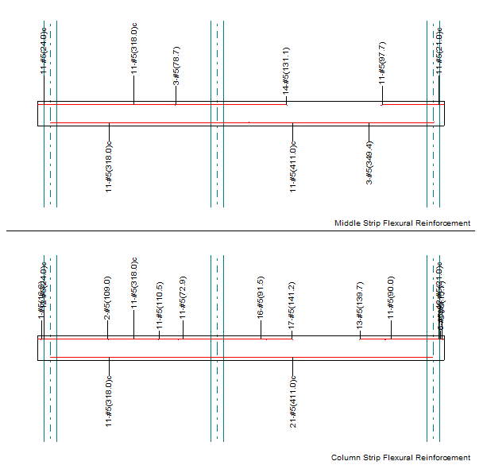
Mountain Hotel
Introduction
Existing Structural Systems
Thesis Proposal
Concrete Redesign
Glazing Evaluation
Conclusions
Questions/Comments
Gravity Redesign
Left: Reinforcement of a 1st story bay
RIGHT: Reinforcement in a typical upper story bay

Slide 15
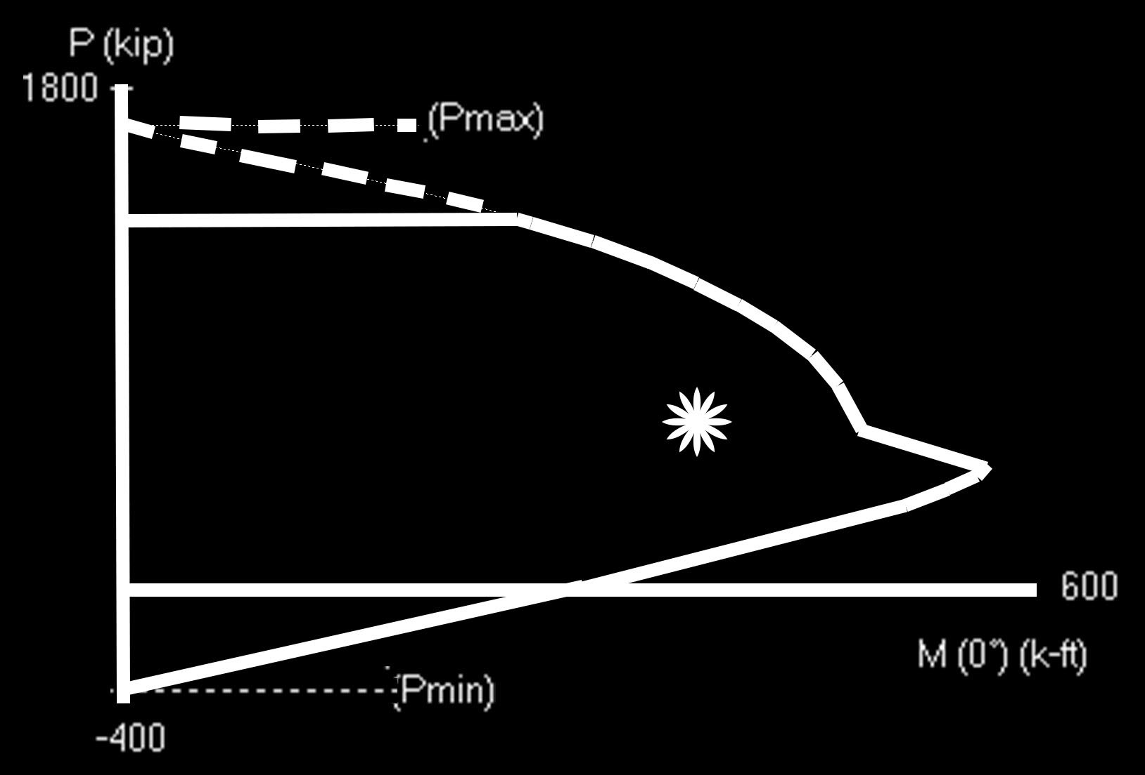
Mountain Hotel
Introduction
Existing Structural Systems
Thesis Proposal
Concrete Redesign
Glazing Evaluation
Conclusions
Questions/Comments
Gravity Redesign
Column Design
Maximum column axial loads were determined by tributary area above.
Live loads were reduced per ASCE 7-10 where less than 100psf.
Column eccentricity from SPSlab analysis performed for the design of the floor system.

Slide 16
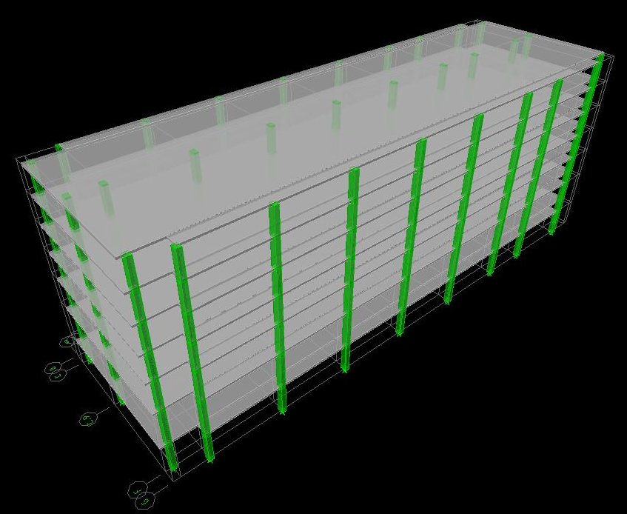
Mountain Hotel
Introduction
Existing Structural Systems
Thesis Proposal
Concrete Redesign
Glazing Evaluation
Conclusions
Questions/Comments
Gravity Redesign

Slide 17
Mountain Hotel
Introduction
Existing Structural Systems
Thesis Proposal
Concrete Redesign
Glazing Evaluation
Conclusions
Questions/Comments
Immediate Occupancy Design Philosophy
Approach to Immediate Occupancy Design
During a design seismic event if the structure does not deflect greater than the amount which causes damage requiring repair before re-occupancy can begin than the structure will satisfy Immediate Occupancy
Inter-story Drift limits:
ASCE7-10 Seismic limit: 0.020hsx/(Cd/Ie)
ATS-192 General Glazing Guidelines: hsx/175
ASCE41-06: 0.005 hsx

Slide 18
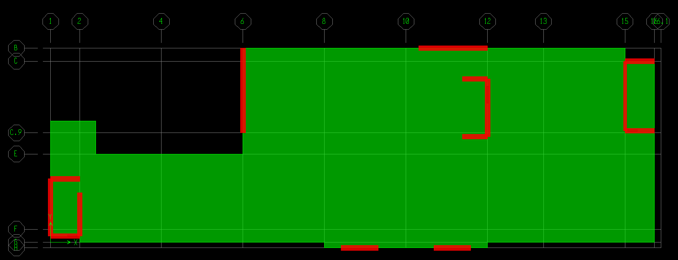
Mountain Hotel
Introduction
Existing Structural Systems
Thesis Proposal
Concrete Redesign
Glazing Evaluation
Conclusions
Questions/Comments
Lateral Redesign
Proposed shear wall layout
N
To minimize impact on existing architecture:
Stair and elevator towers
In solid walls
Maintains original function

Slide 19
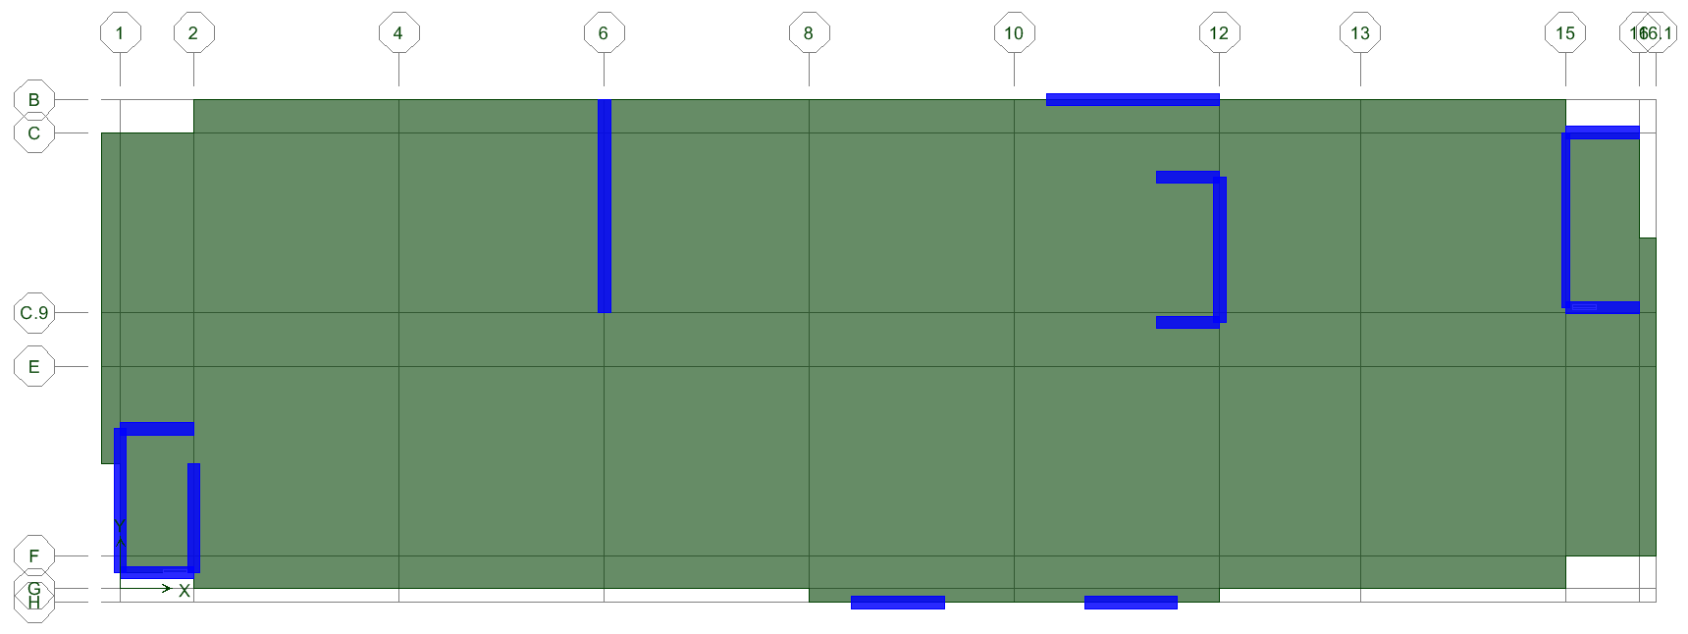
Mountain Hotel
Introduction
Existing Structural Systems
Thesis Proposal
Concrete Redesign
Glazing Evaluation
Conclusions
Questions/Comments
Lateral Redesign
9 x 18” thick shear walls required to resist story drift in x-direction
N
Proposed shear wall layout
5 x 18” thick shear walls used to resist story drift in y-direction
The wall called out in red was reduced to 12” after torsional analysis was performed.

Slide 20
Mountain Hotel
Introduction
Existing Structural Systems
Thesis Proposal
Concrete Redesign
Glazing Evaluation
Conclusions
Questions/Comments
Lateral Redesign
Right: ETABS lateral model used to consider torsional irregularity and P-Delta Effects
BOTTOM: Drifts including torsional irregularity and P-Delta compared to limits

Slide 21
Mountain Hotel
Introduction
Existing Structural Systems
Thesis Proposal
Concrete Redesign
Glazing Evaluation
Conclusions
Questions/Comments
Foundation Redesign
From geotechnical report:
Not prone to soil liquefaction
Allowable Soil Bearing: 3500psf
Service loads calculated for base of each column
Allowable bearing used to size footings
Punching shear used to determine depth
Rebar spacing determined assuming #5 bars used frequently in slab detailing

Slide 22
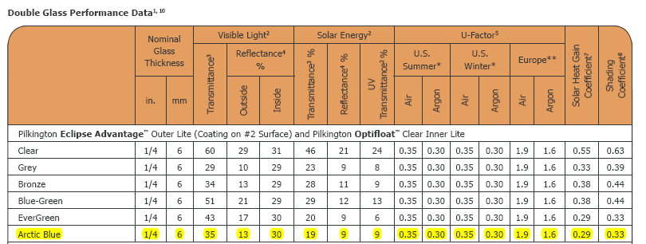
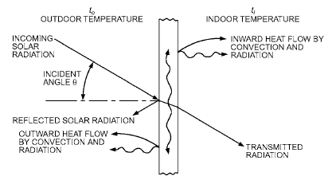
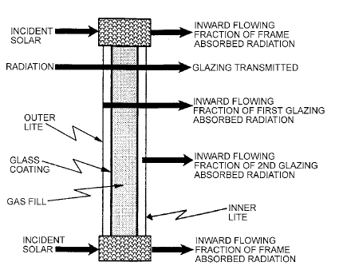
Source: Pilkington Catalogue
Mountain Hotel
Introduction
Existing Structural Systems
Thesis Proposal
Concrete Redesign
Glazing Evaluation
Conclusions
Questions/Comments
Existing Glazing Thermal Analysis
Heat from the sun enters the building using three different processes:
- Direct Radiation
- Diffused Radiation
- Convection
Two pane glass with a low-e coating on the inner face of the outside pane

Slide 23
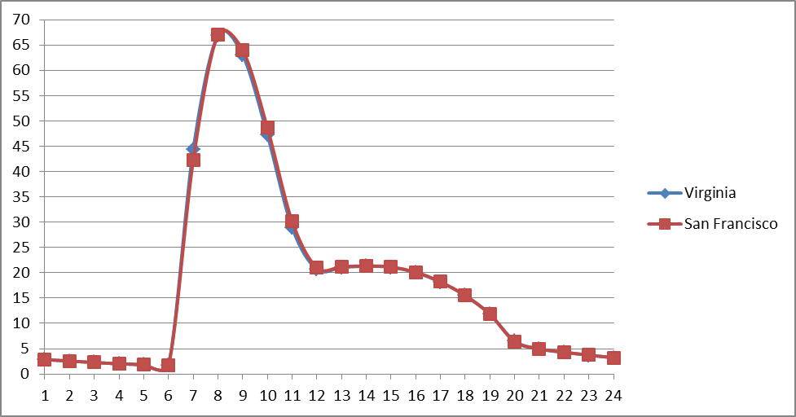
Mountain Hotel
Introduction
Existing Structural Systems
Thesis Proposal
Concrete Redesign
Glazing Evaluation
Conclusions
Questions/Comments
Comparison of Heat Gain
Same orientation as original building
Compared each side as a BTU/sf/hr value for 21day of hottest month of year
Greatest difference in thermal load through glazing was 0.5% greater that of the original design.
Same glazing can be used
Thermal load plotted for a 24 hour period

Slide 24
Mountain Hotel
Introduction
Existing Structural Systems
Thesis Proposal
Concrete Redesign
Glazing Evaluation
Conclusions
Questions/Comments
Design Summary
Summary:
Slabs:
12” thick with #5 bars spaced as noted
Columns:
24” x 18”-24” with (8) #8
Shear Walls:
12”-18” thick from foundation to roof

Slide 25
Mountain Hotel
Introduction
Existing Structural Systems
Thesis Proposal
Concrete Redesign
Glazing Evaluation
Conclusions
Questions/Comments
Questions & Comments
Acknowledgements
Alliance Engineers:
- Tim Kowalcyk
Penn State Architectural Engineering Faculty:
- Professor Kevin Parfitt, Professor Robert Holland
- Dr. Linda Hanagan, Dr. Andres Lepage, Dr. James Freihaut
- Ryan Solnosky
Applied Technology Council:
- Dr. Ronald O. Hamburger
The Lord Jesus Christ
My family and friends

