Slide 1
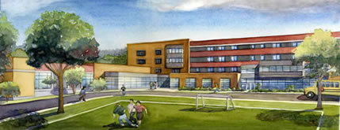
Worcester North
High School

Slide 2
Worcester North
High School
Adam Trumbour 2010 AE|CM

Slide 3
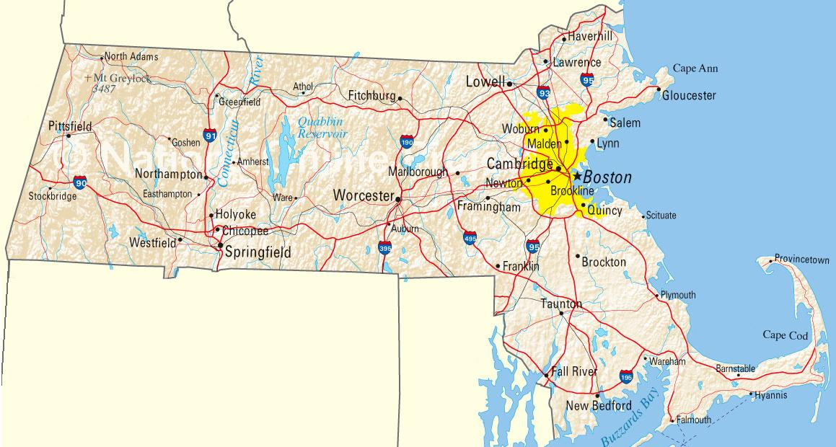
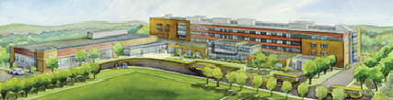
Introduction
Building Overview
Thesis Overview
Breadth Analysis 1: CHPS Study
Breadth Analysis 2: Green Roof
Breadth Analysis 3: Solar PV System
Breadth Analysis 4: LED Luminaires
Conclusions
Lessons Learned
Closing Remarks
Project At A Glance
Location: Worcester, Massachusetts
Size: 195,000 Square-Foot Educational Facility
Replacing Existing 75,000 SF Building
1,200 Students
Worcester North High School

Slide 4
Introduction
Building Overview
Thesis Overview
Breadth Analysis 1: CHPS Study
Breadth Analysis 2: Green Roof
Breadth Analysis 3: Solar PV System
Breadth Analysis 4: LED Luminaires
Conclusions
Lessons Learned
Closing Remarks
Project At A Glance
Guaranteed Maximum Price: $54 Million
Duration: 29 Months April 2009 – September 2011
CM-at-Risk: Gilbane Building Co.
Worcester North High School

Slide 5
Introduction
Building Overview
Thesis Overview
Breadth Analysis 1: CHPS Study
Breadth Analysis 2: Green Roof
Breadth Analysis 3: Solar PV System
Breadth Analysis 4: LED Luminaires
Conclusions
Lessons Learned
Closing Remarks
Overview: Thesis Efforts
Common Thread: Sustainability
How can this building’s efficiency be improved?
Worcester North High School

Slide 6
Introduction
Building Overview
Thesis Overview
Breadth Analysis 1: CHPS Study
Breadth Analysis 2: Green Roof
Breadth Analysis 3: Solar PV System
Breadth Analysis 4: LED Luminaires
Conclusions
Lessons Learned
Closing Remarks
Overview: Thesis Efforts
Common Thread: Sustainability
How can this building’s efficiency be improved?
Analyses:
I. CHPS Rating (Collaborative for High-Performance Schools)
Worcester North High School

Slide 7
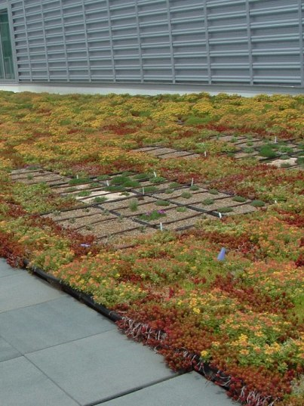
Introduction
Building Overview
Thesis Overview
Breadth Analysis 1: CHPS Study
Breadth Analysis 2: Green Roof
Breadth Analysis 3: Solar PV System
Breadth Analysis 4: LED Luminaires
Conclusions
Lessons Learned
Closing Remarks
Overview: Thesis Efforts
Common Thread: Sustainability
How can this building’s efficiency be improved?
Analyses:
I. CHPS Rating (Collaborative for High-Performance Schools)
II. Green Roof
Worcester North High School

Slide 8
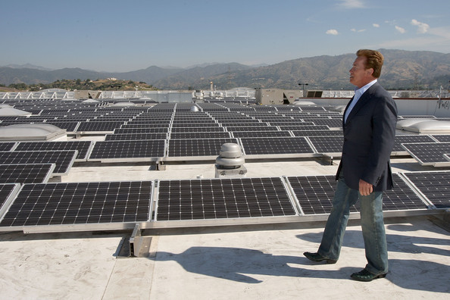
Introduction
Building Overview
Thesis Overview
Breadth Analysis 1: CHPS Study
Breadth Analysis 2: Green Roof
Breadth Analysis 3: Solar PV System
Breadth Analysis 4: LED Luminaires
Conclusions
Lessons Learned
Closing Remarks
Overview: Thesis Efforts
Common Thread: Sustainability
How can this building’s efficiency be improved?
Analyses:
I. CHPS Rating (Collaborative for High-Performance Schools)
II. Green Roof
III. Solar PV System
Worcester North High School

Slide 9
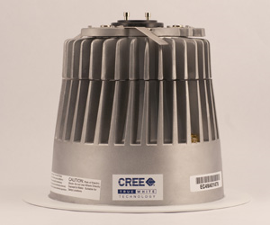
Introduction
Building Overview
Thesis Overview
Breadth Analysis 1: CHPS Study
Breadth Analysis 2: Green Roof
Breadth Analysis 3: Solar PV System
Breadth Analysis 4: LED Luminaires
Conclusions
Lessons Learned
Closing Remarks
Overview: Thesis Efforts
Common Thread: Sustainability
How can this building’s efficiency be improved?
Analyses:
I. CHPS Rating (Collaborative for High-Performance Schools)
II. Green Roof
III. Solar PV System
IV. LED Luminaire Implementation
Worcester North High School

Slide 10
Introduction
Building Overview
Thesis Overview
Breadth Analysis 1: CHPS Study
Breadth Analysis 2: Green Roof
Breadth Analysis 3: Solar PV System
Breadth Analysis 4: LED Luminaires
Conclusions
Lessons Learned
Closing Remarks
CHPS Study: Probing Questions
How do CHPS and/or LEED affect the construction industry and building process?
What can be done to improve the quality and efficiency of the rating system?
Worcester North High School

Slide 11
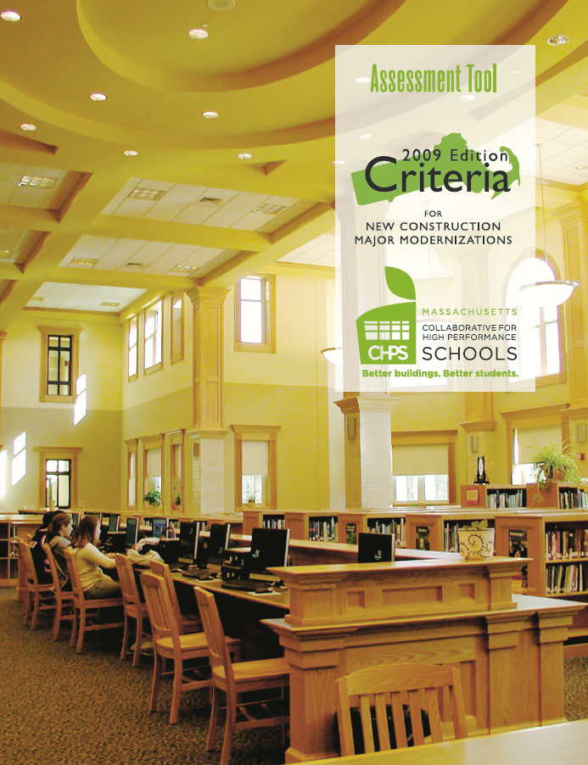
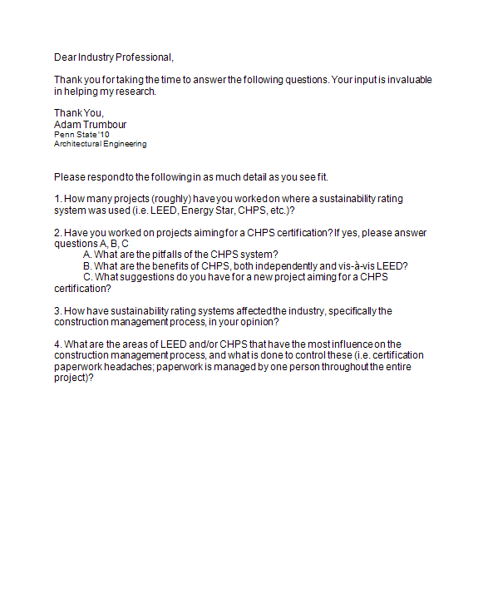
Introduction
Building Overview
Thesis Overview
Breadth Analysis 1: CHPS Study
Breadth Analysis 2: Green Roof
Breadth Analysis 3: Solar PV System
Breadth Analysis 4: LED Luminaires
Conclusions
Lessons Learned
Closing Remarks
CHPS Study: Research Methods
Personal review of the rating system
Surveys of professionals
Worcester North High School

Slide 12
Introduction
Building Overview
Thesis Overview
Breadth Analysis 1: CHPS Study
Breadth Analysis 2: Green Roof
Breadth Analysis 3: Solar PV System
Breadth Analysis 4: LED Luminaires
Conclusions
Lessons Learned
Closing Remarks
CHPS Study: Background
Established in California, 1999
Region-specific programs in 11 states CA, WA, NY, MA, ME, NH, VT, CT, RI, CO, TX
Over 225 organizations are currently members (Schools, Utilities, Design firms, etc.)
Worcester North High School

Slide 13
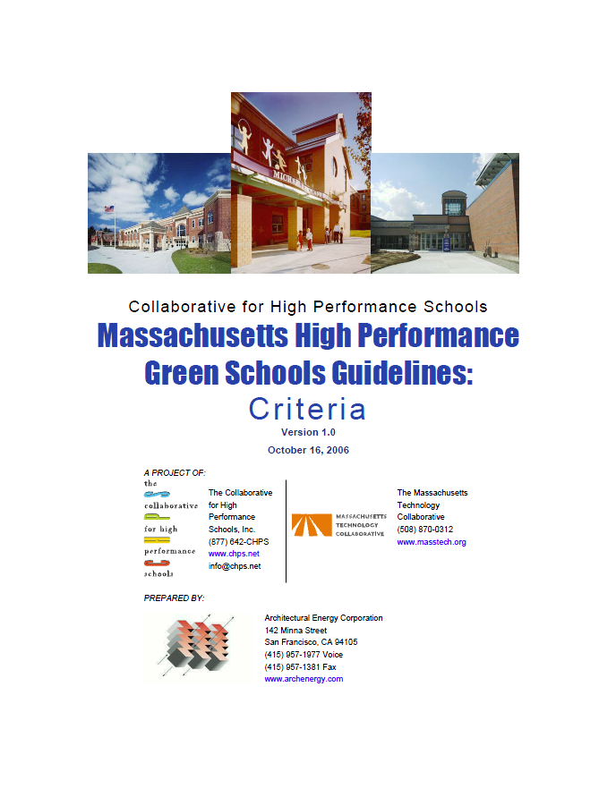
Introduction
Building Overview
Thesis Overview
Breadth Analysis 1: CHPS Study
Breadth Analysis 2: Green Roof
Breadth Analysis 3: Solar PV System
Breadth Analysis 4: LED Luminaires
Conclusions
Lessons Learned
Closing Remarks
CHPS Study: Background
Massachusetts:
Version 1.0 in 2006
Version 2009 second and current version
Standard for all new schools in Massachusetts
23 Prerequisite credits
125 possible points: + Minimum of 40 points to be “Verified” + Minimum of 50 points to be “Verified Leader”
Worcester North High School

Slide 14
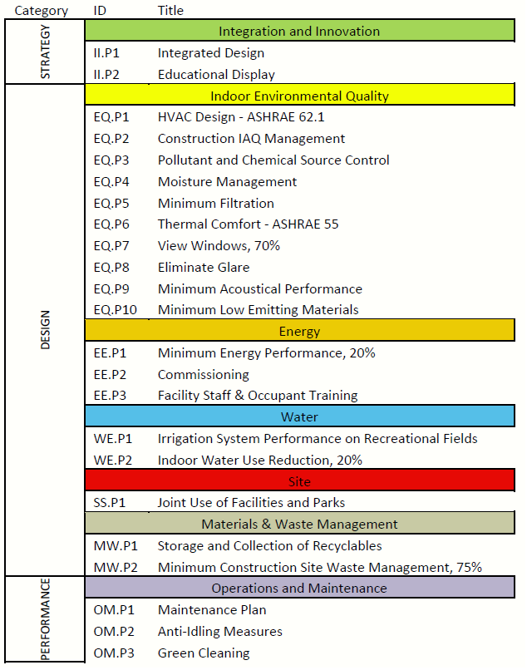
Introduction
Building Overview
Thesis Overview
Breadth Analysis 1: CHPS Study
Breadth Analysis 2: Green Roof
Breadth Analysis 3: Solar PV System
Breadth Analysis 4: LED Luminaires
Conclusions
Lessons Learned
Closing Remarks
CHPS Study: Background
Massachusetts:
Version 1.0 in 2006
Version 2009 second and current version
Standard for all new schools in Massachusetts
23 Prerequisite credits
125 possible points: + Minimum of 40 points to be “Verified” + Minimum of 50 points to be “Verified Leader”
Worcester North High School

Slide 15
Introduction
Building Overview
Thesis Overview
Breadth Analysis 1: CHPS Study
Breadth Analysis 2: Green Roof
Breadth Analysis 3: Solar PV System
Breadth Analysis 4: LED Luminaires
Conclusions
Lessons Learned
Closing Remarks
CHPS Study: Findings
LEED difficult on limited budgets
Closer relationships: CM, Designers, Owner
CHPS is a smaller organization than LEED
Need for lessons learned database
No drastic change to CM by CHPS
North High School will be CHPS Verified
Worcester North High School

Slide 16
Introduction
Building Overview
Thesis Overview
Breadth Analysis 1: CHPS Study
Breadth Analysis 2: Green Roof
Breadth Analysis 3: Solar PV System
Breadth Analysis 4: LED Luminaires
Conclusions
Lessons Learned
Closing Remarks
CHPS Study: Recommendations
CHPS is better for MA schools than LEED
Need for training professionals in CHPS
Create lessons-learned database for CHPS projects
Increase capabilities of regional offices
Glean input from students and administration
Worcester North High School

Slide 17
Introduction
Building Overview
Thesis Overview
Breadth Analysis 1: CHPS Study
Breadth Analysis 2: Green Roof
Breadth Analysis 3: Solar PV System
Breadth Analysis 4: LED Luminaires
Conclusions
Lessons Learned
Closing Remarks
Green Roof Study: Intent
Evaluate the implementation of a green roof on North High school, considering structural effects.
Worcester North High School

Slide 18
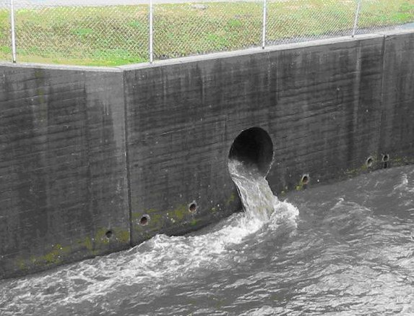
Introduction
Building Overview
Thesis Overview
Breadth Analysis 1: CHPS Study
Breadth Analysis 2: Green Roof
Breadth Analysis 3: Solar PV System
Breadth Analysis 4: LED Luminaires
Conclusions
Lessons Learned
Closing Remarks
Green Roof Study: Background
Reduced storm water runoff
Reduced heat-island effects
Increased aesthetic quality
Increased life of roof membrane
Incremental addition to roof R-value
Possible addition to CHPS score
Worcester North High School

Slide 19
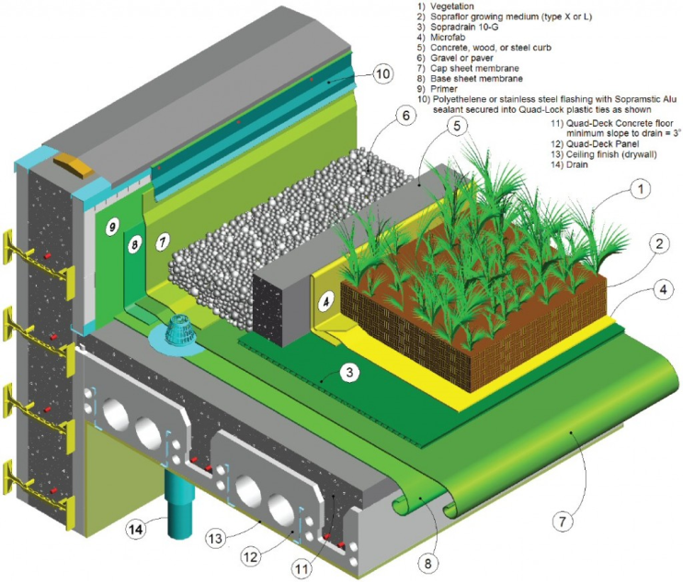
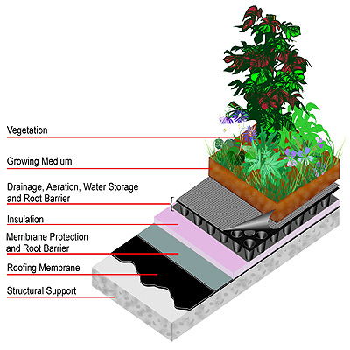
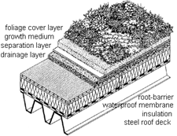
Introduction
Building Overview
Thesis Overview
Breadth Analysis 1: CHPS Study
Breadth Analysis 2: Green Roof
Breadth Analysis 3: Solar PV System
Breadth Analysis 4: LED Luminaires
Conclusions
Lessons Learned
Closing Remarks
Green Roof Study: Analysis Method
Research available green roof systems
Assemble weight data
Choose most economical option
Evaluate structural capacity
Worcester North High School

Slide 20
Introduction
Building Overview
Thesis Overview
Breadth Analysis 1: CHPS Study
Breadth Analysis 2: Green Roof
Breadth Analysis 3: Solar PV System
Breadth Analysis 4: LED Luminaires
Conclusions
Lessons Learned
Closing Remarks
Green Roof Study: Analysis Method
Research available green roof systems
Assemble weight data
Choose most economical option
Evaluate structural capacity
Manufacturer | Size | Soil Depth | Saturated Weight
Roofscapes Roofmeadow | No module size (mat-type) | 3" – 5" | 20 – 34 PSF
ZinCo | No module size (mat-type) | 4.5" | 22 PSF
Hydrotech USA | No module size (mat-type) | 2" – 6" | 17 – 41 PSF
GreenGrid | 2' x 2', 2' x 4', 1.5' x 2' | 4" | 18 – 25 PSF
LiveRoof | 1' x 2' | 4" – 4.25" | 15 – 29 PSF
Barrett Company | No module size (mat-type) |  | 21 PSF
Worcester North High School

Slide 21
Introduction
Building Overview
Thesis Overview
Breadth Analysis 1: CHPS Study
Breadth Analysis 2: Green Roof
Breadth Analysis 3: Solar PV System
Breadth Analysis 4: LED Luminaires
Conclusions
Lessons Learned
Closing Remarks
Green Roof Study: Analysis Method
Research available green roof systems
Assemble weight data
Choose most economical option
Evaluate structural capacity
Manufacturer | Size | Soil Depth | Saturated Weight
Roofscapes Roofmeadow | No module size (mat-type) | 3" – 5" | 20 – 34 PSF
ZinCo | No module size (mat-type) | 4.5" | 22 PSF
Hydrotech USA | No module size (mat-type) | 2" – 6" | 17 – 41 PSF
GreenGrid | 2' x 2', 2' x 4', 1.5' x 2' | 4" | 18 – 25 PSF
LiveRoof | 1' x 2' | 4" – 4.25" | 15 – 29 PSF
Barrett Company | No module size (mat-type) |  | 21 PSF
Worcester North High School

Slide 22
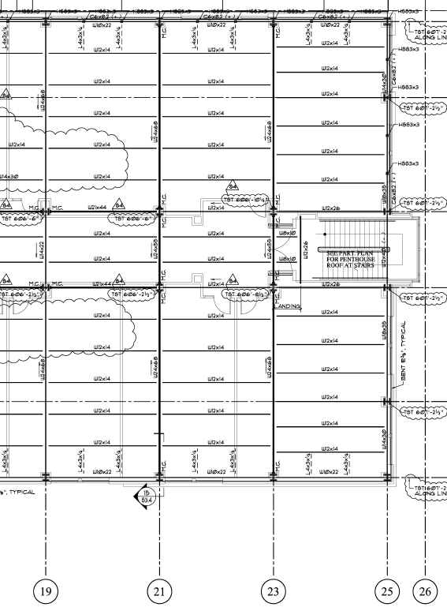
Introduction
Building Overview
Thesis Overview
Breadth Analysis 1: CHPS Study
Breadth Analysis 2: Green Roof
Breadth Analysis 3: Solar PV System
Breadth Analysis 4: LED Luminaires
Conclusions
Lessons Learned
Closing Remarks
Green Roof Study: Analysis Method
Research available green roof systems
Assemble weight data
Choose most economical option
Evaluate structural capacity
Worcester North High School

Slide 23
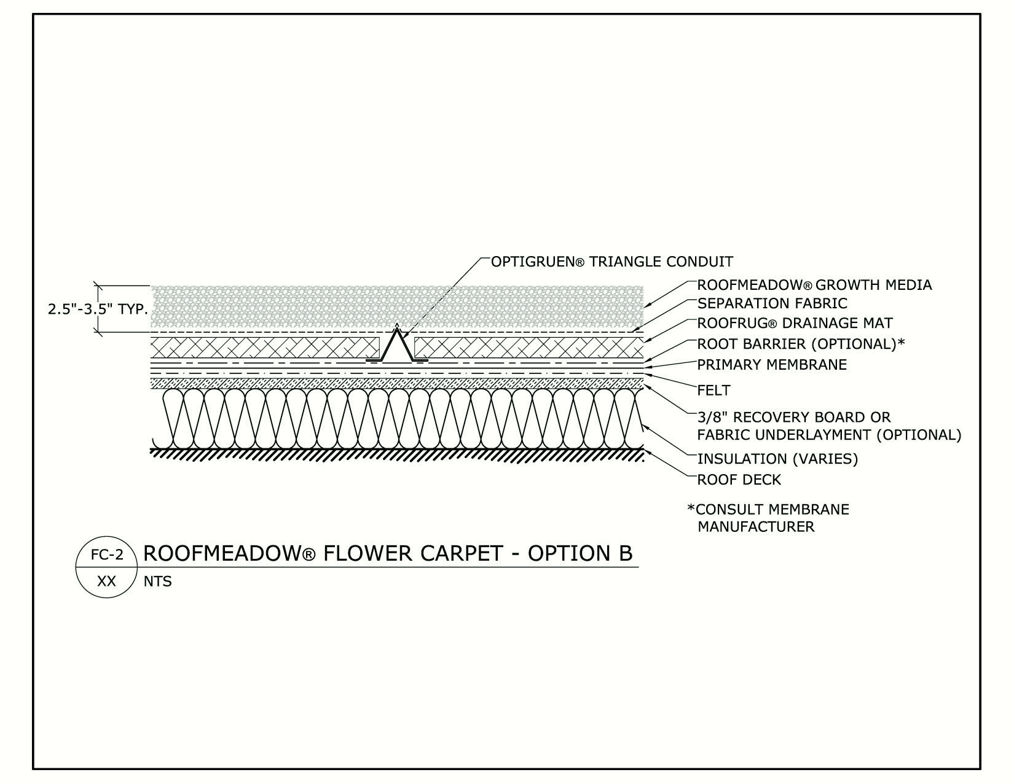
Introduction
Building Overview
Thesis Overview
Breadth Analysis 1: CHPS Study
Breadth Analysis 2: Green Roof
Breadth Analysis 3: Solar PV System
Breadth Analysis 4: LED Luminaires
Conclusions
Lessons Learned
Closing Remarks
Green Roof Study: Findings
Extensive roof appropriate option
Minimum 15 PSF, Maximum 41 PSF
Use 3” system with 23 PSF rating
Maximum area is 51,000 SF
Maximum moment, shear and deflection within allowable limits
Added cost: $522,750
No schedule delay; not on critical path
Worcester North High School

Slide 24
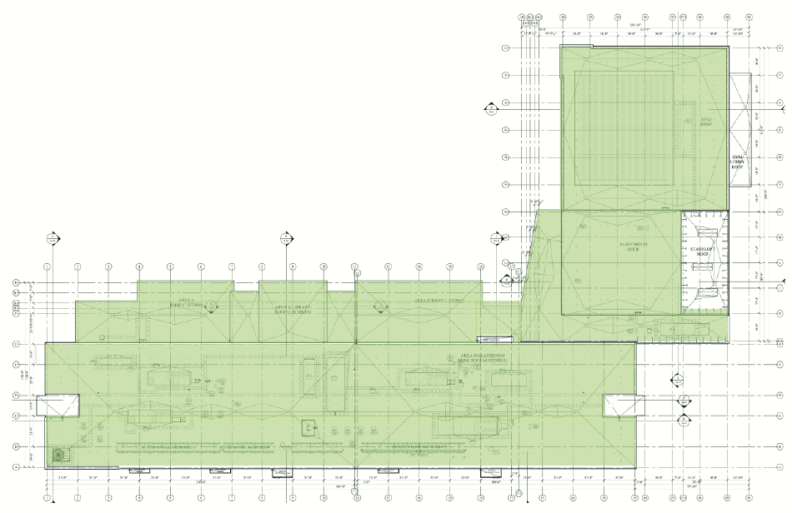
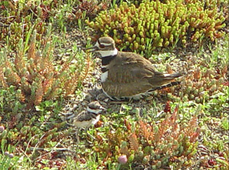
Introduction
Building Overview
Thesis Overview
Breadth Analysis 1: CHPS Study
Breadth Analysis 2: Green Roof
Breadth Analysis 3: Solar PV System
Breadth Analysis 4: LED Luminaires
Conclusions
Lessons Learned
Closing Remarks
Green Roof Study: Recommendation
Install green roof
Use RoofscapesTM assembly: Primarily sedum
51,000 square-feet will cost $522,750
Cost may be recouped after 50 year maintenance is deferred
1 Point addition to CHPS score
Worcester North High School

Slide 25
Introduction
Building Overview
Thesis Overview
Breadth Analysis 1: CHPS Study
Breadth Analysis 2: Green Roof
Breadth Analysis 3: Solar PV System
Breadth Analysis 4: LED Luminaires
Conclusions
Lessons Learned
Closing Remarks
Solar PV: Intent
Design a roof mounted solar photovoltaic system, meeting the given $250,000 allowance.
Worcester North High School

Slide 26
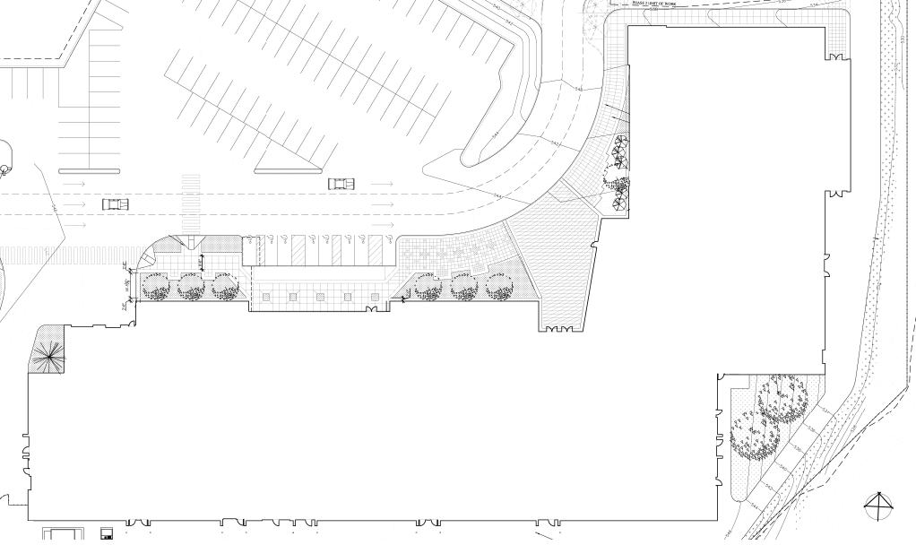
Introduction
Building Overview
Thesis Overview
Breadth Analysis 1: CHPS Study
Breadth Analysis 2: Green Roof
Breadth Analysis 3: Solar PV System
Breadth Analysis 4: LED Luminaires
Conclusions
Lessons Learned
Closing Remarks
Solar PV: Background
$250,000 allowance in budget, unused
System has the ability to provide sustainable power to North High School
Potential credit to CHPS score
System design is project-specific
Worcester North High School

Slide 27
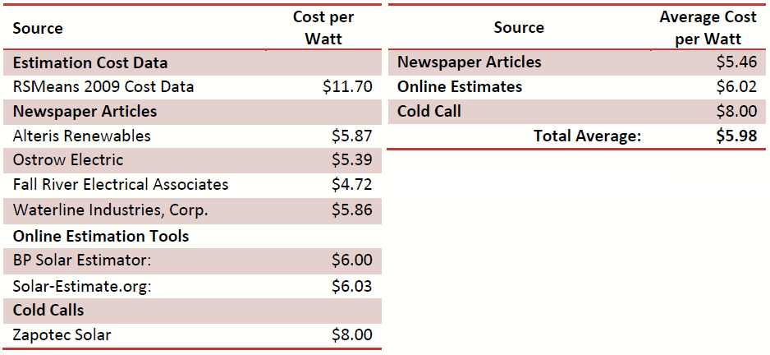
Introduction
Building Overview
Thesis Overview
Breadth Analysis 1: CHPS Study
Breadth Analysis 2: Green Roof
Breadth Analysis 3: Solar PV System
Breadth Analysis 4: LED Luminaires
Conclusions
Lessons Learned
Closing Remarks
Solar PV: Method
Research system types and components, costs
Design 2 options: Meet full $250,000 allowance Fill allotted roof space
Calculate Payback
Worcester North High School

Slide 28
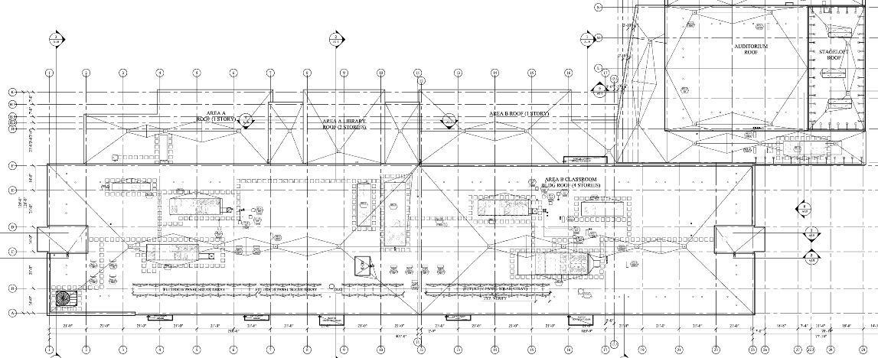
Introduction
Building Overview
Thesis Overview
Breadth Analysis 1: CHPS Study
Breadth Analysis 2: Green Roof
Breadth Analysis 3: Solar PV System
Breadth Analysis 4: LED Luminaires
Conclusions
Lessons Learned
Closing Remarks
Solar PV: Method
Research system types and components, costs
Design 2 options: Meet full $250,000 allowance Fill allotted roof space
Calculate Payback
Worcester North High School

Slide 29
Introduction
Building Overview
Thesis Overview
Breadth Analysis 1: CHPS Study
Breadth Analysis 2: Green Roof
Breadth Analysis 3: Solar PV System
Breadth Analysis 4: LED Luminaires
Conclusions
Lessons Learned
Closing Remarks
Solar PV: Method
Research system types and components, costs
Design 2 options: Meet full $250,000 allowance Fill allotted roof space
Calculate Payback
Worcester North High School

Slide 30
Introduction
Building Overview
Thesis Overview
Breadth Analysis 1: CHPS Study
Breadth Analysis 2: Green Roof
Breadth Analysis 3: Solar PV System
Breadth Analysis 4: LED Luminaires
Conclusions
Lessons Learned
Closing Remarks
Solar PV: $250,000 System
Maximum Power: 38,640 Watts (38.64 kW)
(3) 12.88kW arrays comprise the 38.64 kW system:
Solar Panels: (56) BP Solar 3230T, 230W each
Inverter: (1) Fronius IG Plus, 13.8 kW
Combiner Box: (1) SMA SBCB-6
Wiring: (4) Strings in Parallel (1) string = 14 panels in series
Area Required: 3,000 Square Feet
Worcester North High School

Slide 31
Introduction
Building Overview
Thesis Overview
Breadth Analysis 1: CHPS Study
Breadth Analysis 2: Green Roof
Breadth Analysis 3: Solar PV System
Breadth Analysis 4: LED Luminaires
Conclusions
Lessons Learned
Closing Remarks
Solar PV: 6,000 SF of Roof Space
Maximum Power: 7,590 Watts (7.59 kW)
Solar Panels: (33) BP Solar 3230T, 230W each
Inverter: (1) SMA Sunny Boy SB7000US, 8.75 kW
Combiner Box: (1) SMA SBCB-6
Wiring : (3) Strings in Parallel
(1) String = 11 panels wired in series
Area Required: 592.68 Square Feet
Worcester North High School

Slide 32
Introduction
Building Overview
Thesis Overview
Breadth Analysis 1: CHPS Study
Breadth Analysis 2: Green Roof
Breadth Analysis 3: Solar PV System
Breadth Analysis 4: LED Luminaires
Conclusions
Lessons Learned
Closing Remarks
Solar PV: Recommendation
Both systems show a payback of 31 years (cash financing)
Implement smaller array to reduce structural impact
Implement larger array if funds are available and gymnasium can support array
Up to 5 credits added by PV system
Worcester North High School

Slide 33
Introduction
Building Overview
Thesis Overview
Breadth Analysis 1: CHPS Study
Breadth Analysis 2: Green Roof
Breadth Analysis 3: Solar PV System
Breadth Analysis 4: LED Luminaires
Conclusions
Lessons Learned
Closing Remarks
LED Luminaires: Intent
Investigate the application of LED luminaires as part of the general illumination scheme.
Worcester North High School

Slide 34
Introduction
Building Overview
Thesis Overview
Breadth Analysis 1: CHPS Study
Breadth Analysis 2: Green Roof
Breadth Analysis 3: Solar PV System
Breadth Analysis 4: LED Luminaires
Conclusions
Lessons Learned
Closing Remarks
LED Luminaires: Background
Useful in down, accent and track lighting
Low lumen/watt rating
Color temperature tends to be cool
Ballast often integrated with lamp: replacement?
High initial cost
Worcester North High School

Slide 35
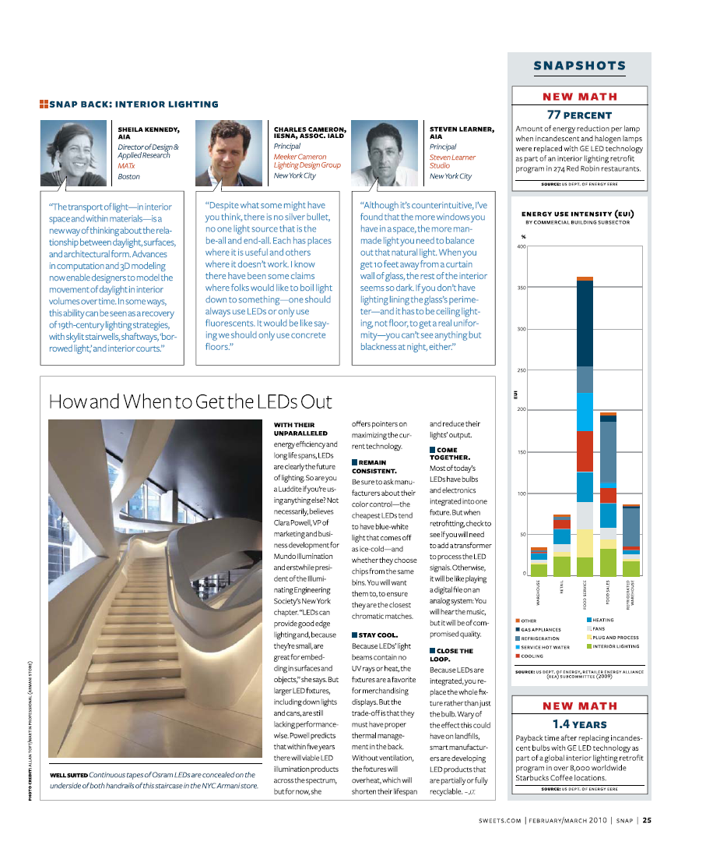
Introduction
Building Overview
Thesis Overview
Breadth Analysis 1: CHPS Study
Breadth Analysis 2: Green Roof
Breadth Analysis 3: Solar PV System
Breadth Analysis 4: LED Luminaires
Conclusions
Lessons Learned
Closing Remarks
LED Luminaires: Method
Literature research
Product search
Compute/Model illumination
Analyze
Recommendation
Worcester North High School

Slide 36
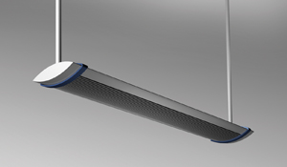
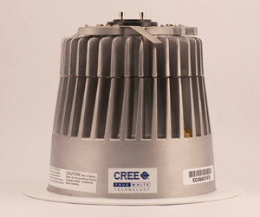
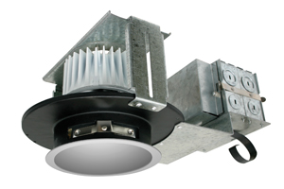
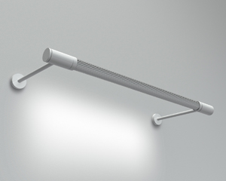
Introduction
Building Overview
Thesis Overview
Breadth Analysis 1: CHPS Study
Breadth Analysis 2: Green Roof
Breadth Analysis 3: Solar PV System
Breadth Analysis 4: LED Luminaires
Conclusions
Lessons Learned
Closing Remarks
LED Luminaires: Method
Literature research
Product search
Compute/Model illumination
Analyze
Recommendation
Worcester North High School

Slide 37
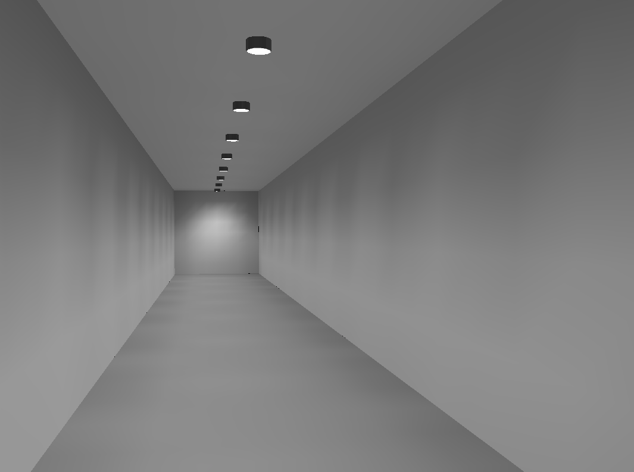
Introduction
Building Overview
Thesis Overview
Breadth Analysis 1: CHPS Study
Breadth Analysis 2: Green Roof
Breadth Analysis 3: Solar PV System
Breadth Analysis 4: LED Luminaires
Conclusions
Lessons Learned
Closing Remarks
LED Luminaires: Method
Literature research
Product search
Compute/Model illumination
Analyze
Recommendation
Worcester North High School

Slide 38
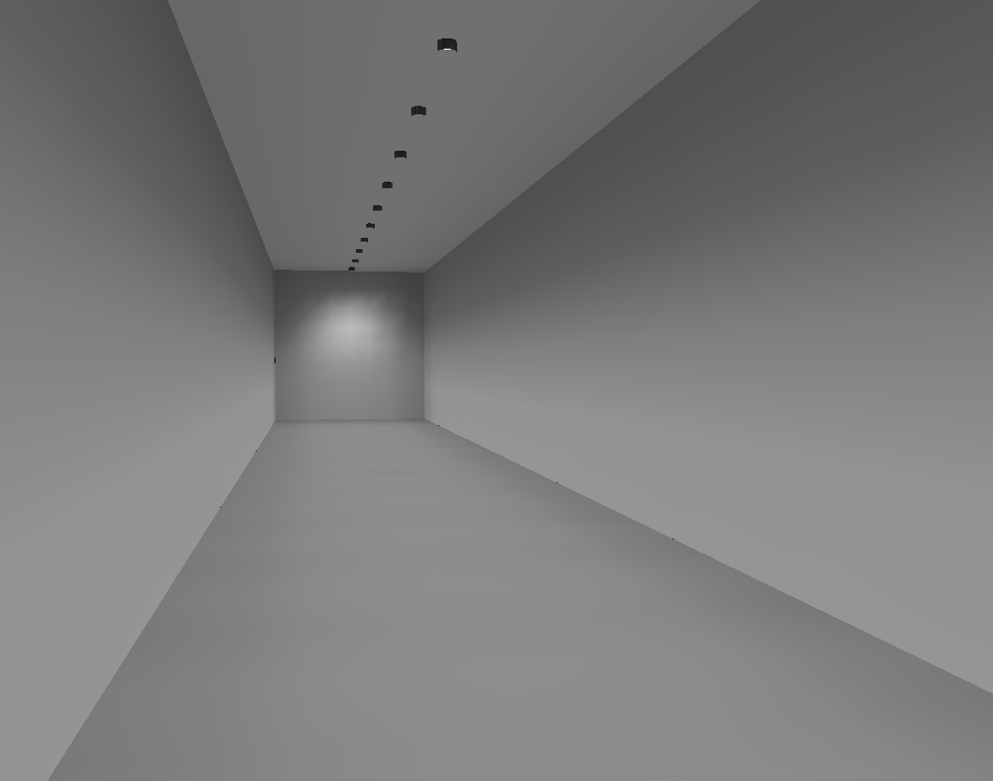
Introduction
Building Overview
Thesis Overview
Breadth Analysis 1: CHPS Study
Breadth Analysis 2: Green Roof
Breadth Analysis 3: Solar PV System
Breadth Analysis 4: LED Luminaires
Conclusions
Lessons Learned
Closing Remarks
Worcester North High School

Slide 39
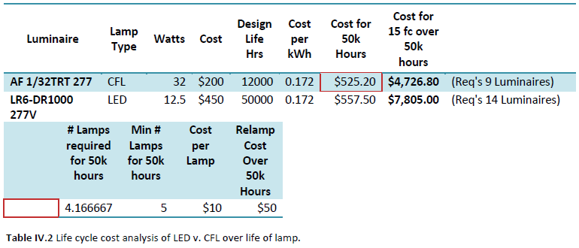
Introduction
Building Overview
Thesis Overview
Breadth Analysis 1: CHPS Study
Breadth Analysis 2: Green Roof
Breadth Analysis 3: Solar PV System
Breadth Analysis 4: LED Luminaires
Conclusions
Lessons Learned
Closing Remarks
LED Luminaires: Method
Literature research
Product search
Compute/Model illumination
Analyze efficiency, cost, payback
Recommendation
Worcester North High School

Slide 40
Introduction
Building Overview
Thesis Overview
Breadth Analysis 1: CHPS Study
Breadth Analysis 2: Green Roof
Breadth Analysis 3: Solar PV System
Breadth Analysis 4: LED Luminaires
Conclusions
Lessons Learned
Closing Remarks
LED Luminaires: Recommendation
Replacing 125 CFLs = 186 LEDs
Energy reduced from 3968 to 2325 watts
$3,696 in annual energy savings
Not ready for general illumination
Downlighting an option
Life-cycle cost too high to justify
LED technology not ready for North High School
Worcester North High School

Slide 41
Introduction
Building Overview
Thesis Overview
Breadth Analysis 1: CHPS Study
Breadth Analysis 2: Green Roof
Breadth Analysis 3: Solar PV System
Breadth Analysis 4: LED Luminaires
Conclusions
Lessons Learned
Closing Remarks
LED Luminaires: Recommendation
Replacing 125 CFLs = 186 LEDs
Energy reduced from 3968 to 2325 watts
$3,696 in annual energy savings
Not ready for general illumination
Downlighting an option
Life-cycle cost too high to justify
LED technology not ready for North High School
Worcester North High School

Slide 42
Introduction
Building Overview
Thesis Overview
Breadth Analysis 1: CHPS Study
Breadth Analysis 2: Green Roof
Breadth Analysis 4: LED Luminaires
Breadth Analysis 3: Solar PV System
Conclusions
Lessons Learned
Closing Remarks
CHPS
Good regional system for schools
Needs improvement in knowledge transfer
Green Roof
Feasible with current roof and 23 PSF assembly
Cost: $ 522,750
Could pay itself back in 50 years
Solar PV System
Two options for owner
Both pay back after 31 years
Acts as a learning tool for students
LED Luminaires
More energy efficient
Life-cycle cost not competitive
Technology forthcoming
Worcester North High School

Slide 43
Introduction
Building Overview
Thesis Overview
Breadth Analysis 1: CHPS Study
Breadth Analysis 2: Green Roof
Breadth Analysis 3: Solar PV System
Breadth Analysis 4: LED Luminaires
Conclusions
Lessons Learned
Closing Remarks
Lessons Learned
Good input is hard to get!
More research is needed on the effects of sustainability ratings on the construction management process.
“Greening” a typical building produces large benefits; making a green building greener presents incremental benefits .
Payback is not as immediate as you’d think.
Great learning experience.
Worcester North High School

Slide 44
Introduction
Building Overview
Thesis Overview
Breadth Analysis 1: CHPS Study
Breadth Analysis 2: Green Roof
Breadth Analysis 3: Solar PV System
Breadth Analysis 4: LED Luminaires
Conclusions
Lessons Learned
Closing Remarks
Questions?
Worcester North High School

