Slide 2
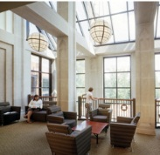
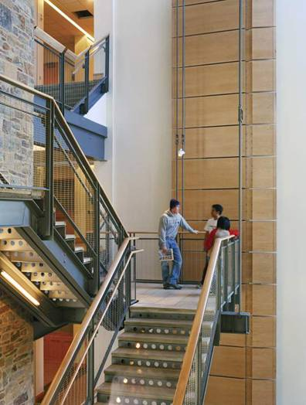
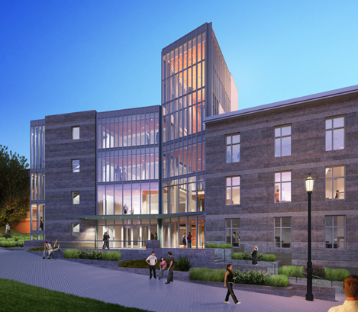
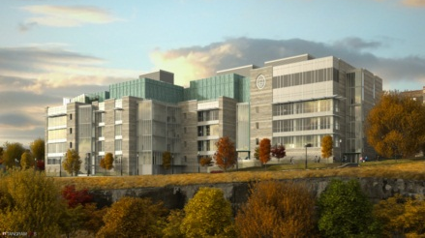
UNIFIED SCIENCE CENTER
THE UNIVERSITY OF SCRANTON SCRANTON, PA
DALE E. HOUCK
MECHANICAL OPTION

Slide 3
UNIFIED SCIENCE CENTER
THE UNIVERSITY OF SCRANTON SCRANTON, PA
PROJECT SUMMARY
EXISTING CONDITIONS
DEPTH STUDIES
SUSTAINABILITY BREADTH STUDIES
CONCLUSIONS
DALE E. HOUCK
MECHANICAL OPTION

Slide 4
UNIFIED SCIENCE CENTER
INTRODUCTION
THE UNIVERSITY OF SCRANTON SCRANTON, PA
PROJECT SUMMARY
PROGRAM
INTRODUCTION
PROJECT SUMMARY
EXISTING CONDITIONS
DEPTH WORK
BREADTH WORK
CONCLUSIONS
150,000 SF NEW CONSTRUCTION
50,000 SF RENOVATIONS
4 FULL FLOORS, PARTIAL GROUND FLOOR
CONSTRUCTION: MAY 2009 – FALL 2011
$73 MILLION GMP CONTRACT
DEPARTMENTS OF BIOLOGY, CHEMISTRY, COMPUTING SCIENCES, PHYSICS, ELECTRICAL ENGINEERING, AND MATHEMATICS
THE UNIVERSITY OF SCRANTON
EINHORN YAFFEE PRESCOTT A&E, P.C.
QUANDEL ENTERPRISES, INC.
CECO ASSOC, INC.
M.L. BAIRD & CO.
OWNER
ARCHITECTS AND ENGINEERS
CONSTRUCTION MANAGER
SITE/CIVIL ENGINEER
LANDSCAPE ARCHITECT

Slide 5
UNIFIED SCIENCE CENTER
INTRODUCTION
THE UNIVERSITY OF SCRANTON SCRANTON, PA
PROJECT SUMMARY
DESIGNED FOR LEED SILVER CERTIFICATION
STONE FAÇADE SUPPLIED BY LOCAL QUARRY
RECYCLED MATERIALS
CONSTRUCTION WASTE MANAGEMENT
EFFICIENT LIGHTING AND MECHANICAL SYSTEMS
EFFICIENT WATER FIXTURES
Architecture
Designed according to principles of project kaleidoscope
Encourages interdisciplinary collaboration
Modern design of new construction seamlessly integrates with renovation of existing structure
INTRODUCTION
PROJECT SUMMARY
EXISTING CONDITIONS
DEPTH WORK
BREADTH WORK
CONCLUSIONS

Slide 6
UNIFIED SCIENCE CENTER
EXISTING CONDITIONS
THE UNIVERSITY OF SCRANTON SCRANTON, PA
AIR SIDE
INTRODUCTION
EXISTING CONDITIONS
AIRSIDE
WATERSIDE
DEPTH WORK
BREADTH WORK
CONCLUSIONS

Slide 7
UNIFIED SCIENCE CENTER
EXISTING CONDITIONS
THE UNIVERSITY OF SCRANTON SCRANTON, PA
AIR SIDE
INTRODUCTION
EXISTING CONDITIONS
AIRSIDE
WATERSIDE
DEPTH WORK
BREADTH WORK
CONCLUSIONS
AIR HANDLING UNITS
VARIABLE AIR VOLUME SUPPLY FANS
ENTHALPY WHEELS
VARIABLE FREQUENCY DRIVE FANS

Slide 8
UNIFIED SCIENCE CENTER
EXISTING CONDITIONS
THE UNIVERSITY OF SCRANTON SCRANTON, PA
WATER SIDE
INTRODUCTION
EXISTING CONDITIONS
AIRSIDE
WATERSIDE
DEPTH WORK
BREADTH WORK
CONCLUSIONS

Slide 9
UNIFIED SCIENCE CENTER
EXISTING CONDITIONS
THE UNIVERSITY OF SCRANTON SCRANTON, PA
WATER SIDE
INTRODUCTION
EXISTING CONDITIONS
AIRSIDE
WATERSIDE
DEPTH WORK
BREADTH WORK
CONCLUSIONS

Slide 10
UNIFIED SCIENCE CENTER
PROJECT DEPTH
THE UNIVERSITY OF SCRANTON SCRANTON, PA
HEAT RECOVERY WHEEL
INTRODUCTION
EXISTING CONDITIONS
DEPTH WORK
SENSIBLE WHEEL
CHILLED BEAMS
VAV SYSTEM
BREADTH WORK
CONCLUSIONS
EXISTING ENTHALPY WHEEL TRANSFERS LATENT AND SENSIBLE HEAT BETWEEN EXHAUST AND SUPPLY AIR

Slide 11
UNIFIED SCIENCE CENTER
PROJECT DEPTH
THE UNIVERSITY OF SCRANTON SCRANTON, PA
HEAT RECOVERY WHEEL
INTRODUCTION
EXISTING CONDITIONS
DEPTH WORK
SENSIBLE WHEEL
CHILLED BEAMS
VAV SYSTEM
BREADTH WORK
CONCLUSIONS
EXISTING ENTHALPY WHEEL TRANSFERS LATENT AND SENSIBLE HEAT BETWEEN EXHAUST AND SUPPLY AIR
ADDITION OF SENSIBLE WHEEL ELIMINATES NEED FOR HEATING COIL

Slide 12
UNIFIED SCIENCE CENTER
PROJECT DEPTH
THE UNIVERSITY OF SCRANTON SCRANTON, PA
HEAT RECOVERY WHEEL
INTRODUCTION
EXISTING CONDITIONS
DEPTH WORK
SENSIBLE WHEEL
CHILLED BEAMS
VAV SYSTEM
BREADTH WORK
CONCLUSIONS

Slide 13
UNIFIED SCIENCE CENTER
PROJECT DEPTH
THE UNIVERSITY OF SCRANTON SCRANTON, PA
HEAT RECOVERY WHEEL
INTRODUCTION
EXISTING CONDITIONS
DEPTH WORK
SENSIBLE WHEEL
CHILLED BEAMS
VAV SYSTEM
BREADTH WORK
CONCLUSIONS
FIRST COST: + $400,000
ENERGY SAVINGS: $45,000/YEAR
SIMPLE PAYBACK PERIOD: 8-9 YEARS

Slide 14
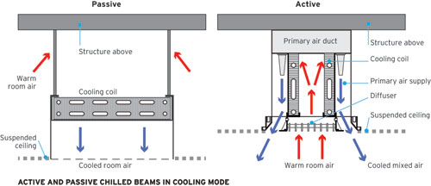
UNIFIED SCIENCE CENTER
PROJECT DEPTH
THE UNIVERSITY OF SCRANTON SCRANTON, PA
CHILLED BEAMS
INTRODUCTION
EXISTING CONDITIONS
DEPTH WORK
SENSIBLE WHEEL
CHILLED BEAMS
VAV SYSTEM
BREADTH WORK
CONCLUSIONS

Slide 15
UNIFIED SCIENCE CENTER
PROJECT DEPTH
THE UNIVERSITY OF SCRANTON SCRANTON, PA
CHILLED BEAMS
INTRODUCTION
EXISTING CONDITIONS
DEPTH WORK
SENSIBLE WHEEL
CHILLED BEAMS
VAV SYSTEM
BREADTH WORK
CONCLUSIONS
FIRST COST: +207,200
ENERGY SAVINGS: $75,000/YEAR
SIMPLE PAYBACK PERIOD: 3-5 YEARS

Slide 16
UNIFIED SCIENCE CENTER
PROJECT DEPTH
THE UNIVERSITY OF SCRANTON SCRANTON, PA
TRADITIONAL VAV SYSTEM
INTRODUCTION
EXISTING CONDITIONS
DEPTH WORK
SENSIBLE WHEEL
CHILLED BEAMS
VAV SYSTEM
BREADTH WORK
CONCLUSIONS
POOR ENERGY USE
POOR USE OF PLENUM SPACE
UNKNOWN VENTILATION PERFORMANCE

Slide 17
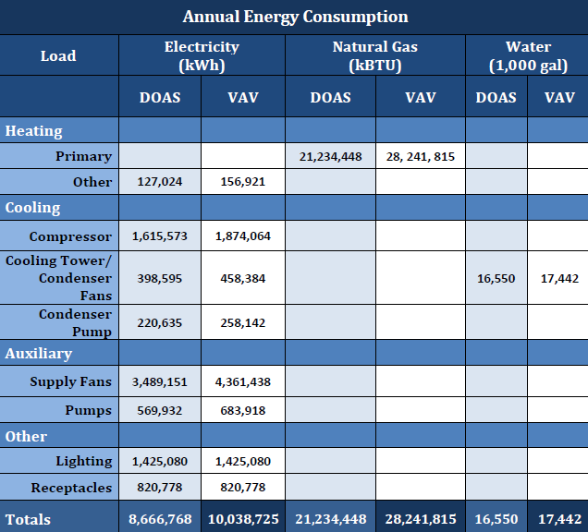
UNIFIED SCIENCE CENTER
PROJECT DEPTH
THE UNIVERSITY OF SCRANTON SCRANTON, PA
TRADITIONAL VAV SYSTEM
INTRODUCTION
EXISTING CONDITIONS
DEPTH WORK
SENSIBLE WHEEL
CHILLED BEAMS
VAV SYSTEM
BREADTH WORK
CONCLUSIONS

Slide 18
UNIFIED SCIENCE CENTER
PROJECT DEPTH
THE UNIVERSITY OF SCRANTON SCRANTON, PA
TRADITIONAL VAV SYSTEM
INTRODUCTION
EXISTING CONDITIONS
DEPTH WORK
SENSIBLE WHEEL
CHILLED BEAMS
VAV SYSTEM
BREADTH WORK
CONCLUSIONS
FIRST COST: COMPARABLE TO EXISTING SYSTEM
ENERGY COST INCREASE: $200,000/YEAR
POOR INDOOR AIR QUALITY
INCREASED MECHANICAL SPACE

Slide 19
UNIFIED SCIENCE CENTER
PROJECT BREADTH
THE UNIVERSITY OF SCRANTON SCRANTON, PA
LIGHT SHELVES
INTRODUCTION
EXISTING CONDITIONS
DEPTH WORK
BREADTH WORK
LIGHT SHELVES
SOLAR PANELS
RAINWATER REUSE
CONCLUSIONS

Slide 20
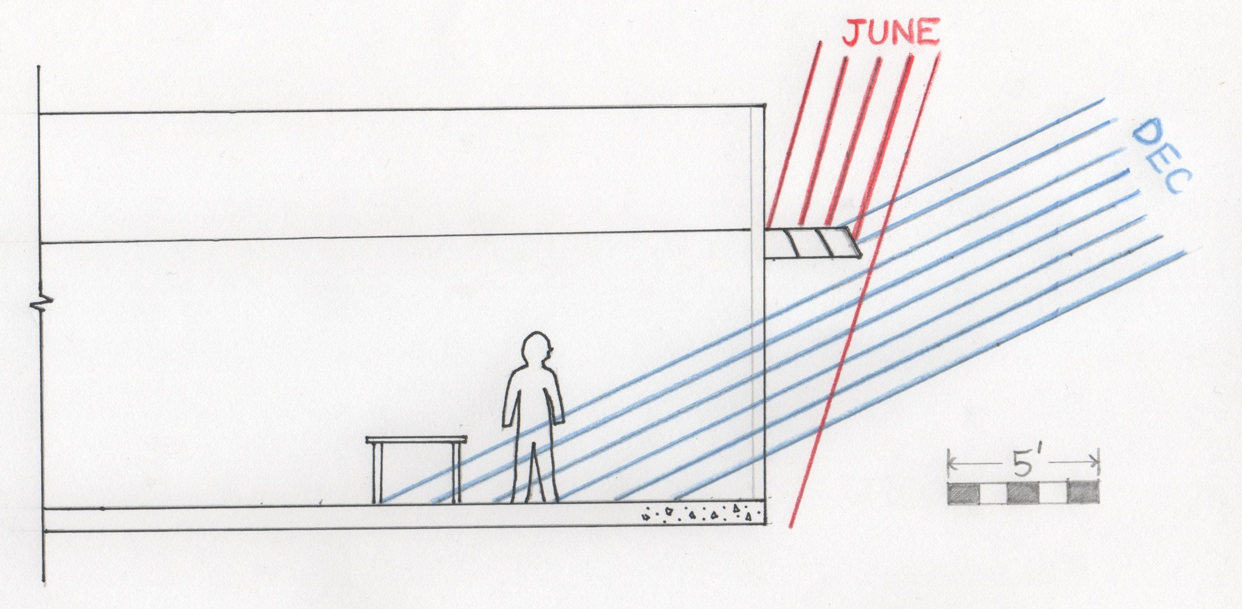
UNIFIED SCIENCE CENTER
PROJECT BREADTH
THE UNIVERSITY OF SCRANTON SCRANTON, PA
LIGHT SHELVES
INTRODUCTION
EXISTING CONDITIONS
DEPTH WORK
BREADTH WORK
LIGHT SHELVES
SOLAR PANELS
RAINWATER REUSE
CONCLUSIONS

Slide 21
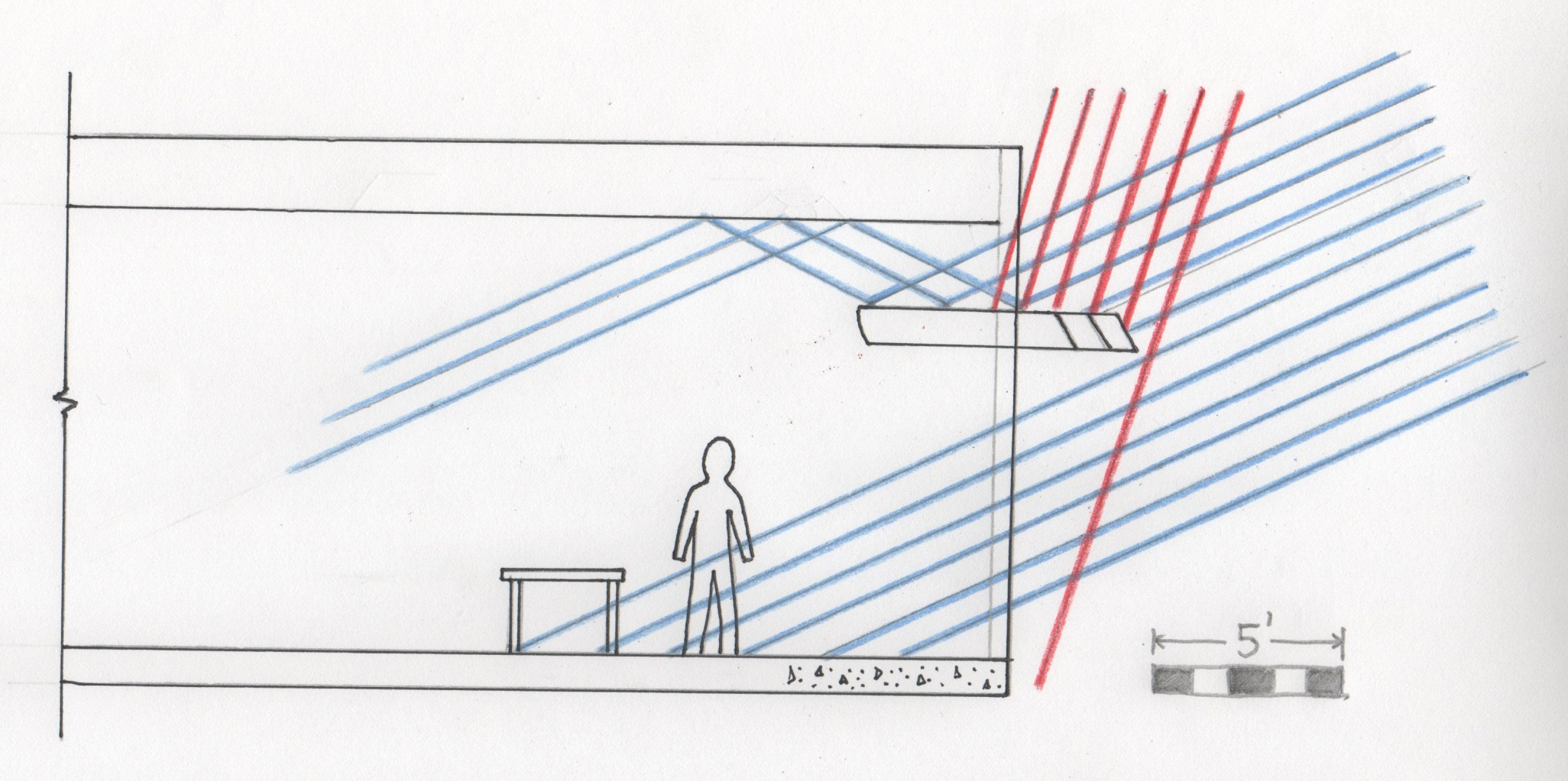
UNIFIED SCIENCE CENTER
PROJECT BREADTH
THE UNIVERSITY OF SCRANTON SCRANTON, PA
LIGHT SHELVES
INTRODUCTION
EXISTING CONDITIONS
DEPTH WORK
BREADTH WORK
LIGHT SHELVES
SOLAR PANELS
RAINWATER REUSE
CONCLUSIONS

Slide 22
UNIFIED SCIENCE CENTER
PROJECT BREADTH
THE UNIVERSITY OF SCRANTON SCRANTON, PA
SOLAR PANELS
INTRODUCTION
EXISTING CONDITIONS
DEPTH WORK
BREADTH WORK
LIGHT SHELVES
SOLAR PANELS
RAINWATER REUSE
CONCLUSIONS

Slide 23
UNIFIED SCIENCE CENTER
PROJECT BREADTH
THE UNIVERSITY OF SCRANTON SCRANTON, PA
SOLAR PANELS
INTRODUCTION
EXISTING CONDITIONS
DEPTH WORK
BREADTH WORK
LIGHT SHELVES
SOLAR PANELS
RAINWATER REUSE
CONCLUSIONS

Slide 24
UNIFIED SCIENCE CENTER
PROJECT BREADTH
THE UNIVERSITY OF SCRANTON SCRANTON, PA
SOLAR PANELS
INTRODUCTION
EXISTING CONDITIONS
DEPTH WORK
BREADTH WORK
LIGHT SHELVES
SOLAR PANELS
RAINWATER REUSE
CONCLUSIONS
900 SF 10 KW SOLAR ARRAY:
INITIAL COST: $90,000
ENERGY SAVINGS: $1,066/YEAR
SIMPLE PAYBACK PERIOD: 90 YEARS

Slide 25
UNIFIED SCIENCE CENTER
PROJECT BREADTH
THE UNIVERSITY OF SCRANTON SCRANTON, PA
RAINWATER COLLECTION
INTRODUCTION
EXISTING CONDITIONS
DEPTH WORK
BREADTH WORK
LIGHT SHELVES
SOLAR PANELS
RAINWATER REUSE
CONCLUSIONS
11,000 SF ROOF AREA
FIRST COST: $437,500
UTILITY SAVINGS: $2,750/YEAR
SIMPLE PAYBACK PERIOD: 160 YEARS

Slide 26
UNIFIED SCIENCE CENTER
CONCLUSIONS
THE UNIVERSITY OF SCRANTON SCRANTON, PA
HEAT RECOVERY WHEELS
GOOD OPTION
CHILLED BEAMS
UNCERTAINTY OF LATENT LOADS
VAV SYSTEM
OUTPERFORMED IN INITIAL AND ANNUAL COST
LIGHT SHELVES
SUBJECT TO PLENUM SPACE
SOLAR PANELS
NOT ECONOMICALLY VIABLE
RAINWATER COLLECTION
NOT ECONOMICALLY VIABLE
INTRODUCTION
EXISTING CONDITIONS
DEPTH WORK
BREADTH WORK
CONCLUSIONS

Slide 27
UNIFIED SCIENCE CENTER
THE UNIVERSITY OF SCRANTON SCRANTON, PA
QUESTIONS?

