Slide 1
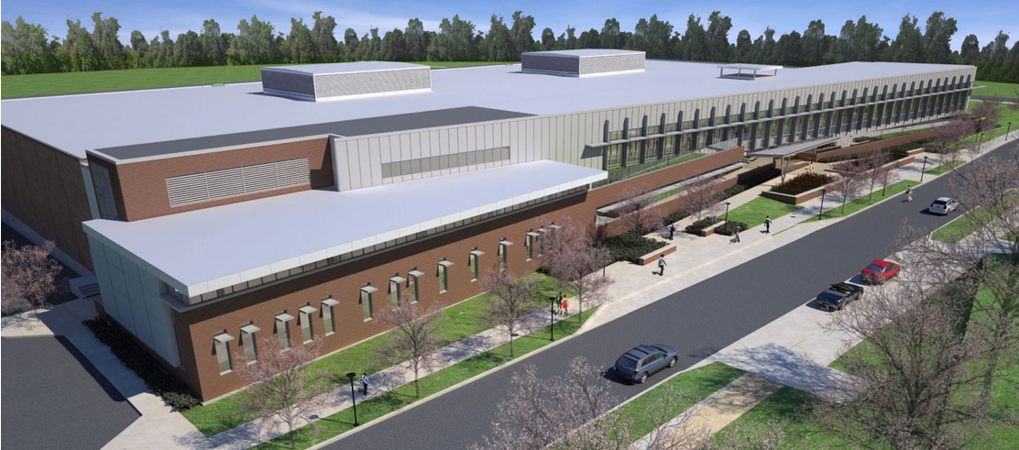
Intramural Building Addition and Renovation – Phase I
University Park, PA
Penn State AE Senior Capstone Project
Gonzalo Lay– Construction Management Option
Advisor: Ray Sowers

Slide 2
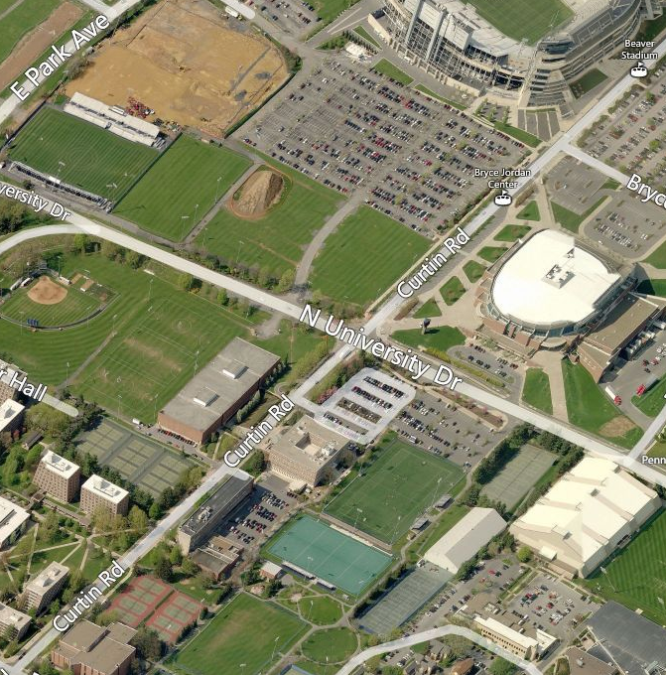
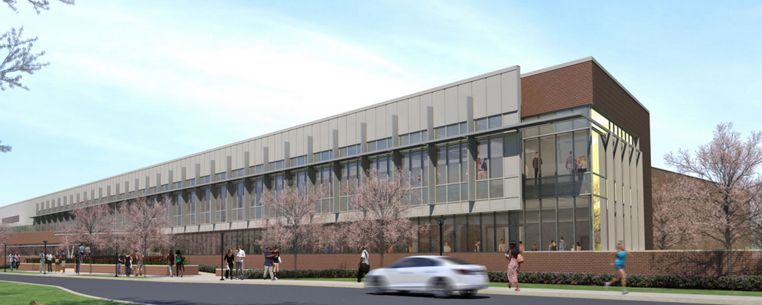
Project Summary
Analysis #1: Prefabrication of Building Enclosure
Proposed Brick Façade vs Current System
Results
Mechanical Breadth
Proposed Curtain Wall vs Current
Results
Analysis #3: Integrated Project Delivery Implementation
Proposed System vs Current
Advantages / Disadvantages
Takeaways
Analysis #4: Occupied vs Vacant Renovations
Proposed System vs Current
Construction Noise & Vibration vs Productivity
Construction Standards
Recommendations
Acknowledgements
Building Information
Addition: 48,000 SF New Construction
Renovation: 100,000 SF
2-Stories Above Grade
Structural Steel Frame
Function: Recreational Use, Gymnasium
Construction Information
Schedule: Start | February 2013
End | February 2014 *Turned Over March, 2014
Delivery Method: CM @ Risk
Contract: Guaranteed Maximum Price
Cost: Project | $ 26.1 Million
Construction | $ 19 Million
Project Summary
Gonzalo Lay Intramural Building Project
Construction Management

Slide 3
Project Summary
Analysis #1: Prefabrication of Building Enclosure
Proposed Brick Façade vs Current System
Results
Mechanical Breadth
Proposed Curtain Wall vs Current
Results
Analysis #3: Integrated Project Delivery Implementation
Proposed System vs Current
Advantages / Disadvantages
Takeaways
Analysis #4: Occupied vs Vacant Renovations
Proposed System vs Current
Construction Noise & Vibration vs Productivity
Construction Standards
Recommendations
Acknowledgements
Analysis #1 – Prefabrication of Building Enclosure
Looks into the use of prefabricated brick panels and unitized curtain wall to accelerate the schedule and reduce project costs.
Mechanical Breadth – Thermal properties and moisture performance were analyzed.
Analysis #2 – Prefabrication Structural Effects
Looks into the structural implications of using prefabricated brick panels on the building frame.
Structural Breadth – Resizing of exterior structural columns and beams.
Analysis #3 – Integrated Project Delivery Implementation
Looks into the use of a different delivery method to improve the planning, coordination and outcome of the project
Analysis #4 – Occupied vs. Vacant Renovation
Evaluates the decision making of the owner on how the project should be constructed, while implementing construction standards to improve the health and safety of occupants.
Project Summary
Gonzalo Lay Intramural Building Project
Construction Management

Slide 4
Project Summary
Analysis #1: Prefabrication of Building Enclosure
Proposed Brick Façade vs Current System
Results
Mechanical Breadth
Proposed Curtain Wall vs Current
Results
Analysis #3: Integrated Project Delivery Implementation
Proposed System vs Current
Advantages / Disadvantages
Takeaways
Analysis #4: Occupied vs Vacant Renovations
Proposed System vs Current
Construction Noise & Vibration vs Productivity
Construction Standards
Recommendations
Acknowledgements
Analysis #1 – Prefabricated Building Enclosure
Gonzalo Lay Intramural Building Project
Construction Management

Slide 5
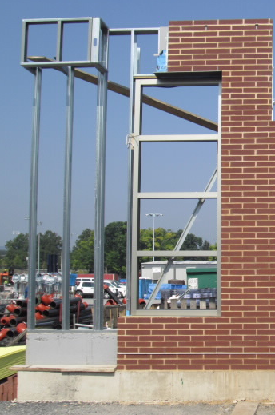
Project Summary
Analysis #1: Prefabrication of Building Enclosure
Proposed Brick Façade vs Current System
Results
Mechanical Breadth
Proposed Curtain Wall vs Current
Results
Analysis #3: Integrated Project Delivery Implementation
Proposed System vs Current
Advantages / Disadvantages
Takeaways
Analysis #4: Occupied vs Vacant Renovations
Proposed System vs Current
Construction Noise & Vibration vs Productivity
Construction Standards
Recommendations
Acknowledgements
Problem Identification
Exterior Enclosure duration 20 weeks
Critical Path
Finished before Interior activities begins
Background
Contractor performance issues
Coordination between trades during installation
=
PROJECT DELAYS
Potential Solutions
Use of prefabrication would lead to faster installation, lower labor costs, improve quality and lower risks of onsite accidents.
Prefabrication of Building Enclosure
Gonzalo Lay Intramural Building Project
Construction Management

Slide 6
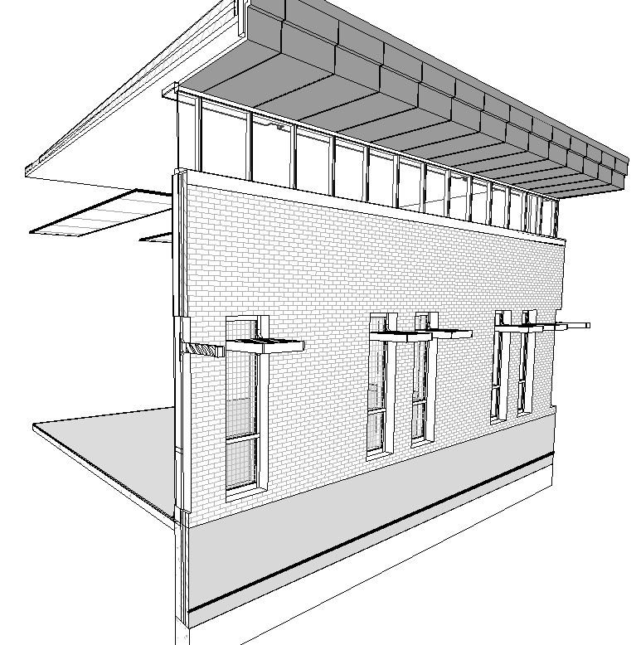
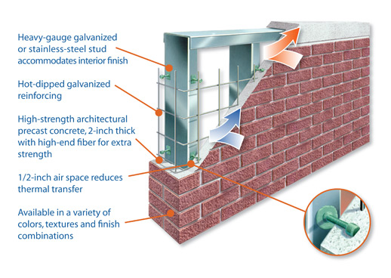
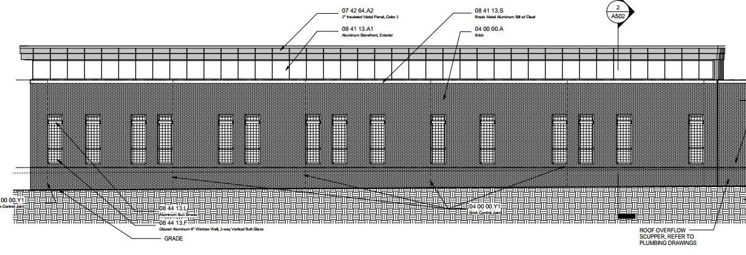
Project Summary
Analysis #1: Prefabrication of Building Enclosure
Proposed Brick Façade vs Current System
Results
Mechanical Breadth
Proposed Curtain Wall vs Current
Results
Analysis #3: Integrated Project Delivery Implementation
Proposed System vs Current
Advantages / Disadvantages
Takeaways
Analysis #4: Occupied vs Vacant Renovations
Proposed System vs Current
Construction Noise & Vibration vs Productivity
Construction Standards
Recommendations
Acknowledgements
CURRENT BRICK FACADE
3 5/8” Norman Brick
Thermal Insulation (Rigid & Spray on)
6” Metal Stud back-up framing
7090 SF of brick installed
ESTIMATED COST: $372,934
DURATION: 92 days
PROPOSED – SLENDERWALL SYSTEM
½” Thin Brick
2” Reinforced Precast concrete layer
Batt Insulation
6” Galv. Steel Studs
Lightweight Design – 30 lbs./ft²
Increased Floor Space
Reduced installation time
Variety of finishes and textures
Location of Brick Façade on Mtl stud
Prefabrication of Building Enclosure
Gonzalo Lay Intramural Building Project
Construction Management

Slide 7
Project Summary
Analysis #1: Prefabrication of Building Enclosure
Proposed Brick Façade vs Current System
Results
Mechanical Breadth
Proposed Curtain Wall vs Current
Results
Analysis #3: Integrated Project Delivery Implementation
Proposed System vs Current
Advantages / Disadvantages
Takeaways
Analysis #4: Occupied vs Vacant Renovations
Proposed System vs Current
Construction Noise & Vibration vs Productivity
Construction Standards
Recommendations
Acknowledgements
PANEL SIZES
Building not designed for panel application
8 Different Widths & 5 Different Heights
Layout of panels designed to avoid architectural changes
Productivity can be increased and cost of panels reduced if Multipurpose room windows re-arranged
South Wall Panels
East Wall Panels
Prefabrication of Building Enclosure
Gonzalo Lay Intramural Building Project
Construction Management

Slide 8
Project Summary
Analysis #1: Prefabrication of Building Enclosure
Proposed Brick Façade vs Current System
Results
Mechanical Breadth
Proposed Curtain Wall vs Current
Results
Analysis #3: Integrated Project Delivery Implementation
Proposed System vs Current
Advantages / Disadvantages
Takeaways
Analysis #4: Occupied vs Vacant Renovations
Proposed System vs Current
Construction Noise & Vibration vs Productivity
Construction Standards
Recommendations
Acknowledgements
COST EVALUATION
Cavity Wall Cost
Includes all building components not required by SlenderWall
Total: $ 372,934
SlenderWall Cost
Based on avg cost of $42/SF
Includes delivery, erection and insulation
General Conditions
Scaffolding eliminated
Crane rental required
Material Hoist eliminated
Total Savings
$75,613
SlenderWall System Breakdown Cost
Panel System | SF | 7,090.00 | 42.0 | $ 291,060.00
Gypsum Board 5/8" (3 Layers) | SF | 7,090.00 | 1.5 | $ 10,395.00
TOTAL |  |  |  | $ 301,455.00
System Cost Comparison
 | Unit | Quantity | Cost/Unit | Total
Panel System | SF | 7,090.00 | 43.5 | $301,455.00
Current System | SF | 7,090.00 | 52.6 | $372,934.00
 |  |  | Difference | $71,479.00
Additional Costs Benefits/Implements
Scaffolding | CSF | 148.8 | $ 130.13 | $ 19,363.34
Crane | Mo | -1.0 | $ 17,289.00 | $ (17,289.00)
Material Hoist | Ea. | 1.0 | $ 2,060.00 | $ 2,060.00
 |  |  | Difference | $ 4,134.34
Prefabrication of Building Enclosure
Gonzalo Lay Intramural Building Project
Construction Management

Slide 9
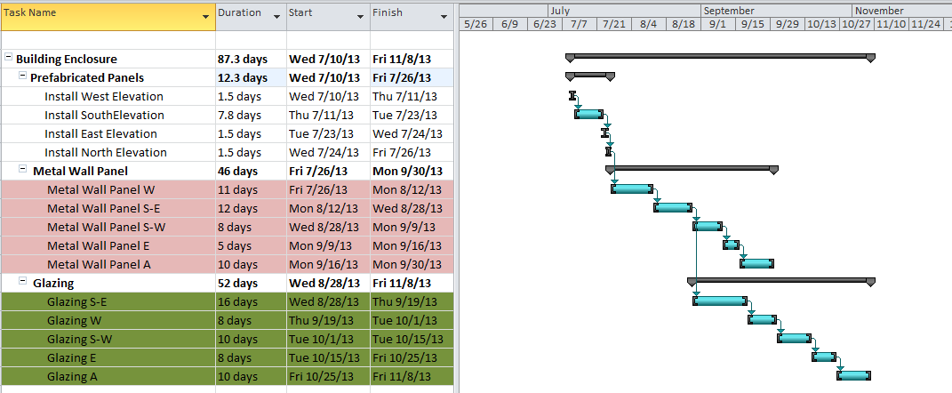
Project Summary
Analysis #1: Prefabrication of Building Enclosure
Proposed Brick Façade vs Current System
Results
Mechanical Breadth
Proposed Curtain Wall vs Current
Results
Analysis #3: Integrated Project Delivery Implementation
Proposed System vs Current
Advantages / Disadvantages
Takeaways
Analysis #4: Occupied vs Vacant Renovations
Proposed System vs Current
Construction Noise & Vibration vs Productivity
Construction Standards
Recommendations
Acknowledgements
SCHEDULE EVALUATION
Installation Sequence
Begin after steel erection is completed and floor slabs are poured
Start at West façade in a counterclockwise direction
Install one floor at the time, spandrel and wall panels
Schedule Impact
2 hr. installation per panel - modified
Original duration: 92 days
SlenderWall duration: 13 days
Building Enclosure Schedule
Reduced by 12 Days
Elevation | Quantity | Productivity (hr.)/ Panel | Duration (hr.) | Days
West | 6 | 2 | 12.0 | 1.5
South | 31 | 2 | 62.0 | 7.8
East | 6 | 2 | 12.0 | 1.5
North @ East | 6 | 2 | 12.0 | 1.5
 |  |  | Total | 13
Prefabrication of Building Enclosure
Gonzalo Lay Intramural Building Project
Construction Management

Slide 10
Project Summary
Analysis #1: Prefabrication of Building Enclosure
Proposed Brick Façade vs Current System
Results
Mechanical Breadth
Proposed Curtain Wall vs Current
Results
Analysis #3: Integrated Project Delivery Implementation
Proposed System vs Current
Advantages / Disadvantages
Takeaways
Analysis #4: Occupied vs Vacant Renovations
Proposed System vs Current
Construction Noise & Vibration vs Productivity
Construction Standards
Recommendations
Acknowledgements
THERMAL PERFORMANCE
R-Value Comparison
Cavity Wall: 27.335
SlenderWall: 27.090
Heat Transfer
Summer
Cavity Wall: 3,600 Btu/hr.
SlenderWall: 3,632 Btu/hr.
Winter
Cavity Wall: 15,642 Btu/hr.
SlenderWall: 15,783 Btu/hr.
Conclusion
Thermal performance of SlenderWall system will not affect the design of mechanical system
Heat Transfer
Summer
 | R-Value | Change in Temp | Area | Heat Transfer
 | ∑ R | Δ T | SF | Btu/Hr
Current | 27.335 | 14.2 | 6,930.00 | 3,600.00
Proposed | 27.09 | 14.2 | 6,930.00 | 3,632.56
 |  |  | Difference | (32.56)
Winter
Current | 27.335 | 61.7 | 6,930.00 | 15,642.25
Proposed | 27.09 | 61.7 | 6,930.00 | 15,783.72
 |  |  | Difference | (141.47)
Mechanical Breadth
Gonzalo Lay Intramural Building Project
Construction Management

Slide 11
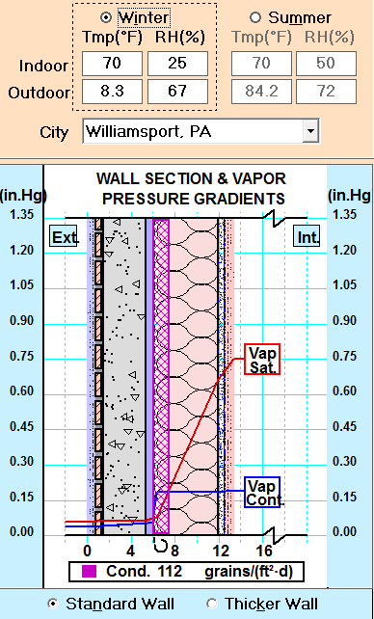
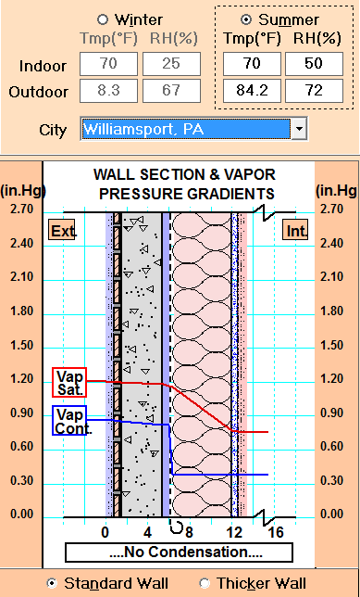
Project Summary
Analysis #1: Prefabrication of Building Enclosure
Proposed Brick Façade vs Current System
Results
Mechanical Breadth
Proposed Curtain Wall vs Current
Results
Analysis #3: Integrated Project Delivery Implementation
Proposed System vs Current
Advantages / Disadvantages
Takeaways
Analysis #4: Occupied vs Vacant Renovations
Proposed System vs Current
Construction Noise & Vibration vs Productivity
Construction Standards
Recommendations
Acknowledgements
MOISTURE PERFORMANCE
Conditions
Winter
Indoor 70F | 25% RH
Outdoor 8.3F | 67% RH
Summer
Indoor 70F | 50% RH
Outdoor 84.2F | 72% RH
Cavity Wall
Summer: No Condensation
Winter: Chance of 17 grains/(ft2-day) in vapor barrier
SlenderWall
Summer: No Condensation
Winter: Chance of 112 grains/(ft2-day) in air cavity
Preventions
Apply vapor barrier to back of studs
Mechanical Breadth
Gonzalo Lay Intramural Building Project
Construction Management

Slide 12
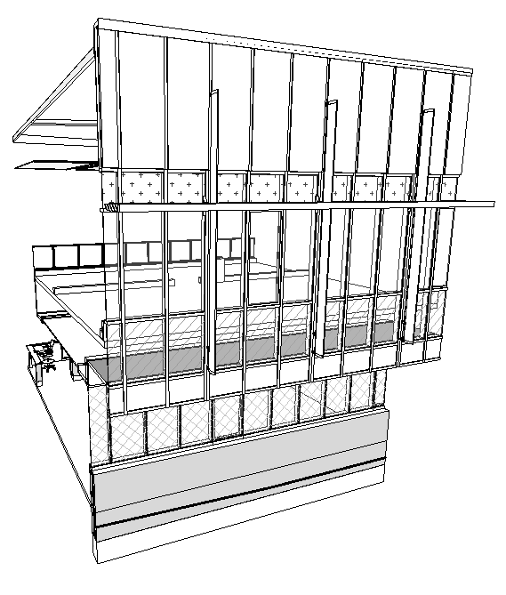
Project Summary
Analysis #1: Prefabrication of Building Enclosure
Proposed Brick Façade vs Current System
Results
Mechanical Breadth
Proposed Curtain Wall vs Current
Results
Analysis #3: Integrated Project Delivery Implementation
Proposed System vs Current
Advantages / Disadvantages
Takeaways
Analysis #4: Occupied vs Vacant Renovations
Proposed System vs Current
Construction Noise & Vibration vs Productivity
Construction Standards
Recommendations
Acknowledgements
Problem Identification
Stick-built curtain wall system leads to longer on-site installation and increased labor costs
Potential Solutions
Implementing a unitized curtain wall panel system that can be delivered on time
Location of Major Curtain Wall Area
Prefabrication of Building Enclosure
Gonzalo Lay Intramural Building Project
Construction Management

Slide 13
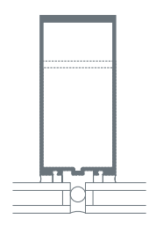
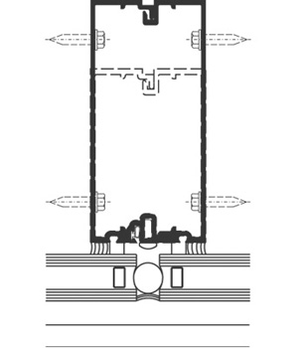
Project Summary
Analysis #1: Prefabrication of Building Enclosure
Proposed Brick Façade vs Current System
Results
Mechanical Breadth
Proposed Curtain Wall vs Current
Results
Analysis #3: Integrated Project Delivery Implementation
Proposed System vs Current
Advantages / Disadvantages
Takeaways
Analysis #4: Occupied vs Vacant Renovations
Proposed System vs Current
Construction Noise & Vibration vs Productivity
Construction Standards
Recommendations
Acknowledgements
STICK BUILT CURTAIN WALL
Pros
Efficient Delivery
Flexibility and Ease of Installation
Lower costs of materials
Cons
Longer installation times
Limited quality of product
Site Congestion
Current – Kawneer 1600 Wall System
PROPOSED UNITIZED SYSTEM
Pros
Faster installations
Higher quality product
Decreased site congestion
Cons
Multiple deliveries
Higher costs of materials
Equipment required
Proposed – Kawneer 1600 SS (Pre-glazed system)
Prefabrication of Building Enclosure
Gonzalo Lay Intramural Building Project
Construction Management

Slide 14
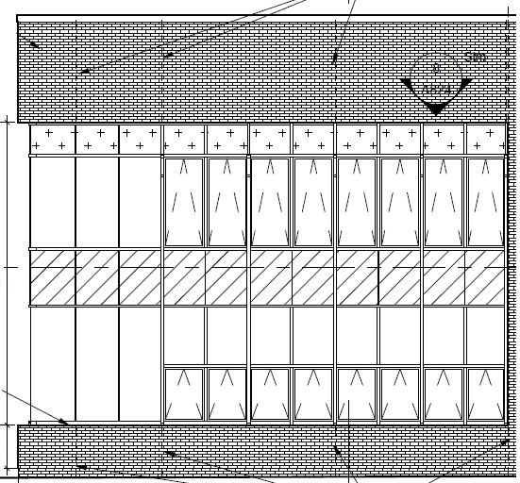
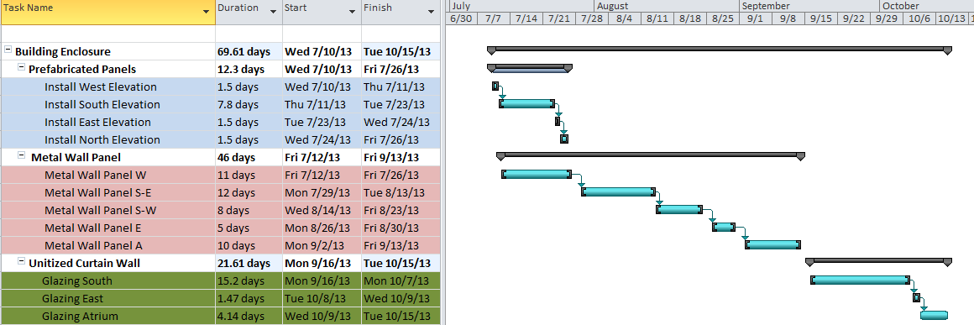
Project Summary
Analysis #1: Prefabrication of Building Enclosure
Proposed Brick Façade vs Current System
Results
Mechanical Breadth
Proposed Curtain Wall vs Current
Results
Analysis #3: Integrated Project Delivery Implementation
Proposed System vs Current
Advantages / Disadvantages
Takeaways
Analysis #4: Occupied vs Vacant Renovations
Proposed System vs Current
Construction Noise & Vibration vs Productivity
Construction Standards
Recommendations
Acknowledgements
Elevation | Productivity panels/day | No. Panels | Duration
South | 15 | 140 | 9.33
South | 7 | 41 | 5.86
East | 15 | 22 | 1.47
Atrium | 15 | 30 | 2.00
Atrium | 7 | 15 | 2.14
 |  | Total | 20.80
Schedule
Original Duration 99 days
Proposed Duration 70 days
Accelerated building enclosure schedule by 29 Days
Cost
$190,586 added to Project Cost
Item | Quantity | Unit | Unit Total | Total
Stick Built System | 8,663.00 | SF | $ 110.00 | $ 952,930.00
Subtotal |  |  |  | $ 952,930.00
Unitized System | 8,663.00 | SF | $ 132.00 | $ 1,143,516.00
Subtotal |  |  |  | $ 1,143,516.00
Difference |  |  |  | $ (190,586.00)
Prefabrication of Building Enclosure
Gonzalo Lay Intramural Building Project
Construction Management

Slide 15
Project Summary
Analysis #1: Prefabrication of Building Enclosure
Proposed Brick Façade vs Current System
Results
Mechanical Breadth
Proposed Curtain Wall vs Current
Results
Analysis #3: Integrated Project Delivery Implementation
Proposed System vs Current
Advantages / Disadvantages
Takeaways
Analysis #4: Occupied vs Vacant Renovations
Proposed System vs Current
Construction Noise & Vibration vs Productivity
Construction Standards
Recommendations
Acknowledgements
Analysis #3 - IPD Implementation
Gonzalo Lay Intramural Building Project
Construction Management

Slide 16
Project Summary
Analysis #1: Prefabrication of Building Enclosure
Proposed Brick Façade vs Current System
Results
Mechanical Breadth
Proposed Curtain Wall vs Current
Results
Analysis #3: Integrated Project Delivery Implementation
Proposed System vs Current
Advantages / Disadvantages
Takeaways
Analysis #4: Occupied vs Vacant Renovations
Proposed System vs Current
Construction Noise & Vibration vs Productivity
Construction Standards
Recommendations
Acknowledgements
Problem Identification
Discrepancies between design team and contractors caused project
Contractor performance issues
Coordination between trades during installation
Potential Solutions
Early involvement of project main members will result in better project planning and diminish the risk of project delays and changes.
IPD Implementation
Gonzalo Lay Intramural Building Project
Construction Management

Slide 17
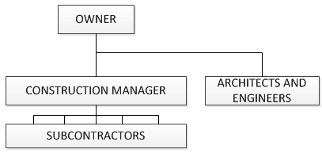
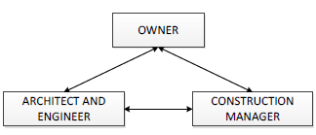
Project Summary
Analysis #1: Prefabrication of Building Enclosure
Proposed Brick Façade vs Current System
Results
Mechanical Breadth
Proposed Curtain Wall vs Current
Results
Analysis #3: Integrated Project Delivery Implementation
Proposed System vs Current
Advantages / Disadvantages
Takeaways
Analysis #4: Occupied vs Vacant Renovations
Proposed System vs Current
Construction Noise & Vibration vs Productivity
Construction Standards
Recommendations
Acknowledgements
CM AT RISK
Construction Manager holds risks of construction
Holds contracts with subcontractors to perform work
Guarantees completion of project for a negotiated GMP
CM not involved in project until Design Development Phase
RFIs and change orders are likely
Success is measured by self interests
INTEGRATED PROJECT DELIVERY
Collaborative efforts to succeed as a team
Shared risks between owner, design team and construction manager
High quality for reasonable price
CM involved early in project
Change Orders likelihood diminishes
RFIs have faster response rates
Construction Schedule Reduced
Higher level of planning eases flow of construction
IPD Implementation
Gonzalo Lay Intramural Building Project
Construction Management

Slide 18
Project Summary
Analysis #1: Prefabrication of Building Enclosure
Proposed Brick Façade vs Current System
Results
Mechanical Breadth
Proposed Curtain Wall vs Current
Results
Analysis #3: Integrated Project Delivery Implementation
Proposed System vs Current
Advantages / Disadvantages
Takeaways
Analysis #4: Occupied vs Vacant Renovations
Proposed System vs Current
Construction Noise & Vibration vs Productivity
Construction Standards
Recommendations
Acknowledgements
MAIN BENEFITS
Early contributions to design
Reduced design conflicts
Improved schedule management
Reduced design document time
Traditional Project Delivery |  | Integrated Project Delivery
Fragmented, ad-hoc, hierarchical, controlled | Participants | Team of project constituencies, open and collaborative
Linear, segregated, limited information exchange | Process | Concurrent, project life-cycle oriented, shared information, collaborative
No | Early Contractor Involvement | Yes
Individually managed | Risk | Managed and shared risks in a collective manner
Cost-based, individually focused | Compensation | Performance and value based
Not shared, Minimal communication | Documentation | Shared, Open Communication
SUCCESS CRITERIA
Meet owners criteria
Budget and Schedule met
Improved overall quality
SUCCESS FACTORS
Clearly defined scope
Contractor experience
Synergy and good relationships
Owner participation
IPD Implementation
Gonzalo Lay Intramural Building Project
Construction Management

Slide 19
Project Summary
Analysis #1: Prefabrication of Building Enclosure
Proposed Brick Façade vs Current System
Results
Mechanical Breadth
Proposed Curtain Wall vs Current
Results
Analysis #3: Integrated Project Delivery Implementation
Proposed System vs Current
Advantages / Disadvantages
Takeaways
Analysis #4: Occupied vs Vacant Renovations
Proposed System vs Current
Construction Noise & Vibration vs Productivity
Construction Standards
Recommendations
Acknowledgements
IPD IMPLEMENTATION
Team Selection
Team Interview Process
Response to Proposal
Shared Risk Contract
Planning Between Key Members
Construction
RFQ to A/E’s and CMs
Representative from each party – Day workshop | project related
Project design ideas | approval by BOT
Must be signed by all parties (Owner, CM, AE) – later involve Subs
Design, budgeting, scheduling, planning activities takes place
Collaboration enforced throughout project
IPD Implementation
Gonzalo Lay Intramural Building Project
Construction Management

Slide 20
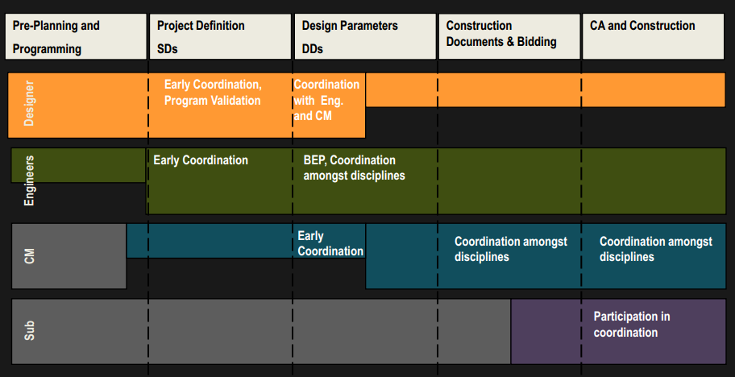
Project Summary
Analysis #1: Prefabrication of Building Enclosure
Proposed Brick Façade vs Current System
Results
Mechanical Breadth
Proposed Curtain Wall vs Current
Results
Analysis #3: Integrated Project Delivery Implementation
Proposed System vs Current
Advantages / Disadvantages
Takeaways
Analysis #4: Occupied vs Vacant Renovations
Proposed System vs Current
Construction Noise & Vibration vs Productivity
Construction Standards
Recommendations
Acknowledgements
EVALUATION
DURATION
Construction schedule is reduced.
Design phase is extended
Courtesy of http://network.aia.org
IPD Implementation
Gonzalo Lay Intramural Building Project
Construction Management

Slide 21
Project Summary
Analysis #1: Prefabrication of Building Enclosure
Proposed Brick Façade vs Current System
Results
Mechanical Breadth
Proposed Curtain Wall vs Current
Results
Analysis #3: Integrated Project Delivery Implementation
Proposed System vs Current
Advantages / Disadvantages
Takeaways
Analysis #4: Occupied vs Vacant Renovations
Proposed System vs Current
Construction Noise & Vibration vs Productivity
Construction Standards
Recommendations
Acknowledgements
EVALUATION
DURATION
Construction schedule is reduced.
Design phase is extended
COLLABORATION
Big room – daily team interaction
Courtesy of http://network.aia.org
IPD Implementation
Gonzalo Lay Intramural Building Project
Construction Management

Slide 22
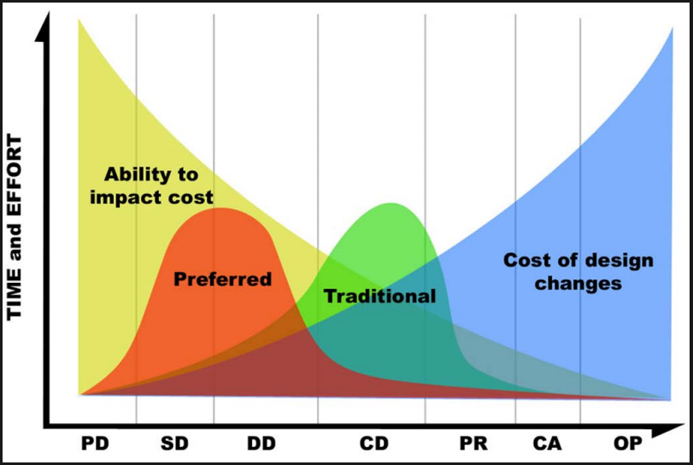
Project Summary
Analysis #1: Prefabrication of Building Enclosure
Proposed Brick Façade vs Current System
Results
Mechanical Breadth
Proposed Curtain Wall vs Current
Results
Analysis #3: Integrated Project Delivery Implementation
Proposed System vs Current
Advantages / Disadvantages
Takeaways
Analysis #4: Occupied vs Vacant Renovations
Proposed System vs Current
Construction Noise & Vibration vs Productivity
Construction Standards
Recommendations
Acknowledgements
EVALUATION
DURATION
Construction schedule is reduced.
Design phase is extended
COLLABORATION
Big room – daily team interaction
COST
Elimination of RFIs and Change Orders during construction
Project costs are more controlled
IPD Implementation
Gonzalo Lay Intramural Building Project
Construction Management

Slide 23
Project Summary
Analysis #1: Prefabrication of Building Enclosure
Proposed Brick Façade vs Current System
Results
Mechanical Breadth
Proposed Curtain Wall vs Current
Results
Analysis #3: Integrated Project Delivery Implementation
Proposed System vs Current
Advantages / Disadvantages
Takeaways
Analysis #4: Occupied vs Vacant Renovations
Proposed System vs Current
Construction Noise & Vibration vs Productivity
Construction Standards
Recommendations
Acknowledgements
EVALUATION
DURATION
Construction schedule is reduced.
Design phase is extended
COLLABORATION
Big room – daily team interaction
COST
Elimination of RFIs and Change Orders during construction
Project costs are more controlled
QUALITY
Improved work coordination
Access to information
IPD Implementation
Gonzalo Lay Intramural Building Project
Construction Management

Slide 24
Project Summary
Analysis #1: Prefabrication of Building Enclosure
Proposed Brick Façade vs Current System
Results
Mechanical Breadth
Proposed Curtain Wall vs Current
Results
Analysis #3: Integrated Project Delivery Implementation
Proposed System vs Current
Advantages / Disadvantages
Takeaways
Analysis #4: Occupied vs Vacant Renovations
Proposed System vs Current
Construction Noise & Vibration vs Productivity
Construction Standards
Recommendations
Acknowledgements
TAKEAWAYS
Early Team Involvement
Improved synergy
Reduced issues (Design and Construction)
Collaboration
Shared information
Ease of coordination
Increased productivity
Shared Risks
Working towards same goal
Cost savings (litigations and lawsuits)
Efficient Construction
Less waste
No change orders
Experience
Owner must be have prev. experience
Time involvement
Contract
Owner must generate a contract or use standard
Liabilities and shared risks must be evaluated
IPD Implementation
Gonzalo Lay Intramural Building Project
Construction Management

Slide 25
Project Summary
Analysis #1: Prefabrication of Building Enclosure
Proposed Brick Façade vs Current System
Results
Mechanical Breadth
Proposed Curtain Wall vs Current
Results
Analysis #3: Integrated Project Delivery Implementation
Proposed System vs Current
Advantages / Disadvantages
Takeaways
Analysis #4: Occupied vs Vacant Renovations
Proposed System vs Current
Construction Noise & Vibration vs Productivity
Construction Standards
Recommendations
Acknowledgements
Analysis #4 - Occupied vs Vacant Renovations
Gonzalo Lay Intramural Building Project
Construction Management

Slide 26
Project Summary
Analysis #1: Prefabrication of Building Enclosure
Proposed Brick Façade vs Current System
Results
Mechanical Breadth
Proposed Curtain Wall vs Current
Results
Analysis #3: Integrated Project Delivery Implementation
Proposed System vs Current
Advantages / Disadvantages
Takeaways
Analysis #4: Occupied vs Vacant Renovations
Proposed System vs Current
Construction Noise & Vibration vs Productivity
Construction Standards
Recommendations
Acknowledgements
Problem Identification
Unexpected construction activities can disrupt the comfort of building occupants in a phased renovation.
Background
Building occupants are expected to work together with the construction crews to prevent disturbances and allow to perform daily work.
Potential Solutions
Alternative to vacate the existing building and allow construction activities to be ongoing
Produce construction guidelines for improved occupant health and safety
Occupied vs Vacant Renovations
Gonzalo Lay Intramural Building Project
Construction Management

Slide 27
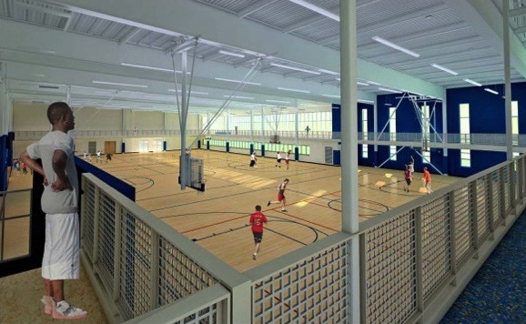
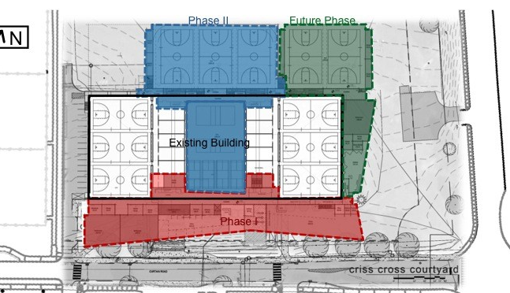
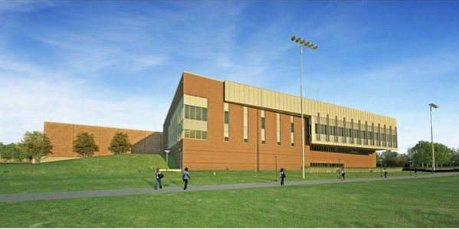
Project Summary
Analysis #1: Prefabrication of Building Enclosure
Proposed Brick Façade vs Current System
Results
Mechanical Breadth
Proposed Curtain Wall vs Current
Results
Analysis #3: Integrated Project Delivery Implementation
Proposed System vs Current
Advantages / Disadvantages
Takeaways
Analysis #4: Occupied vs Vacant Renovations
Proposed System vs Current
Construction Noise & Vibration vs Productivity
Construction Standards
Recommendations
Acknowledgements
VACANT RENOVATION
Larger scope of work
Funding available*
Decreased project duration
Lowered Risks of Accidents/Injuries/Complains
Improved Quality of work
Ease of coordination and planning
Occupant relocation
Building use demands
Conflict of activities
Project costs
Occupied vs Vacant Renovations
Gonzalo Lay Intramural Building Project
Construction Management

Slide 28
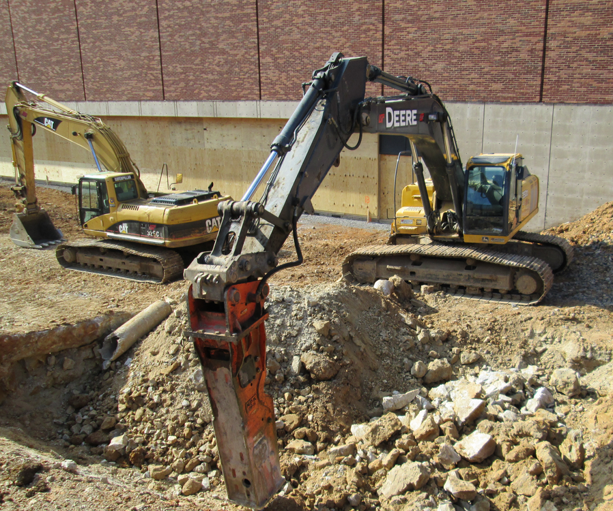
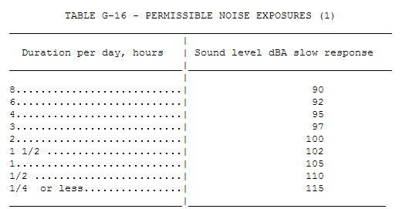
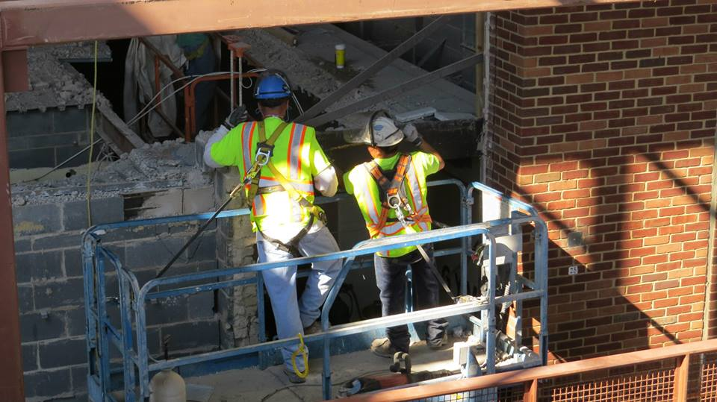
Project Summary
Analysis #1: Prefabrication of Building Enclosure
Proposed Brick Façade vs Current System
Results
Mechanical Breadth
Proposed Curtain Wall vs Current
Results
Analysis #3: Integrated Project Delivery Implementation
Proposed System vs Current
Advantages / Disadvantages
Takeaways
Analysis #4: Occupied vs Vacant Renovations
Proposed System vs Current
Construction Noise & Vibration vs Productivity
Construction Standards
Recommendations
Acknowledgements
OCCUPIED RENOVATION – Controlling Noise and Vibration
Stationary Equipment
Mobile Equipment
Affected phases
Courtesy of OSHA
Occupied vs Vacant Renovations
Gonzalo Lay Intramural Building Project
Construction Management

Slide 29
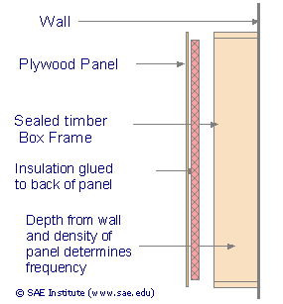
Project Summary
Analysis #1: Prefabrication of Building Enclosure
Proposed Brick Façade vs Current System
Results
Mechanical Breadth
Proposed Curtain Wall vs Current
Results
Analysis #3: Integrated Project Delivery Implementation
Proposed System vs Current
Advantages / Disadvantages
Takeaways
Analysis #4: Occupied vs Vacant Renovations
Proposed System vs Current
Construction Noise & Vibration vs Productivity
Construction Standards
Recommendations
Acknowledgements
OCCUPIED RENOVATION – Productivity
Disruptive sounds
High / low frequencies
Intermittent /Continuous
Tasks
Simple / Complex
Effects
Stress
Frustration
Adaptation – Increase HR
Blood Pressure
Adrenaline and Cortisol
PREVENTION
Hours of Operations and Noise levels
Communication
Low Frequency Panel absorber
Mobile Equipment | Time | Educational Facility | Residential
Daily | 7:00 am to 5:00 pm | 85 dBA | 70 dBA
Weekends | 9:00 am to 5:00 pm | 65 dBA | 60 dBA
Stationary Equipment
Daily | 7:00 am to 5:00 pm | 70 dBA | 60 dBA
Weekend | 9:00 am to 5:00 pm | 60 dBA | 50 dBA
Courtesy of SAE Institute
Occupied vs Vacant Renovations
Gonzalo Lay Intramural Building Project
Construction Management

Slide 30
Project Summary
Analysis #1: Prefabrication of Building Enclosure
Proposed Brick Façade vs Current System
Results
Mechanical Breadth
Proposed Curtain Wall vs Current
Results
Analysis #3: Integrated Project Delivery Implementation
Proposed System vs Current
Advantages / Disadvantages
Takeaways
Analysis #4: Occupied vs Vacant Renovations
Proposed System vs Current
Construction Noise & Vibration vs Productivity
Construction Standards
Recommendations
Acknowledgements
ADAPTED CONSTRUCTION STANDARDS
Communication
Primary Contact, weekly meetings
Look ahead schedule, coordination
Occupant/Contractor feedback
Fire Safety
Evacuation layout plan, means of egress
Signage and frequent interaction with shutdown systems
House Keeping
Wet cleaning techniques and HEPA vacuum
Contractor work area clean
Weather
Door mats required @ means of egress
Signage for identified hazards
Interior Traffic
Airtight temp. partitions – travel paths
Physical barriers for penetrations
Indoor Air Quality
Negative air pressure (cont.) in construction area
Daily cleaning
HVAC temp. shutdown when high levels of pollutants
Noise
Appropriate worker volume communication
High Noise level activities must be approved by PM
Acoustical enclosures for noisy equipment
Vibration
Logistics, vehicular traffic far from bldg. footprint
Sequencing activities
Occupied vs Vacant Renovations
Gonzalo Lay Intramural Building Project
Construction Management

Slide 31
Project Summary
Analysis #1: Prefabrication of Building Enclosure
Proposed Brick Façade vs Current System
Results
Mechanical Breadth
Proposed Curtain Wall vs Current
Results
Analysis #3: Integrated Project Delivery Implementation
Proposed System vs Current
Advantages / Disadvantages
Takeaways
Analysis #4: Occupied vs Vacant Renovations
Proposed System vs Current
Construction Noise & Vibration vs Productivity
Construction Standards
Recommendations
Acknowledgements
ANALYSIS #1 – Prefabrication of Building Enclosure
SlenderWall Panels –reduce exterior enclosure schedule by 12 days
reduce project costs by $75,613
quality product, increase floor space, less safety concerns
Unitized Curtain Wall – reduce exterior enclosure schedule by 29 days
adds $190,586 to project costs
better use if larger area
ANALYSIS #3 – Integrated Project Delivery Implementation
Co-location of project party ease communication
Early involvement improves project outcome
Reduced risks of change orders and RFIs
Shared-risk and liabilities questionable
Recommended applications
Collaboration – big room
Early involvement
ANALYSIS #4 – Occupied vs Vacant Renovation
Vacant – allow for larger scopes of work, reduced risks
facilitates planning and coordination
funding must be available
Occupied – helps meet recreational student demand
Construction Standards
Improve the health and safety of building occupants
Final Recommendations
Gonzalo Lay Intramural Building Project
Construction Management

Slide 32
Project Summary
Analysis #1: Prefabrication of Building Enclosure
Proposed Brick Façade vs Current System
Results
Mechanical Breadth
Proposed Curtain Wall vs Current
Results
Analysis #3: Integrated Project Delivery Implementation
Proposed System vs Current
Advantages / Disadvantages
Takeaways
Analysis #4: Occupied vs Vacant Renovations
Proposed System vs Current
Construction Noise & Vibration vs Productivity
Construction Standards
Recommendations
Acknowledgements
THANKS!
ACADEMIC ACKNOWLEDGEMENTS
Ray Sowers, CM Academic Adviser
John Betchtel, CM Adviser
Ali Memari, Building Enclosure Adviser
Penn State AE Faculty
INDUSTRY ACKNOWLEDGEMENTS
SPECIAL THANKS
Family & Friends
Jason Toso – Mortenson Construction
Jeremy Smith - Easi-Set Industries
Dominick Baruffi – Sto, StoPanel
Matt Christian - Harmon Inc.
Office of Physical Plant
Intramural Building Staff
Acknowledgements
Gonzalo Lay Intramural Building Project
Construction Management

Slide 33
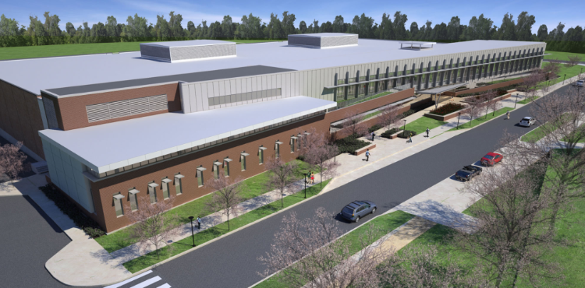
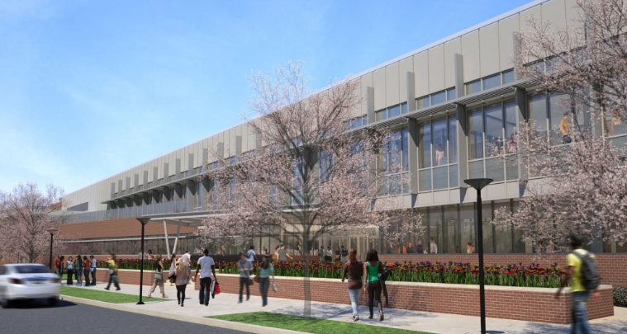
Project Summary
Analysis #1: Prefabrication of Building Enclosure
Proposed Brick Façade vs Current System
Results
Mechanical Breadth
Proposed Curtain Wall vs Current
Results
Analysis #3: Integrated Project Delivery Implementation
Proposed System vs Current
Advantages / Disadvantages
Takeaways
Analysis #4: Occupied vs Vacant Renovations
Proposed System vs Current
Construction Noise & Vibration vs Productivity
Construction Standards
Recommendations
Acknowledgements
Questions
Gonzalo Lay Intramural Building Project
Construction Management

Slide 34
Project Summary
Analysis #1: Prefabrication of Building Enclosure
Proposed Brick Façade vs Current System
Results
Mechanical Breadth
Proposed Curtain Wall vs Current
Results
Analysis #3: Integrated Project Delivery Implementation
Proposed System vs Current
Advantages / Disadvantages
Takeaways
Analysis #4: Occupied vs Vacant Renovations
Proposed System vs Current
Construction Noise & Vibration vs Productivity
Construction Standards
Recommendations
Acknowledgements
Width (ft.) | Height (ft.) | Area (SF) | # Panels | Total Area (SF) | Opening? | Location | Weight per SF | Panel Weight (lbs.)
10.0 | 15.5 | 155.0 | 1 | 155.0 | N | East Wall | 30.0 | 4,650.0
10.0 | 18.5 | 185.0 | 1 | 185.0 | N | East Wall | 30.0 | 5,550.0
12.0 | 15.5 | 186.0 | 1 | 186.0 | N | East Wall | 30.0 | 5,580.0
12.0 | 18.5 | 222.0 | 1 | 222.0 | N | East Wall | 30.0 | 6,660.0
38.0 | 3.5 | 133.0 | 1 | 133.0 | N | East Wall | 30.0 | 3,990.0
38.0 | 8.0 | 304.0 | 1 | 304.0 | N | East Wall | 30.0 | 9,120.0
6.0 | 15.5 | 93.0 | 1 | 93.0 | N | North @ Ea. | 30.0 | 2,790.0
6.0 | 18.5 | 111.0 | 1 | 111.0 | N | North @ Ea. | 30.0 | 3,330.0
8.0 | 15.5 | 124.0 | 1 | 124.0 | Y | North @ Ea. | 30.0 | 3,720.0
8.0 | 18.5 | 148.0 | 1 | 148.0 | N | North @ Ea. | 30.0 | 4,440.0
10.0 | 15.5 | 155.0 | 1 | 155.0 | N | North @ Ea. | 30.0 | 4,650.0
10.0 | 18.5 | 185.0 | 1 | 185.0 | N | North @ Ea. | 30.0 | 5,550.0
10.0 | 13.5 | 135.0 | 5 | 675.0 | Y | South Mech | 30.0 | 20,250.0
6.0 | 15.5 | 93.0 | 1 | 93.0 | N | South Wall | 30.0 | 2,790.0
8.0 | 15.5 | 124.0 | 6 | 744.0 | Y | South Wall | 30.0 | 22,320.0
12.0 | 15.5 | 186.0 | 6 | 1,116.0 | Y | South Wall | 30.0 | 33,480.0
20.0 | 3.5 | 70.0 | 1 | 70.0 | N | South Wall | 30.0 | 2,100.0
20.0 | 6.0 | 120.0 | 5 | 600.0 | N | South Wall | 30.0 | 18,000.0
30.0 | 3.5 | 105.0 | 1 | 105.0 | N | South Wall | 30.0 | 3,150.0
40.0 | 3.5 | 140.0 | 6 | 840.0 | N | South Wall | 30.0 | 25,200.0
6.0 | 15.5 | 93.0 | 3 | 279.0 | N | West Wall | 30.0 | 8,370.0
6.0 | 18.5 | 111.0 | 2 | 222.0 | Y | West Wall | 30.0 | 6,660.0
10.0 | 13.5 | 185.0 | 1 | 185.0 | Y | West Wall | 30.0 | 5,550.0
Total |  |  | 49 | 6930 |  |  |  | 187,320.00
Current Exterior Brick Veneer System Breakdown Cost
 | Unit | Quantity | Cost/Unit | Total
Brick | SF | 7,090.00 | 23.0 | $ 163,070.00
Rigid 2.5" Insulation | SF | 7,090.00 | 2.5 | $ 17,725.00
Vapor Retardant | SF | 7,090.00 | 3.5 | $ 24,815.00
Spray-On Insulation | SF | 7,090.00 | 4.0 | $ 28,360.00
6" Mtl Stud | SF | 7,090.00 | 12.0 | $ 85,080.00
Caulking & Sealants | SF | 7,090.00 | 0.3 | $ 1,772.50
Gypsum Board | SF | 7,090.00 | 7.3 | $ 51,402.50
Misc. Metals | SF | 7,090.00 | 0.1 | $ 709.00
TOTAL |  |  |  | $ 372,934.00
Nitterhouse Concrete Brick Veneer System Breakdown Cost
Panel System | SF | 6,930.00 | 40.0 | $ 277,200.00
Sheathing, 6" Mtl Stud, Gyp | SF | 6,930.00 | 12.0 | $ 83,160.00
Rigid 2.5" Insulation | SF | 6,930.00 | 2.5 | $ 17,325.00
Vapor Retardant | SF | 6,930.00 | 3.5 | $ 24,255.00
Spray-On Insulation | SF | 6,930.00 | 4.0 | $ 27,720.00
Gypsum Board | SF | 7,090.00 | 7.3 | $ 51,402.50
Misc. Metals | SF | 7,090.00 | 0.1 | $ 709.00
TOTAL |  |  |  | $ 429,660.00
SlenderWall System Breakdown Cost
Panel System | SF | 6,930.00 | 42.0 | $ 291,060.00
Gypsum Board 5/8" (3 Layers) | SF | 6,930.00 | 1.5 | $ 10,395.00
TOTAL |  |  |  | $ 301,455.00
StoPanel System Breakdown Cost
Panel System | SF | 6,930.00 | 72.0 | $ 498,960.00
Elevation | Quantity | Productivity (hr)/ Panel | Duration (hr.) | Days
West | 6 | 2 | 12.0 | 1.5
South | 31 | 2 | 62.0 | 7.8
East | 6 | 2 | 12.0 | 1.5
North @ East | 6 | 2 | 12.0 | 1.5
 |  |  | Total | 13
Appendix
Gonzalo Lay Intramural Building Project
Construction Management

Slide 35
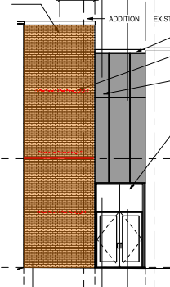
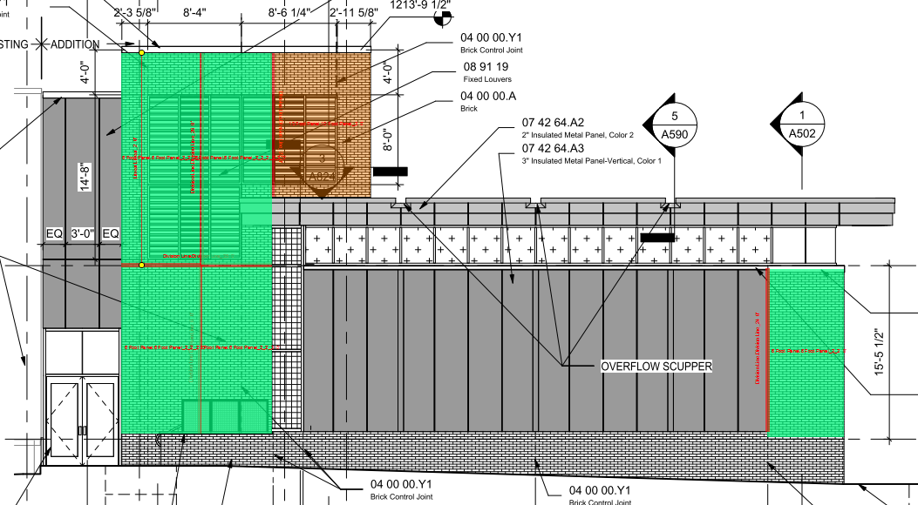
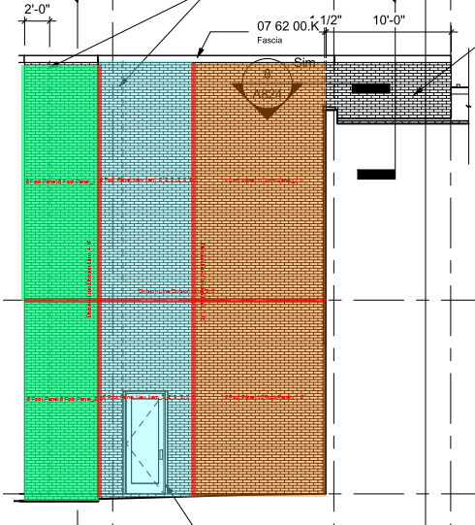
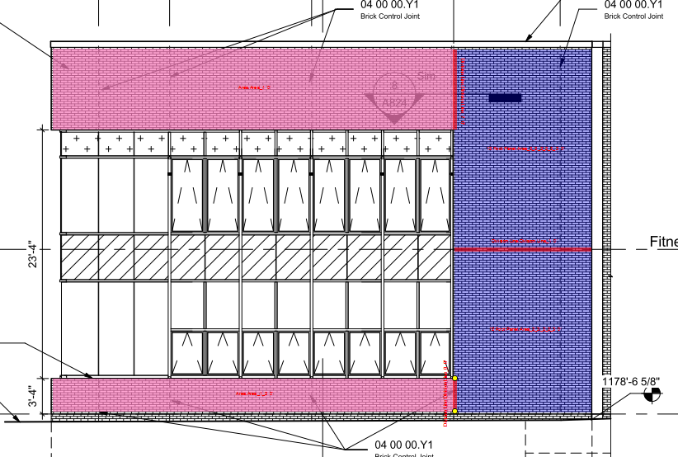
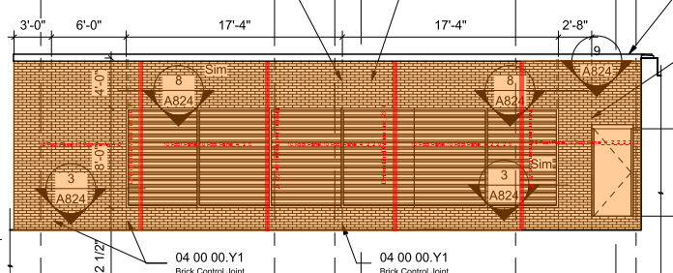
Project Summary
Analysis #1: Prefabrication of Building Enclosure
Proposed Brick Façade vs Current System
Results
Mechanical Breadth
Proposed Curtain Wall vs Current
Results
Analysis #3: Integrated Project Delivery Implementation
Proposed System vs Current
Advantages / Disadvantages
Takeaways
Analysis #4: Occupied vs Vacant Renovations
Proposed System vs Current
Construction Noise & Vibration vs Productivity
Construction Standards
Recommendations
Acknowledgements
Appendix
Gonzalo Lay Intramural Building Project
Construction Management

Slide 36
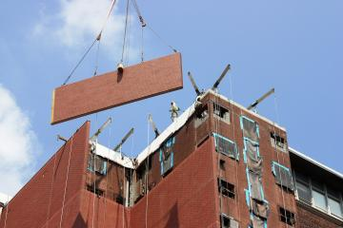
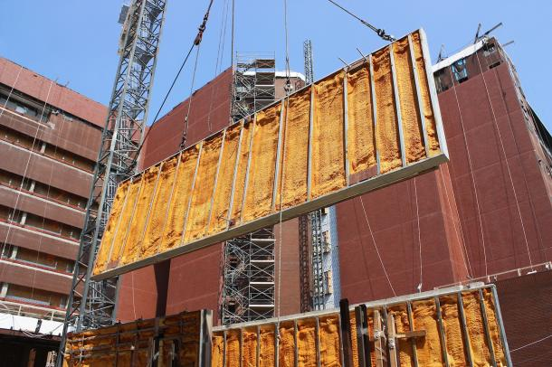
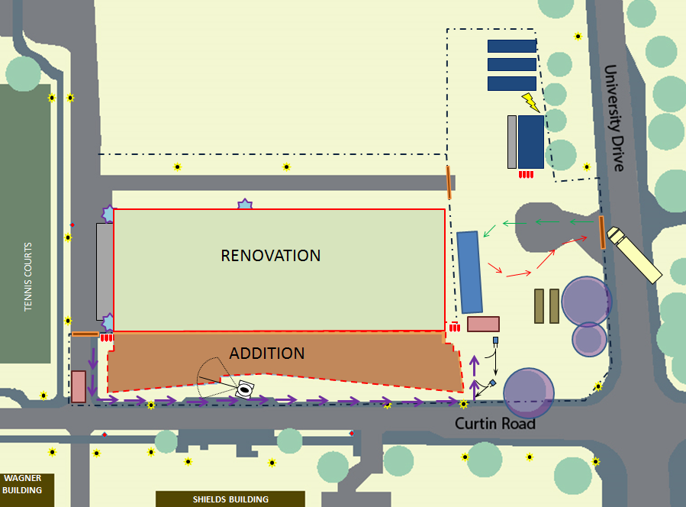
Project Summary
Analysis #1: Prefabrication of Building Enclosure
Proposed Brick Façade vs Current System
Results
Mechanical Breadth
Proposed Curtain Wall vs Current
Results
Analysis #3: Integrated Project Delivery Implementation
Proposed System vs Current
Advantages / Disadvantages
Takeaways
Analysis #4: Occupied vs Vacant Renovations
Proposed System vs Current
Construction Noise & Vibration vs Productivity
Construction Standards
Recommendations
Acknowledgements
System Cost Comparison
 | Unit | Quantity | Cost/Unit | Total
Panel System | SF | 6,930.00 | 43.5 | $301,455.00
Current System | SF | 7,090.00 | 52.6 | $372,934.00
 |  |  | Difference | $71,479.00
Total Savings
SlenderWall Savings | $71,479.00
Crane Usage | ($17,289.00)
Removal of Scaffold | $19,363.00
Removal of Hoist | $2,060.00
 | $75,613.00
Additional Costs Benefits/Implements
Scaffolding | CSF | 148.8 | $ 130.13 | $ 19,363.34
Crane | Mo | -1.0 | $ 17,289.00 | $ (17,289.00)
Material Hoist | Ea. | 1.0 | $ 2,060.00 | $ 2,060.00
 |  |  | Difference | $ 4,134.34
Appendix
Gonzalo Lay Intramural Building Project
Construction Management

Slide 37
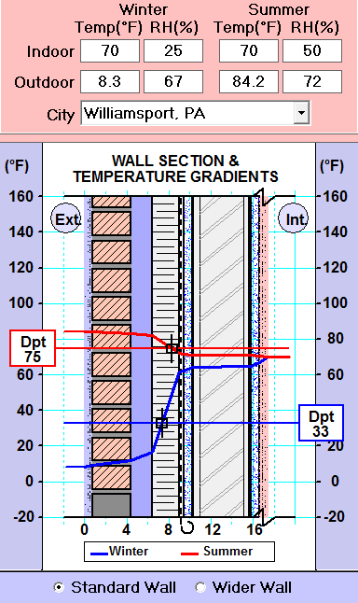
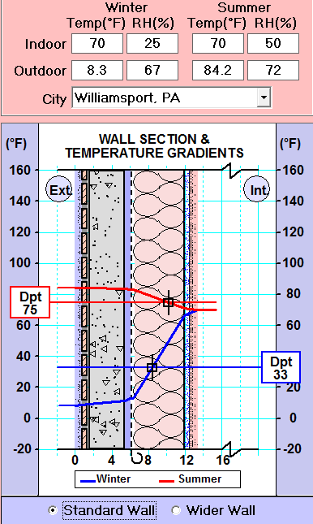
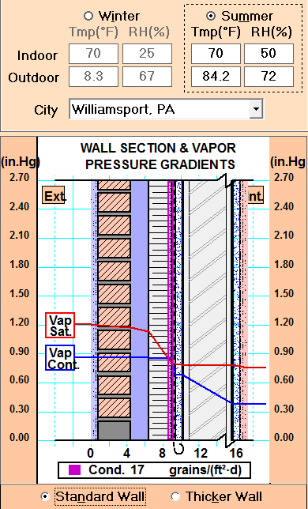
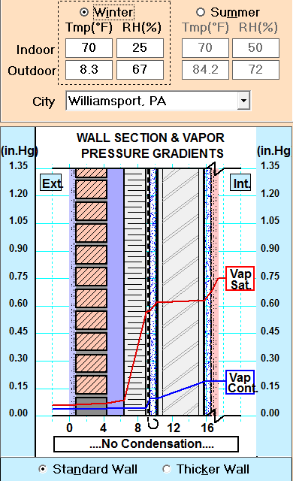
Project Summary
Analysis #1: Prefabrication of Building Enclosure
Proposed Brick Façade vs Current System
Results
Mechanical Breadth
Proposed Curtain Wall vs Current
Results
Analysis #3: Integrated Project Delivery Implementation
Proposed System vs Current
Advantages / Disadvantages
Takeaways
Analysis #4: Occupied vs Vacant Renovations
Proposed System vs Current
Construction Noise & Vibration vs Productivity
Construction Standards
Recommendations
Acknowledgements
Existing System
Component | Thickness (in) | Unit R-Value | Unit | Total R-Value
Inside Air Layer | N/A | 0.68 | Ea. | 0.68
Gypsum Board | 0.625 | 0.56 | Ea. | 0.56
Metal Stud | 6.00 | 0.98 | Ea. | 0.98
1.5 Spray Ins | 1.50 | 5.75 | In. | 8.625
Sheathing | 0.625 | 0.56 | Ea. | 0.56
Rigid Insulation | 2.50 | 12.00 | Ea. | 12.00
Air Cavity | 2.00 | 1.68 | In. | 3.36
Brick | 3.625 | 0.40 | Ea. | 0.40
Exterior Air Layer | N/A | 0.17 | Ea. | 0.17
Total Thickness | 15.375 | R-Value | hr.-SF-F/BTU | 27.335
 |  | U-Value | BTU/hr.-SF-F | 0.0365
Proposed System
Component | Thickness (in) | Unit R-Value | Unit | Total R-Value
Inside Air Layer | N/A | 0.68 | Ea. | 0.68
Gypsum Board | 0.50 | 0.56 | Ea. | 0.56
Vapor Barrier | N/A | 0.12 | Ea. | 0.12
Batt. Insulation | 6.00 | 21.00 | Ea. | 21.00
Air Gap | 0.50 | 1.68 | In. | 1.68
Precast Concrete | 2.00 | 2.80 | In. | 2.80
Brick veneer | 0.50 | 0.15 | In. | 0.08
Exterior Air Layer | N/A | 0.17 | Ea. | 0.17
Total Thickness | 9.50 | R-Value | hr.-SF-F/BTU | 27.09
 |  | U-Value | BTU/hr.-SF-F | 0.0369
Heat Transfer
Summer
 | R-Value | Change in Temp | Area | Heat Transfer
 | ∑ R | Δ T | SF | Btu/Hr.
Current | 27.335 | 14.2 | 6,930.00 | 3,600.00
Proposed | 27.09 | 14.2 | 6,930.00 | 3,632.56
 |  |  | Difference | (32.56)
Winter
Current | 27.335 | 61.7 | 6,930.00 | 15,642.25
Proposed | 27.09 | 61.7 | 6,930.00 | 15,783.72
 |  |  | Difference | (141.47)
Appendix
Gonzalo Lay Intramural Building Project
Construction Management

Slide 38
Project Summary
Analysis #1: Prefabrication of Building Enclosure
Proposed Brick Façade vs Current System
Results
Mechanical Breadth
Proposed Curtain Wall vs Current
Results
Analysis #3: Integrated Project Delivery Implementation
Proposed System vs Current
Advantages / Disadvantages
Takeaways
Analysis #4: Occupied vs Vacant Renovations
Proposed System vs Current
Construction Noise & Vibration vs Productivity
Construction Standards
Recommendations
Acknowledgements
Elevation | Length of Glazing (ft.) | Avg. Glass Width (ft.) | SF of Glazing
South | 130.00 | 3 | 807.00
 | 150.00 | 3 | 1,105.00
 | 280.00 | 3 | 4,035.00
 | 12.00 | 3 | 173.00
East | 36.75 | 3 | 858.00
Atrium | 40.00 | 3 | 701.00
 | 15.00 | 3 | 342.00
 | 27.00 | 3 | 430.00
 | 20.00 | 3 | 212.00
 |  | Total | 8,663.00
Elevation | Size |  | SF | No. Panels | Total SF
 | Width | Height
South | 3 | 2.66 | 7.98 | 93 | 742.14
South | 6 | 2.66 | 15.96 | 1 | 15.96
East | 3 | 2.66 | 7.98 | 11 | 87.78
South | 3 | 7 | 21.00 | 141 | 2961.00
East | 3 | 7 | 21.00 | 11 | 231.00
South | 3 | 4.5 | 13.50 | 70 | 945.00
East | 3 | 4.5 | 13.50 | 11 | 148.50
South | 3 | 8.75 | 26.25 | 3 | 78.75
East | 3 | 8.75 | 26.25 | 11 | 288.75
Atrium | 3 | 9 | 27.00 | 15 | 405.00
Atrium | 3 | 8.75 | 26.25 | 15 | 393.75
Atrium | 3 | 2.66 | 7.98 | 15 | 119.70
Atrium | 3 | 4.5 | 13.50 | 30 | 405.00
Atrium | 3 | 3.66 | 10.98 | 6 | 65.88
South | 3.5 | 4.5 | 15.75 | 38 | 598.50
South | 3.5 | 2.66 | 9.31 | 10 | 93.10
 |  |  | Total | 481 | 7703.00
Elevation | Size |  | SF | No. Panels | Total SF
 | Width | Height
South | 3.00 | 14.25 | 42.75 | 70 | 2,992.50
South | 3.00 | 10.75 | 32.25 | 23 | 741.75
South | 3.00 | 9.00 | 27.00 | 3 | 81.00
South | 3.00 | 7.00 | 21.00 | 47 | 987.00
South | 3.50 | 7.00 | 24.50 | 10 | 245.00
South | 3.50 | 6.00 | 21.00 | 28 | 588.00
East | 3.00 | 14.25 | 42.75 | 11 | 470.25
East | 3.00 | 9.00 | 27.00 | 11 | 297.00
Atrium | 3.00 | 13.00 | 39.00 | 15 | 585.00
Atrium | 3.00 | 10.00 | 30.00 | 6 | 180.00
Atrium | 3.00 | 8.00 | 24.00 | 15 | 360.00
Atrium | 3.00 | 6.50 | 19.50 | 9 | 175.50
 |  |  | Total | 248 | 7,703.00
Elevation | Productivity panels/day | No. Panels | Duration
South | 15 | 140 | 9.33
South | 7 | 41 | 5.86
East | 15 | 22 | 1.47
Atrium | 15 | 30 | 2.00
Atrium | 7 | 15 | 2.14
 |  | Total | 20.80
Item | Quantity | Unit | Unit Total | Total
Stick Built System | 8,663.00 | SF | $ 110.00 | $ 952,930.00
Subtotal |  |  |  | $ 952,930.00
Unitized System | 8,663.00 | SF | $ 132.00 | $ 1,143,516.00
Subtotal |  |  |  | $ 1,143,516.00
Difference |  |  |  | $ (190,586.00)
Appendix
Gonzalo Lay Intramural Building Project
Construction Management

