Slide 1
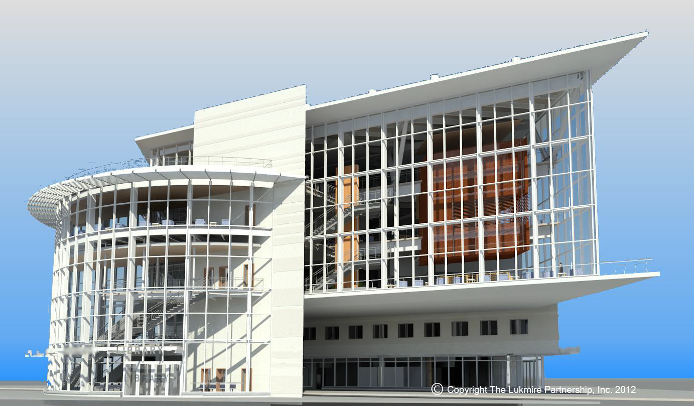
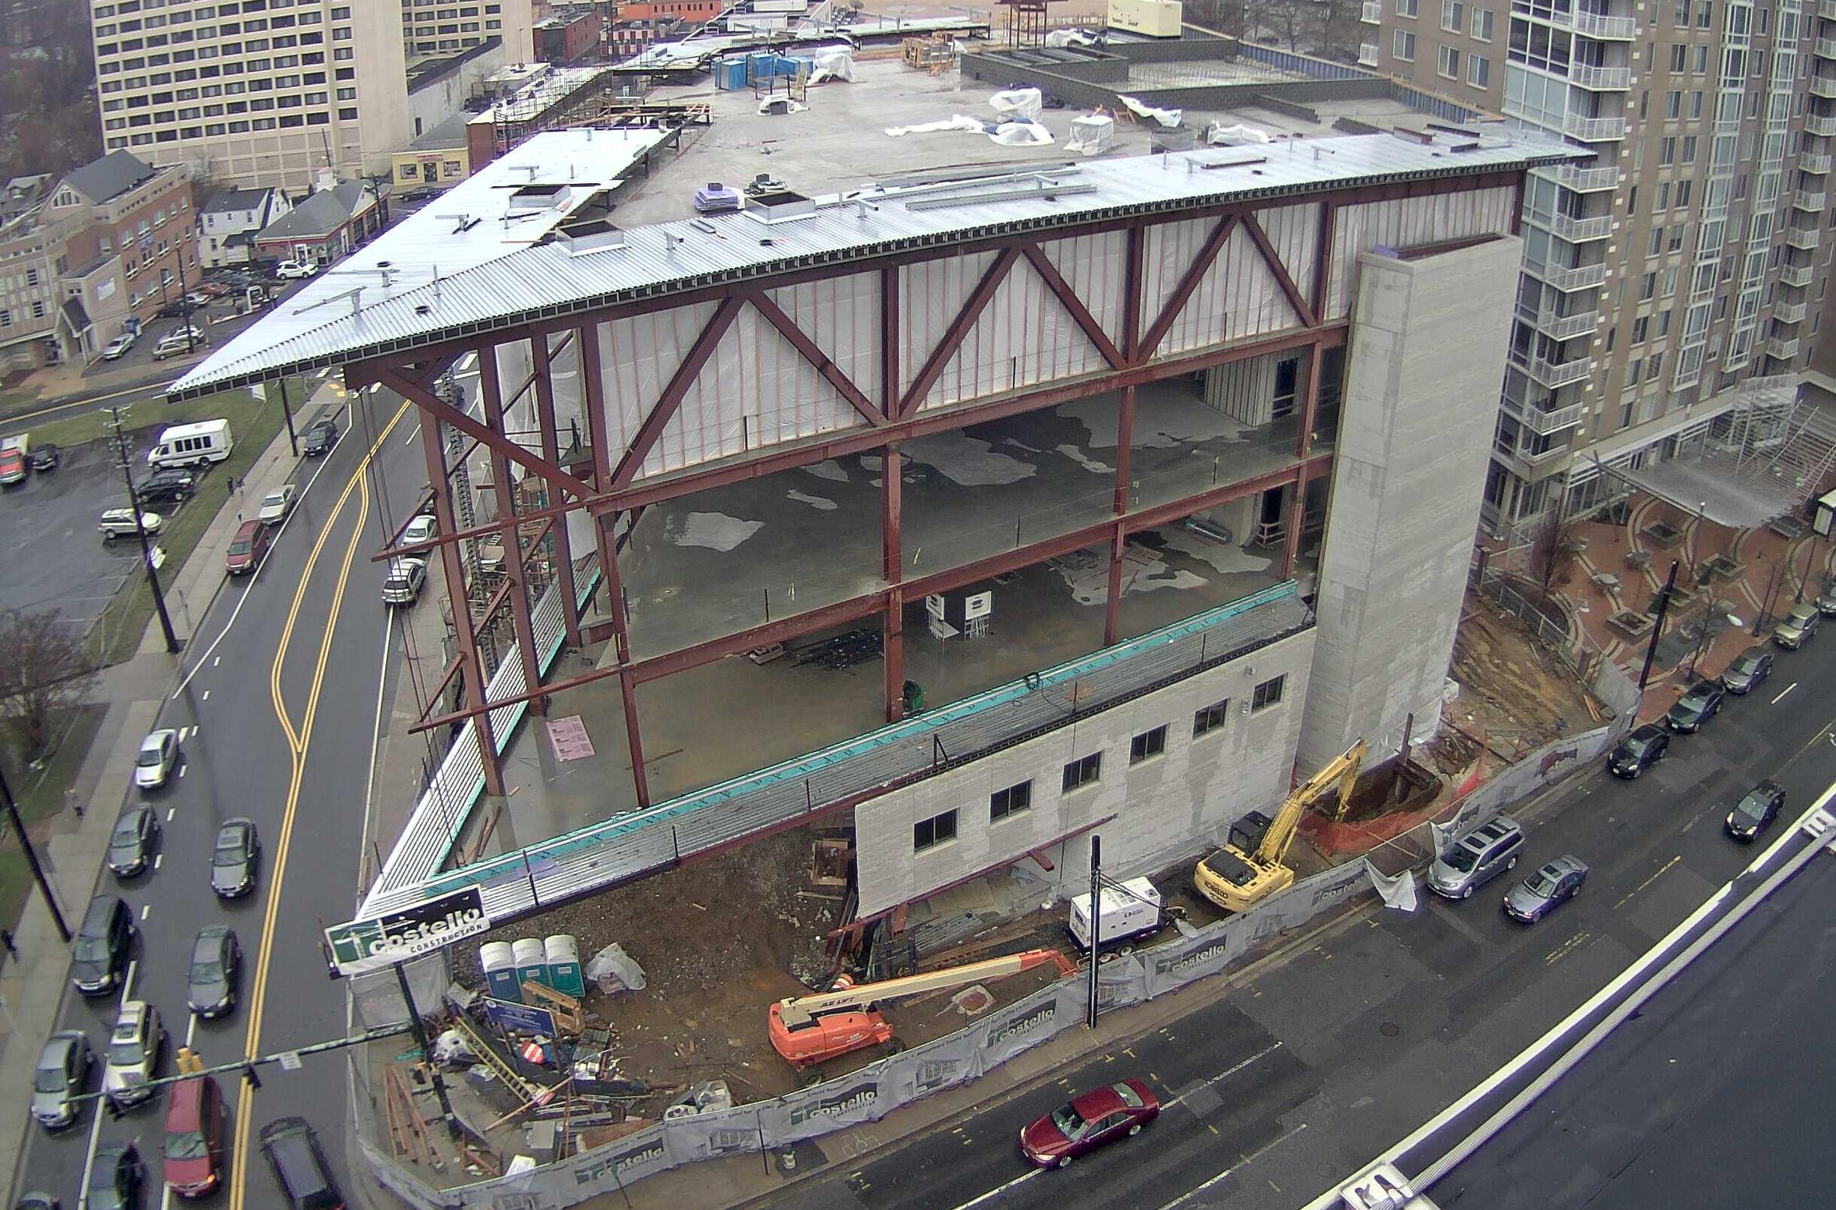
1
Library In Metropolitan Washington, D.C.
Penn State Architectural Engineering Senior Capstone Project
Lowell Stine | Construction | Rob Leicht
Picture Provided by Multivista

Slide 2
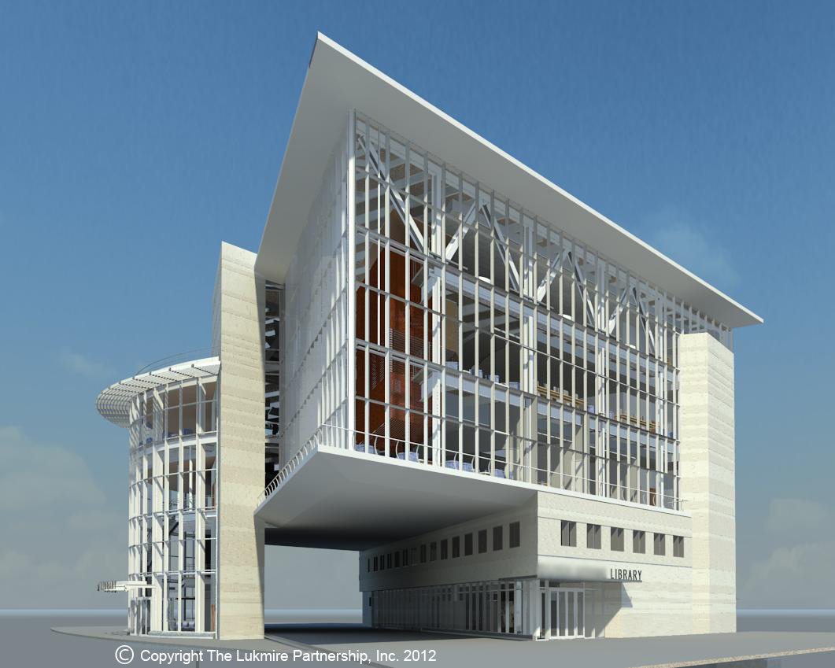
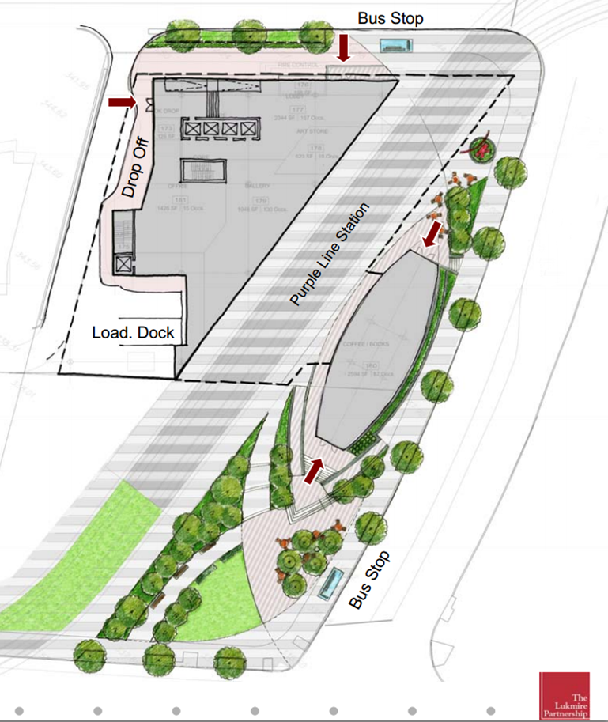
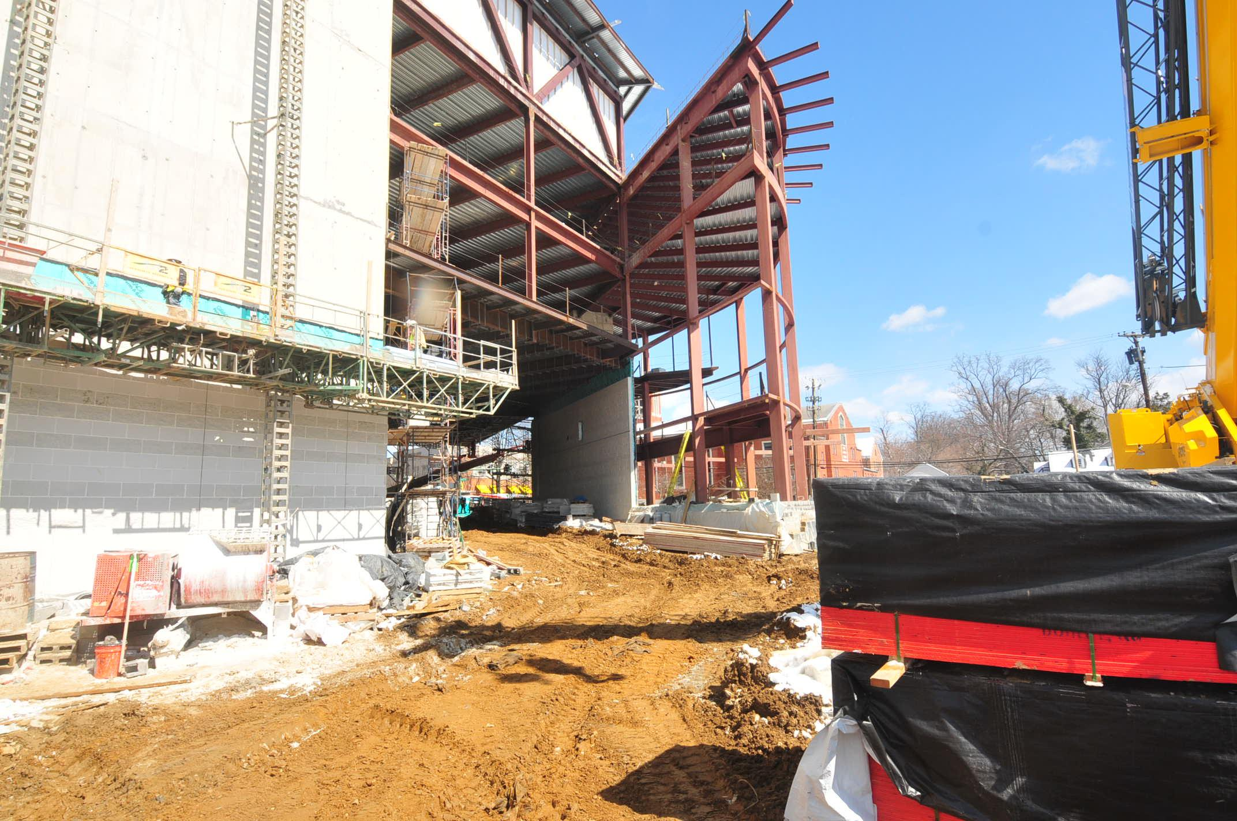
Project Introduction
2
Library In Metropolitan Washington, D.C.
Lowell Stine | Construction
Outline
  Project Introduction
  Early Involvement
  Caisson Rebar Cage Prefab Structural Sequencing
  Structural Breadth
  Mechanical Room
  Acoustical Breadth
  Summary of Conclusions
  Acknowledgments
Picture Provided by Multivista

Slide 3
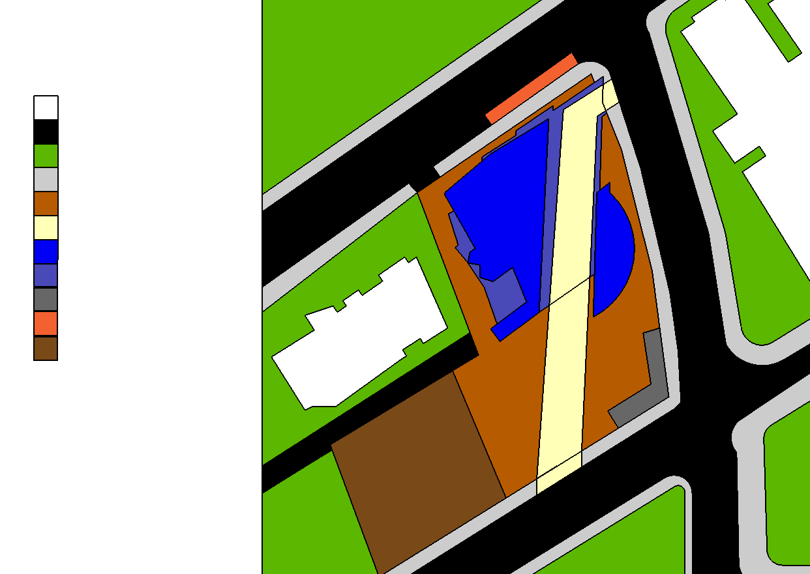
Project Introduction
3
Library In Metropolitan Washington, D.C.
Lowell Stine | Construction
Outline
  Project Introduction
  Early Involvement
  Caisson Rebar Cage Prefab Structural Sequencing
  Structural Breadth
  Mechanical Room
  Acoustical Breadth
  Summary of Conclusions
  Acknowledgments
Project Team
Building Name: Library in Metropolitan Washington, D.C.
Location: Metropolitan Washington, D.C. (Undisclosed)
Occupant: County Library & Non-profit Art Group
Function Types: A-3 (Assembly)
B (Business)
M (Mercantile)
Gross Area: 90,000 ft²
Number of Stories: Five Plus Basement
Project Delivery: Design-Bid-Build
Construction Dates: January 2013 – October 2014
Project Cost: $69.5 Million
Key
Existing Buildings
Roads
Open Space
Sidewalks
Construction Site
Access Road
Building Footprint
Building Overhang
Site Trailers
Unloading Area
Future Apt. Site
Existing
Building
5 Story
60’
Owner: Undisclosed County | Construction Manager: MBP | Civil Engineer: ADTEK
Architect: The Lukmire Partnership | Mechanical & Plumbing Engineer: Mendoza, Ribas, Farinas & Associates | Landscape Architect: Parker Rodriguez
Contractor: Costello Construction | Electrical Engineer: Mendoza, Ribas, Farinas & Associates | Interior Design: The Studio of Sandra Ragan
Structural Engineer: Columbia Engineering | IT/Security: Wright Engineering | Lighting Consultant: MCLA
New Building
5 Story
85’
Existing Building
10 Story
100’

Slide 4
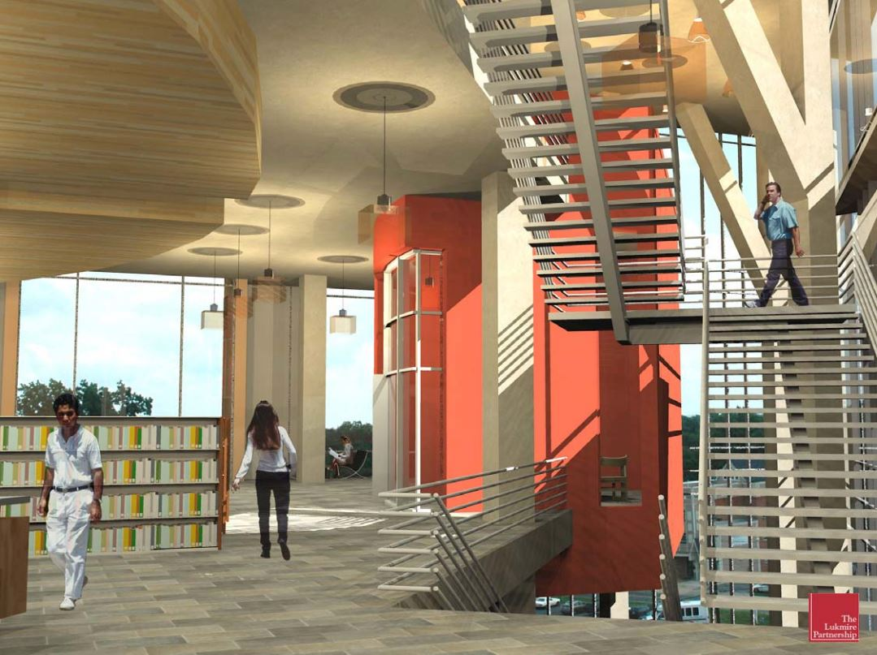
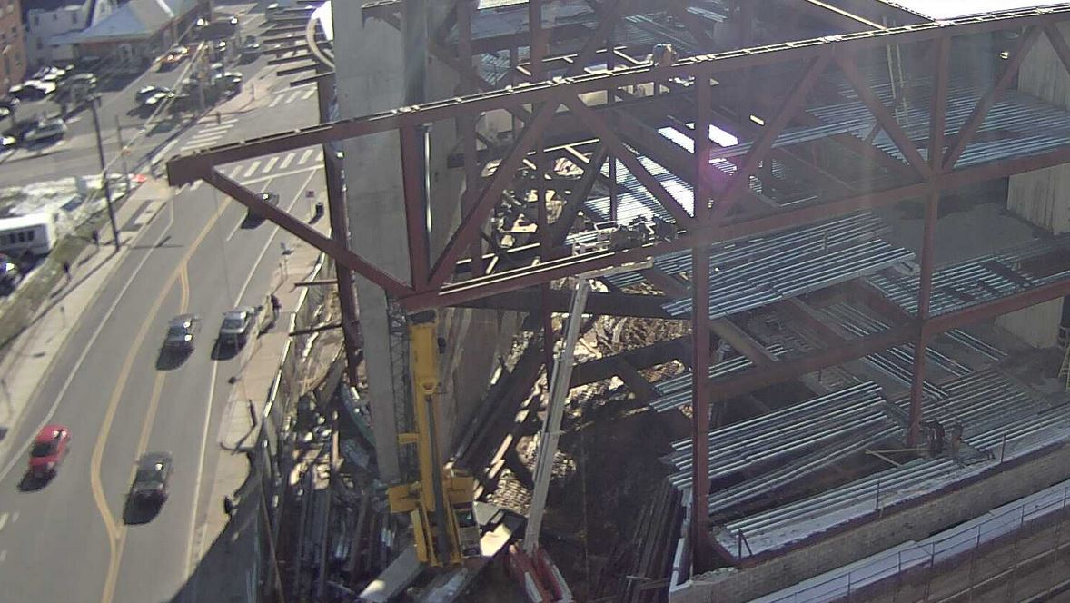
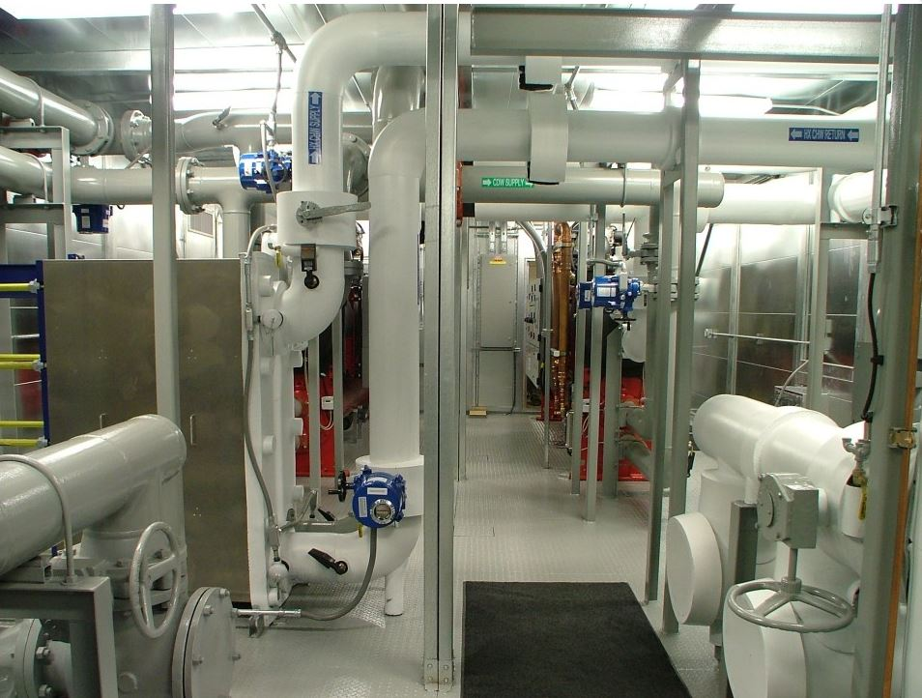
Project Introduction
4
Library In Metropolitan Washington, D.C.
Lowell Stine | Construction
Outline
  Project Introduction
  Early Involvement
  Caisson Rebar Cage Prefab Structural Sequencing
  Structural Breadth
  Mechanical Room
  Acoustical Breadth
  Summary of Conclusions
  Acknowledgments
Systems
Architectural:
50’ Cantilever of 3rd thru 5th Floors
Exposed Structure in Library Space
Structure:
Concrete Caissons
Structural Steel
Composite Slabs
Building Enclosure:
53% Curtain Wall – UV Protection
Terra Cotta Panels
Architectural CMU’s
Mechanical:
IPEC (Integrated Packages Equipment Center)
Hydronic In-Slab Heating
New Building
5 Story
85’
Picture Courtesy of The Lukmire Partnership, Inc.
Picture Provided by Multivista
Picture Provided by http://www.systecon.com

Slide 5
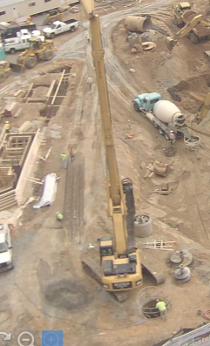
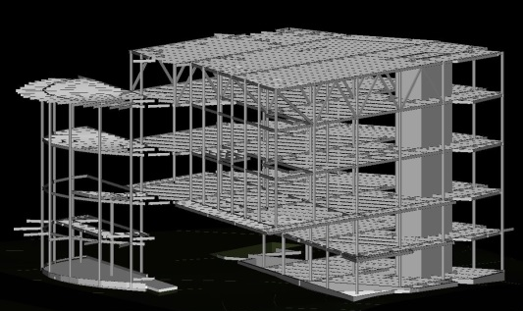
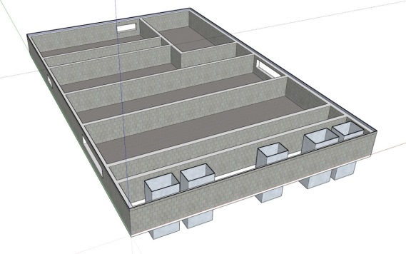
Analysis Overview
5
Library In Metropolitan Washington, D.C.
Lowell Stine | Construction
Outline
  Project Introduction
  Early Involvement
  Caisson Rebar Cage Prefab Structural Sequencing
  Structural Breadth
  Mechanical Room
  Acoustical Breadth
  Summary of Conclusions
  Acknowledgments
Measurable Success
1) Minimize costs and schedule delays from change orders and rework
2) Minimize wasted material and labor costs and limit schedule delays
3) Shorten structural erection durations
4) Cost effectiveness and fewer constructability challenges
Early Involvement in Design Research Analysis
Caisson Rebar Cage Fabrication Analysis
Structural Sequencing Analysis
Structural Breadth
Mechanical Penthouse vs. IPEC Analysis
Acoustical Breadth
Design
Foundation
Structure
Building Systems
Programming
Design
Procurement
Construction

Slide 6
6
Library In Metropolitan Washington, D.C.
Lowell Stine | Construction
Outline
  Project Introduction
  Early Involvement
  Caisson Rebar Cage Prefab Structural Sequencing
  Structural Breadth
  Mechanical Room
  Acoustical Breadth
  Summary of Conclusions
  Acknowledgments
Early Involvement in Design Research Analysis

Slide 7
Early Involvement in Design Research Analysis
7
Library In Metropolitan Washington, D.C.
Lowell Stine | Construction
Outline
  Project Introduction
  Early Involvement
  Caisson Rebar Cage Prefab Structural Sequencing
  Structural Breadth
  Mechanical Room
  Acoustical Breadth
  Summary of Conclusions
  Acknowledgments
Goal
Considerations / Requirements
Specifics of this Project
Typical Problem Areas

Slide 8
Early Involvement in Design Research Analysis
7
Library In Metropolitan Washington, D.C.
Lowell Stine | Construction
Outline
  Project Introduction
  Early Involvement
  Caisson Rebar Cage Prefab Structural Sequencing
  Structural Breadth
  Mechanical Room
  Acoustical Breadth
  Summary of Conclusions
  Acknowledgments
Goal
Considerations / Requirements
Specifics of this Project
Typical Problem Areas
Industry Member Interviews
Scopes
Benefits
Owner Buy-in
Future
Similar Topics
# | Criteria | Consistency
1 | Owner Buy-in | 5 of 5
2 | Cost Considerations | 5 of 5
3 | Scope Included | 5 of 5
4 | Relationship Outcomes | 4 of 5
5 | Quality & Project Flow | 4 of 5
6 | Schedule Considerations | 4 of 5
7 | Contract Considerations | 3 of 5
8 | Owner Involvement | 3 of 5
9 | Future of Early Involvement | 3 of 5

Slide 9
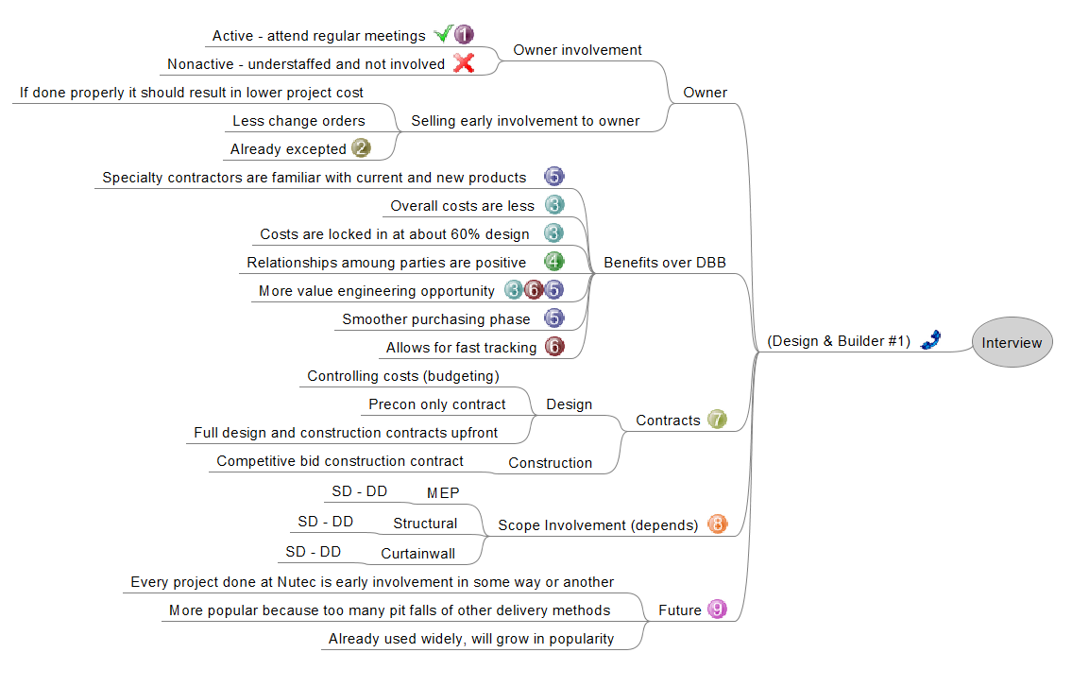
Early Involvement in Design Research Analysis
7
Library In Metropolitan Washington, D.C.
Lowell Stine | Construction
Outline
  Project Introduction
  Early Involvement
  Caisson Rebar Cage Prefab Structural Sequencing
  Structural Breadth
  Mechanical Room
  Acoustical Breadth
  Summary of Conclusions
  Acknowledgments
Mind Maps
Goal
Considerations / Requirements
Specifics of this Project
Typical Problem Areas
Industry Member Interviews
Scopes
Benefits
Owner Buy-in
Future
Mind Maps
Show Topics
Trace Patterns
Similar Topics
# | Criteria | Consistency
1 | Owner Buy-in | 5 of 5
2 | Cost Considerations | 5 of 5
3 | Scope Included | 5 of 5
4 | Relationship Outcomes | 4 of 5
5 | Quality & Project Flow | 4 of 5
6 | Schedule Considerations | 4 of 5
7 | Contract Considerations | 3 of 5
8 | Owner Involvement | 3 of 5
9 | Future of Early Involvement | 3 of 5

Slide 10
Early Involvement in Design Research Analysis
8
Library In Metropolitan Washington, D.C.
Lowell Stine | Construction
Outline
  Project Introduction
  Early Involvement
  Caisson Rebar Cage Prefab Structural Sequencing
  Structural Breadth
  Mechanical Room
  Acoustical Breadth
  Summary of Conclusions
  Acknowledgments
Overall Conclusions
Smooth Transition Between Phases
Early Cost Influence
Process Flow
Influence of Cost Curve
Programming
High
Programming
Design
Design
Ability to Influence Costs
Procurement
Procurement
Construction
Low
Close-out
Construction
Conception
Completion
Project Duration

Slide 11
Early Involvement in Design Research Analysis
9
Library In Metropolitan Washington, D.C.
Lowell Stine | Construction
Outline
  Project Introduction
  Early Involvement
  Caisson Rebar Cage Prefab Structural Sequencing
  Structural Breadth
  Mechanical Room
  Acoustical Breadth
  Summary of Conclusions
  Acknowledgments
Scope Inclusion Areas
Scopes | Program | Conceptual | Schematic Design | Design Development | Construction Documents | Construction
Contractor | Start-up | Scope Selection & Sign Contract | Sub Selection & Design Input | Sub Selection & Design Input | Design Input & Long Lead Items | Management
MEP | - | Planning, Questions & Sign Contract | Consult w/ Subs | Design Input | Design Input & Long Lead Items | Procurement
Structural | - | - | - | Consult w/ Subs, Design Input & Sign Contract | Design Input & Long Lead Items | Procurement
Curtain Wall | - | - | Consult w/ Subs & Sign Contract | Design Input | Design Input & Long Lead Items | Procurement
Results
Earlier Involvement is Beneficial
Less Change Orders
Cost Savings
Funding Issues
Scope Selection (Project Specific)
Rating Scale
 | Owner | CM | Contractor | Design Team
Funding | X | - | - | -
Resources Available | ✓ | ✓ | ✓ | ✓
Experience | ✓ | ✓ | X | ✓

Slide 12
10
Library In Metropolitan Washington, D.C.
Lowell Stine | Construction
Outline
  Project Introduction
  Early Involvement
  Caisson Rebar Cage Prefab Structural Sequencing
  Structural Breadth
  Mechanical Room
  Acoustical Breadth
  Summary of Conclusions
  Acknowledgments
Caisson Rebar Cage Fabrication
Analysis

Slide 13

Caisson Rebar Cage Fabrication Analysis
11
Library In Metropolitan Washington, D.C.
Lowell Stine | Construction
Outline
  Project Introduction
  Early Involvement
  Caisson Rebar Cage Prefab Structural Sequencing
  Structural Breadth
  Mechanical Room
  Acoustical Breadth
  Summary of Conclusions
  Acknowledgments
Goal
Determine Appropriate Fabrication Method
Cost Savings
Scheduled Reduction
Picture Provided by Multivista

Slide 14
Caisson Rebar Cage Fabrication Analysis
11
Library In Metropolitan Washington, D.C.
Lowell Stine | Construction
Outline
  Project Introduction
  Early Involvement
  Caisson Rebar Cage Prefab Structural Sequencing
  Structural Breadth
  Mechanical Room
  Acoustical Breadth
  Summary of Conclusions
  Acknowledgments
Goal
Determine Appropriate Fabrication Method
Cost Savings
Scheduled Reduction
Background
9 Caisson Types (48 Total)
Prefab to Planned Length
Planned Lengths Incorrect
15 Day Delay
Caisson Types
Type | Vertical Rebar # | Qty. of Vertical Rebar | Tie # | # of Ties per LF | Weight of Vertical Rebar (lb/LF) | Weight of Ties (lb/LF)
1a | 9 | 8 | 4 | 1 | 27 | 6
1b | 9 | 6 | 4 | 1 | 20 | 6
2a | 11 | 8 | 4 | 1 | 43 | 9
2b | 11 | 12 | 4 | 1 | 64 | 11
2c | 11 | 16 | 4 | 1 | 85 | 13
2d | 11 | 24 | 4 | 1 | 128 | 15
2e | 11 | 28 | 5 | 1 | 149 | 21
2f | 11 | 16 | 4 | 2 | 85 | 27
2g | 11 | 28 | 5 | 2 | 149 | 41
Picture Provided by Multivista

Slide 15
Caisson Rebar Cage Fabrication Analysis
11
Library In Metropolitan Washington, D.C.
Lowell Stine | Construction
Outline
  Project Introduction
  Early Involvement
  Caisson Rebar Cage Prefab Structural Sequencing
  Structural Breadth
  Mechanical Room
  Acoustical Breadth
  Summary of Conclusions
  Acknowledgments
Goal
Determine Appropriate Fabrication Method
Cost Savings
Scheduled Reduction
Background
9 Caisson Types (48 Total)
Prefab to Planned Length
Planned Lengths Incorrect
15 Day Delay
Fabrication Methods
100% Planned
Planed + 10%
80% of Planned
10’ Sections
15’ Sections
Caisson Types
Type | Vertical Rebar # | Qty. of Vertical Rebar | Tie # | # of Ties per LF | Weight of Vertical Rebar (lb/LF) | Weight of Ties (lb/LF)
1a | 9 | 8 | 4 | 1 | 27 | 6
1b | 9 | 6 | 4 | 1 | 20 | 6
2a | 11 | 8 | 4 | 1 | 43 | 9
2b | 11 | 12 | 4 | 1 | 64 | 11
2c | 11 | 16 | 4 | 1 | 85 | 13
2d | 11 | 24 | 4 | 1 | 128 | 15
2e | 11 | 28 | 5 | 1 | 149 | 21
2f | 11 | 16 | 4 | 2 | 85 | 27
2g | 11 | 28 | 5 | 2 | 149 | 41
Picture Provided by Multivista

Slide 16
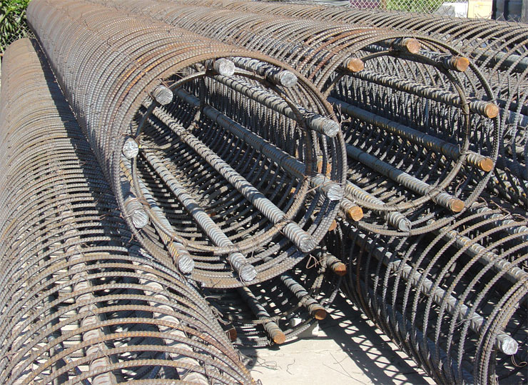
Caisson Rebar Cage Fabrication Analysis
12
Library In Metropolitan Washington, D.C.
Lowell Stine | Construction
Outline
  Project Introduction
  Early Involvement
  Caisson Rebar Cage Prefab Structural Sequencing
  Structural Breadth
  Mechanical Room
  Acoustical Breadth
  Summary of Conclusions
  Acknowledgments
Results
30’ Max Cage Length
Picture Provided by www.rebarsuply.net

Slide 17
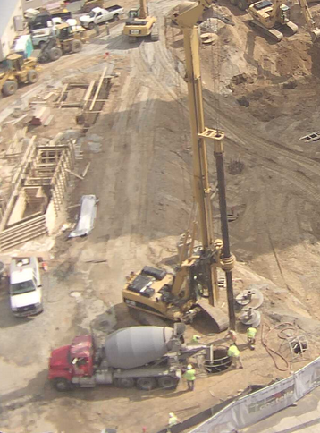
Caisson Rebar Cage Fabrication Analysis
12
Library In Metropolitan Washington, D.C.
Lowell Stine | Construction
Outline
  Project Introduction
  Early Involvement
  Caisson Rebar Cage Prefab Structural Sequencing
  Structural Breadth
  Mechanical Room
  Acoustical Breadth
  Summary of Conclusions
  Acknowledgments
Results
30’ Max Cage Length
Truck Crane Installation
Concrete Pump Placement
Picture Provided by Multivista
Picture Provided by www.rebarsuply.net

Slide 18
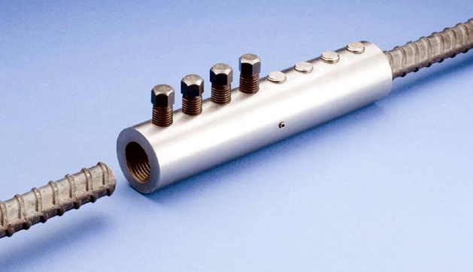
Caisson Rebar Cage Fabrication Analysis
12
Library In Metropolitan Washington, D.C.
Lowell Stine | Construction
Outline
  Project Introduction
  Early Involvement
  Caisson Rebar Cage Prefab Structural Sequencing
  Structural Breadth
  Mechanical Room
  Acoustical Breadth
  Summary of Conclusions
  Acknowledgments
Results
30’ Max Cage Length
Truck Crane Installation
Concrete Pump Placement
High Splice Costs
Cut-off Higher Productivity
Picture Provided by http://news.thomasnet.com/
Picture Provided by Multivista
Picture Provided by www.rebarsuply.net

Slide 19
Caisson Rebar Cage Fabrication Analysis
12
Library In Metropolitan Washington, D.C.
Lowell Stine | Construction
Outline
  Project Introduction
  Early Involvement
  Caisson Rebar Cage Prefab Structural Sequencing
  Structural Breadth
  Mechanical Room
  Acoustical Breadth
  Summary of Conclusions
  Acknowledgments
Prefabrication Option Comparison
Caisson Types | Base Line | Over 10% Prefab Estimation | Prefab 80% of Estimation | 10’ Length Sections | 15’ Length Sections
1a | $ 1,207.13 | $ 2,018.26 | $ 580.70 | $ 2,545.31 | $ 1, 040.01
1b | $ 1,756.59 | $ 2,059.49 | $ 993.63 | $ 579.61 | $ 285.71
2a | $ 2,313.82 | $ 2,827.37 | $ 1,856.53 | $ 3,661.62 | $ 1,512.15
2b | $ 1,845.69 | $ 2,300.02 | $ 937.03 | $ 2,177.57 | $ 260.10
2c | $ - | $ - | $ - | $ 2,022.40 | $ 1,011.20
2d | $ 1,516.80 | $ - | $ 1,516.80 | $ 3,033.60 | $ 1,516.80
2e | $ 12,484.19 | $12,139.79 | $ 13,377.24 | $ 33,762.24 | $ 15,289.27
2f | $ - | $ 243.22 | $ 3,024.00 | $ 3,725.88 | $ -
2g | $ 1,827.72 | $ 2,183.29 | $ 1,116.59 | $ - | $ 808.19
Grand Totals | $ 22,951.94 | $ 32,329.00 | $ 23,402.52 | $ 51,508.23 | $ 21,723.43
Results
30’ Max Cage Length
Truck Crane Installation
Concrete Pump Placement
High Splice Costs
Cut-off Higher Productivity
Use 100% Prefabricated Method
Accept Unknowns
Picture Provided by http://news.thomasnet.com/
Picture Provided by Multivista
Picture Provided by www.rebarsuply.net

Slide 20
13
Library In Metropolitan Washington, D.C.
Lowell Stine | Construction
Outline
  Project Introduction
  Early Involvement
  Caisson Rebar Cage Prefab Structural Sequencing
  Structural Breadth
  Mechanical Room
  Acoustical Breadth
  Summary of Conclusions
  Acknowledgments
Structural Sequencing
Analysis

Slide 21
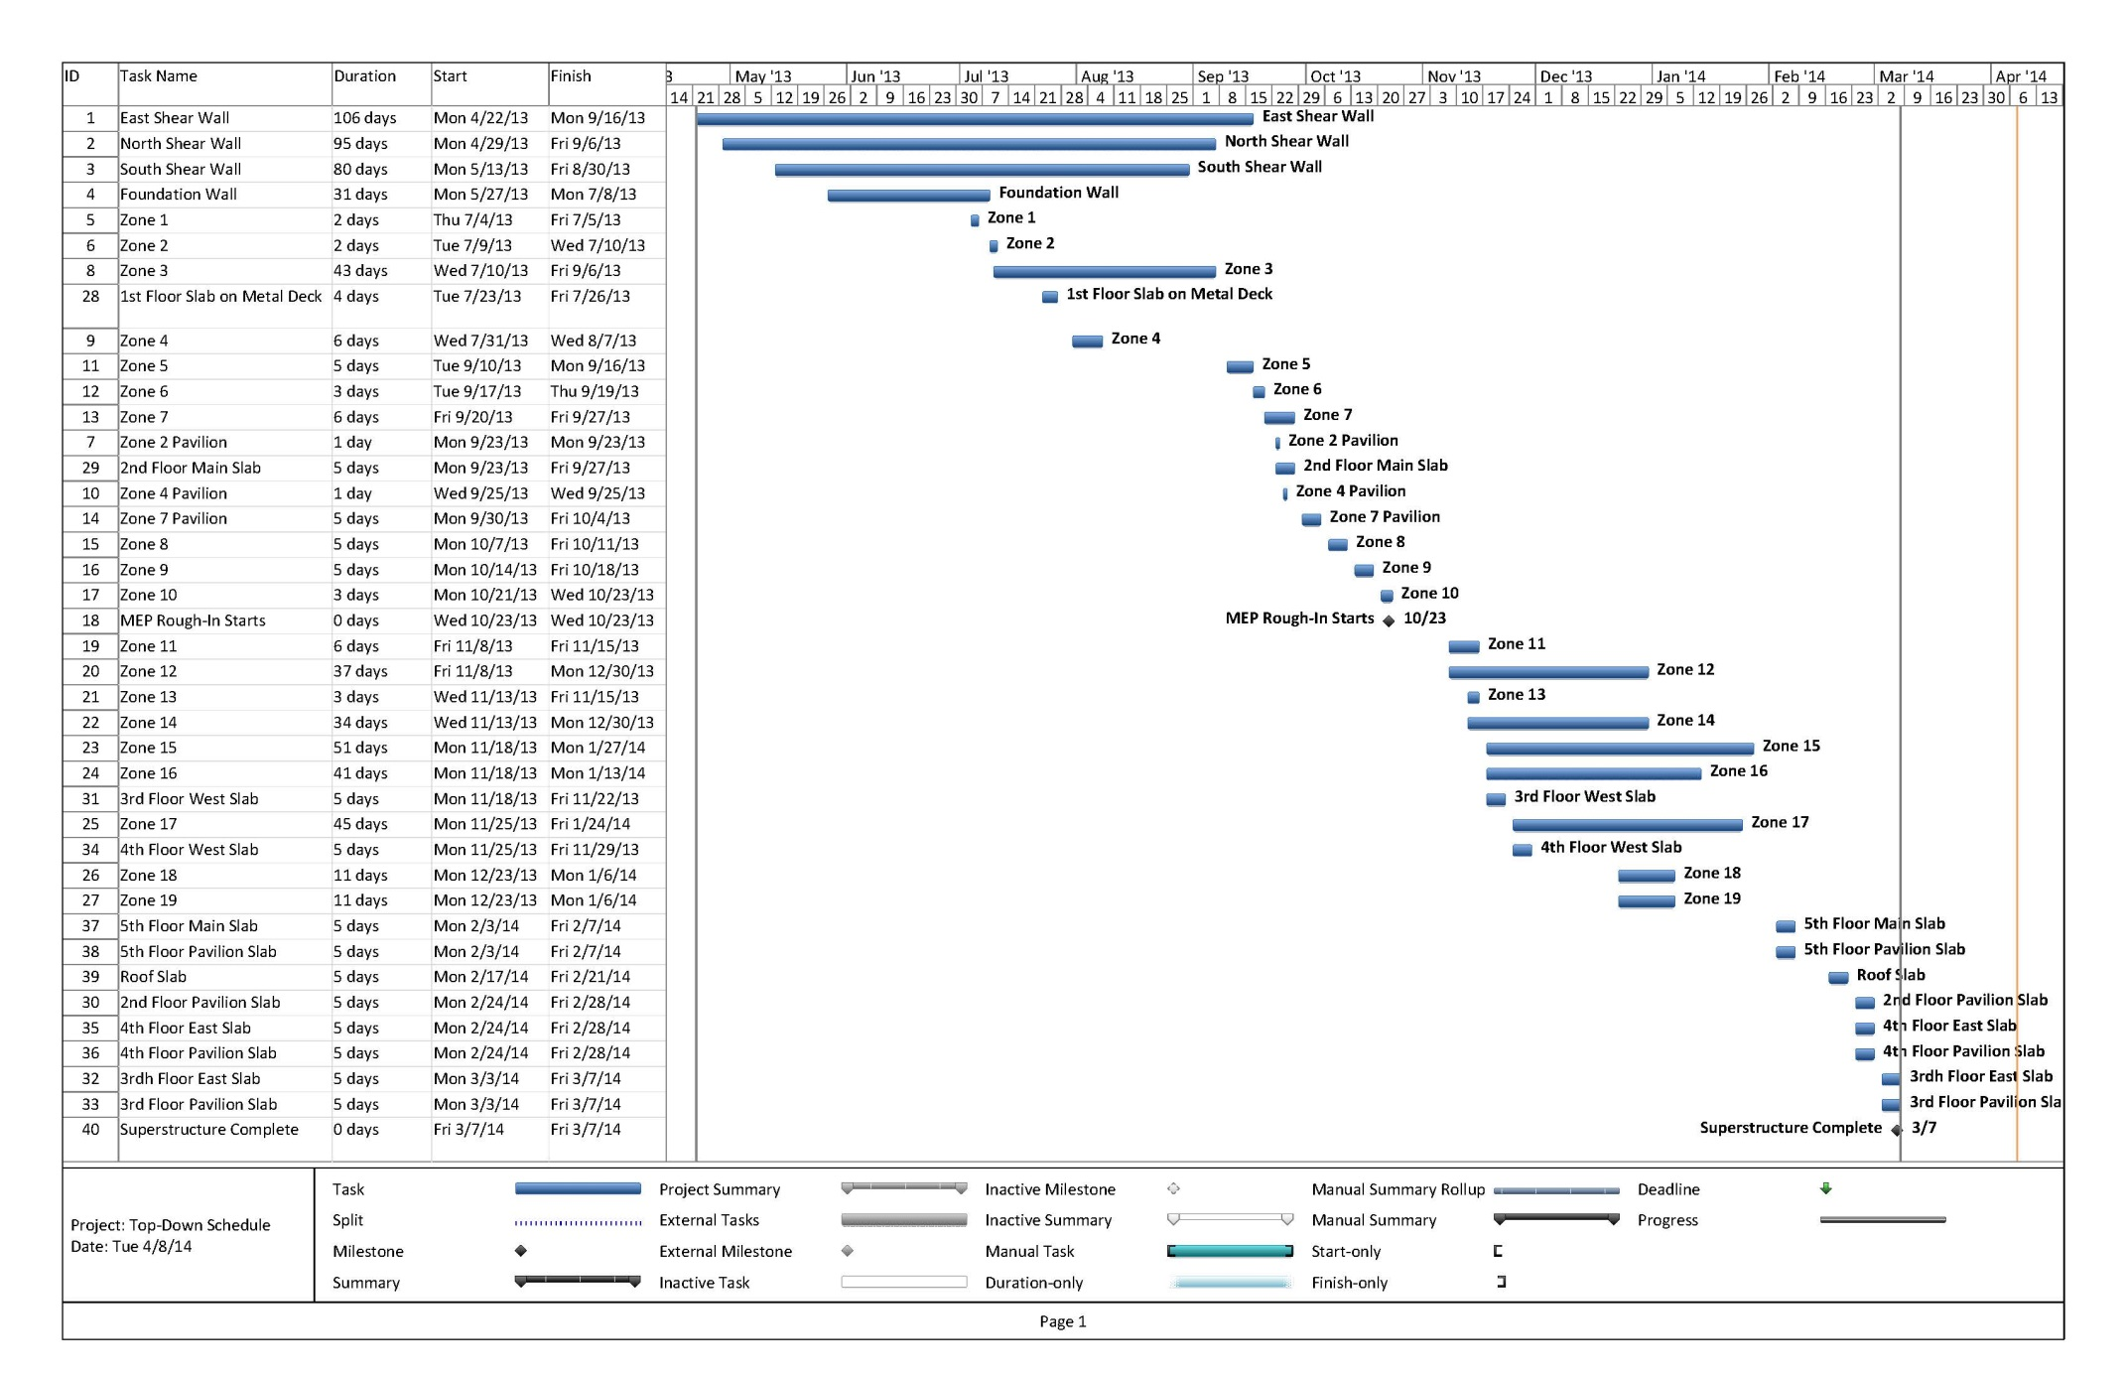
Structural Sequencing Analysis
14
Library In Metropolitan Washington, D.C.
Lowell Stine | Construction
Outline
  Project Introduction
  Early Involvement
  Caisson Rebar Cage Prefab Structural Sequencing
  Structural Breadth
  Mechanical Room
  Acoustical Breadth
  Summary of Conclusions
  Acknowledgments
Goal
Reevaluate Structural Sequence
Save Erection Costs
Shorten Erection Schedule

Slide 22



Structural Sequencing Analysis
14
Library In Metropolitan Washington, D.C.
Lowell Stine | Construction
Outline
  Project Introduction
  Early Involvement
  Caisson Rebar Cage Prefab Structural Sequencing
  Structural Breadth
  Mechanical Room
  Acoustical Breadth
  Summary of Conclusions
  Acknowledgments
Goal
Reevaluate Structural Sequence
Save Erection Costs
Shorten Erection Schedule
Background Information
Current Erection
Complex Erection Sequence
5 Week Delay

Slide 23
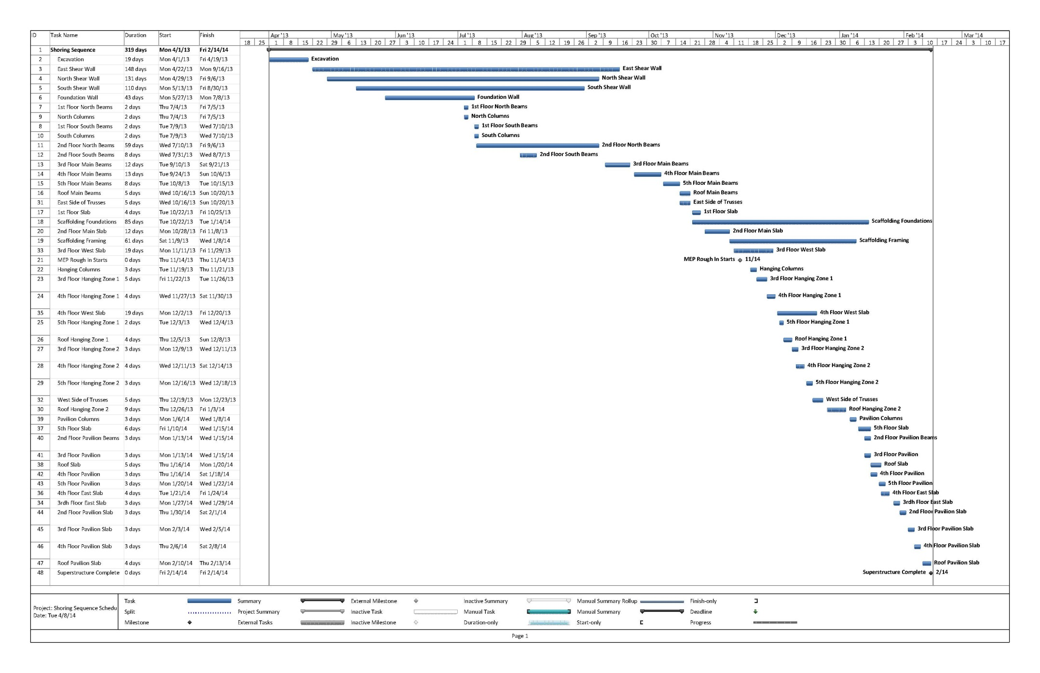
Structural Sequencing Analysis
15
Library In Metropolitan Washington, D.C.
Lowell Stine | Construction
Outline
  Project Introduction
  Early Involvement
  Caisson Rebar Cage Prefab Structural Sequencing
  Structural Breadth
  Mechanical Room
  Acoustical Breadth
  Summary of Conclusions
  Acknowledgments
Shoring Sequence
Linear

Slide 24
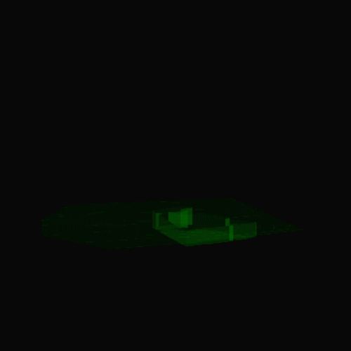
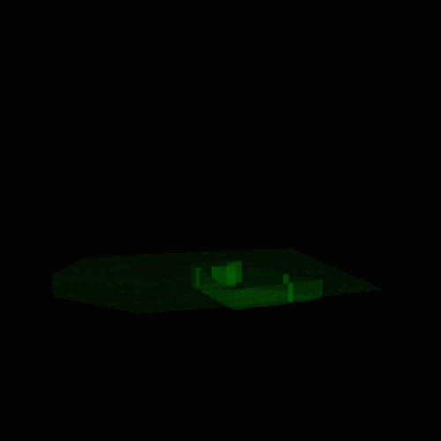
Structural Sequencing Analysis
15
Library In Metropolitan Washington, D.C.
Lowell Stine | Construction
Outline
  Project Introduction
  Early Involvement
  Caisson Rebar Cage Prefab Structural Sequencing
  Structural Breadth
  Mechanical Room
  Acoustical Breadth
  Summary of Conclusions
  Acknowledgments
Shoring Sequence
Linear
4-D Comparisons
Slabs After Shoring
Hanger Resizing?
4
1
3
5
2

Slide 25
Structural Sequencing Analysis
16
Library In Metropolitan Washington, D.C.
Lowell Stine | Construction
Outline
  Project Introduction
  Early Involvement
  Caisson Rebar Cage Prefab Structural Sequencing
  Structural Breadth
  Mechanical Room
  Acoustical Breadth
  Summary of Conclusions
  Acknowledgments
Complexity of Erection
Complex structure
Inconsistent erection sequence

Slide 26
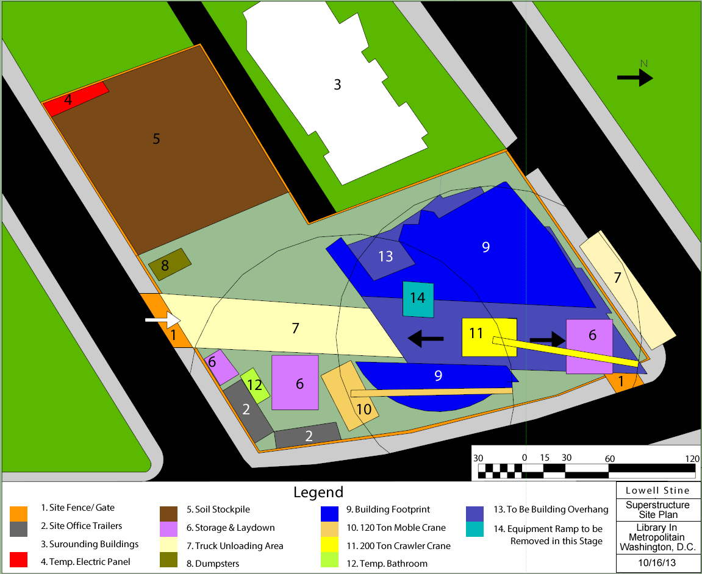
Structural Sequencing Analysis
16
Library In Metropolitan Washington, D.C.
Lowell Stine | Construction
Outline
  Project Introduction
  Early Involvement
  Caisson Rebar Cage Prefab Structural Sequencing
  Structural Breadth
  Mechanical Room
  Acoustical Breadth
  Summary of Conclusions
  Acknowledgments
Complexity of Erection
Complex structure
Inconsistent erection sequence
Site
Very urban site
Shoring will occupy large area
Tight delivery scheduling

Slide 27
Structural Sequencing Analysis
16
Library In Metropolitan Washington, D.C.
Lowell Stine | Construction
Outline
  Project Introduction
  Early Involvement
  Caisson Rebar Cage Prefab Structural Sequencing
  Structural Breadth
  Mechanical Room
  Acoustical Breadth
  Summary of Conclusions
  Acknowledgments
Complexity of Erection
Complex structure
Inconsistent erection sequence
Site
Very urban site
Shoring will occupy large area
Tight delivery scheduling
Safety
High priority
Dangerous welding locations
OSHA compliance
Picture Provided by Multivista

Slide 28
Structural Sequencing Analysis
16
Library In Metropolitan Washington, D.C.
Lowell Stine | Construction
Outline
  Project Introduction
  Early Involvement
  Caisson Rebar Cage Prefab Structural Sequencing
  Structural Breadth
  Mechanical Room
  Acoustical Breadth
  Summary of Conclusions
  Acknowledgments
Complexity of Erection
Complex structure
Inconsistent erection sequence
Site
Very urban site
Shoring will occupy large area
Tight delivery scheduling
Safety
High priority
Dangerous welding locations
OSHA compliance
Trade Integration
Delay of MEP rough-in start-up
MEP Rough-in Start Dates
Description | Top-Down Option | Shoring Option
MEP Rough-in Start | 10/23/13 | 11/14/13
Picture Provided by Multivista

Slide 29

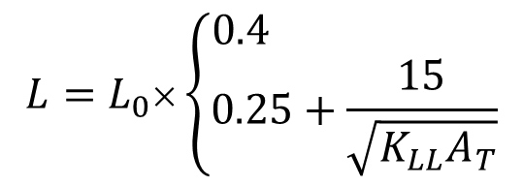
Structural Breadth - Shoring Design
17
Library In Metropolitan Washington, D.C.
Lowell Stine | Construction
Outline
  Project Introduction
  Early Involvement
  Caisson Rebar Cage Prefab Structural Sequencing
  Structural Breadth
  Mechanical Room
  Acoustical Breadth
  Summary of Conclusions
  Acknowledgments
Required Shoring Load
Dead Loads
Live Loads
P_{u}= 291 psf
$$L=L_{0}×\left\{\begin{matrix}0.4 \\ 0.25+\frac{15}{\sqrt{K_{LL}A_{T}}}\end{matrix}\right.$$
$$P_{u}=1.2D+1.6L$$

Slide 30
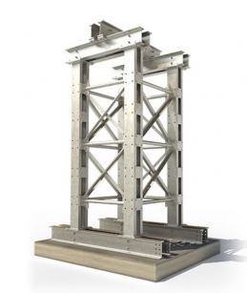

Structural Breadth - Shoring Design
17
Library In Metropolitan Washington, D.C.
Lowell Stine | Construction
Outline
  Project Introduction
  Early Involvement
  Caisson Rebar Cage Prefab Structural Sequencing
  Structural Breadth
  Mechanical Room
  Acoustical Breadth
  Summary of Conclusions
  Acknowledgments
Required Shoring Load
Dead Loads
Live Loads
P_{u}= 291 psf
Picking Shoring System
Mabey’s Mass Series
Shoring Towers
$$L=L_{0}×\left\{\begin{matrix}0.4 \\ 0.25+\frac{15}{\sqrt{K_{LL}A_{T}}}\end{matrix}\right.$$
Picture Provided by Mabey Inc.
$$P_{u}=1.2D+1.6L$$

Slide 31
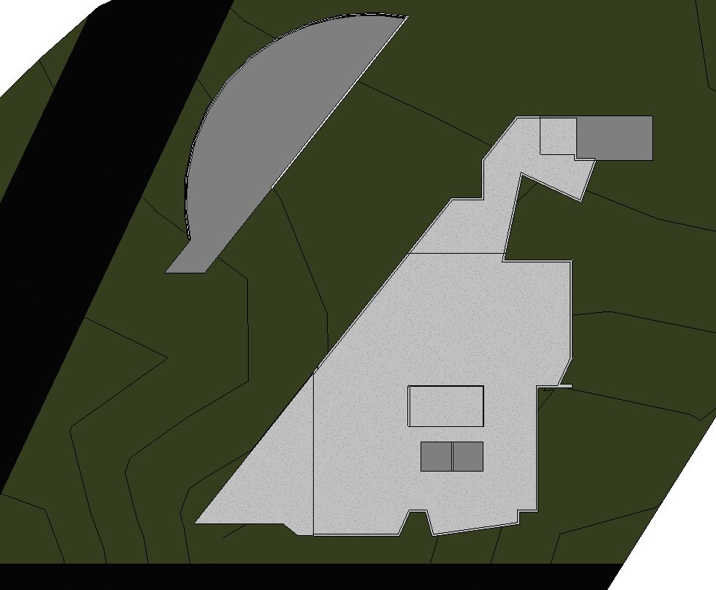
Structural Breadth - Shoring Design
17
Library In Metropolitan Washington, D.C.
Lowell Stine | Construction
Outline
  Project Introduction
  Early Involvement
  Caisson Rebar Cage Prefab Structural Sequencing
  Structural Breadth
  Mechanical Room
  Acoustical Breadth
  Summary of Conclusions
  Acknowledgments
Required Shoring Load
Dead Loads
Live Loads
P_{u}= 291 psf
Picking Shoring System
Mabey’s Mass Series
Shoring Towers
Finalize Shoring Design
Mass 25 - 100 kips
Space at 20’x18’
(16) 5’x5’ & (2) 5’x10’
$$L=L_{0}×\left\{\begin{matrix}0.4 \\ 0.25+\frac{15}{\sqrt{K_{LL}A_{T}}}\end{matrix}\right.$$
Picture Provided by Mabey Inc.
$$P_{u}=1.2D+1.6L$$

Slide 32
Structural Breadth - Shoring Design
17
Library In Metropolitan Washington, D.C.
Lowell Stine | Construction
Outline
  Project Introduction
  Early Involvement
  Caisson Rebar Cage Prefab Structural Sequencing
  Structural Breadth
  Mechanical Room
  Acoustical Breadth
  Summary of Conclusions
  Acknowledgments
Required Shoring Load
Dead Loads
Live Loads
P_{u}= 291 psf
Picking Shoring System
Mabey’s Mass Series
Shoring Towers
Finalize Shoring Design
Mass 25 - 100 kips
Space at 20’x18’
(16) 5’x5’ & (2) 5’x10’

Slide 33
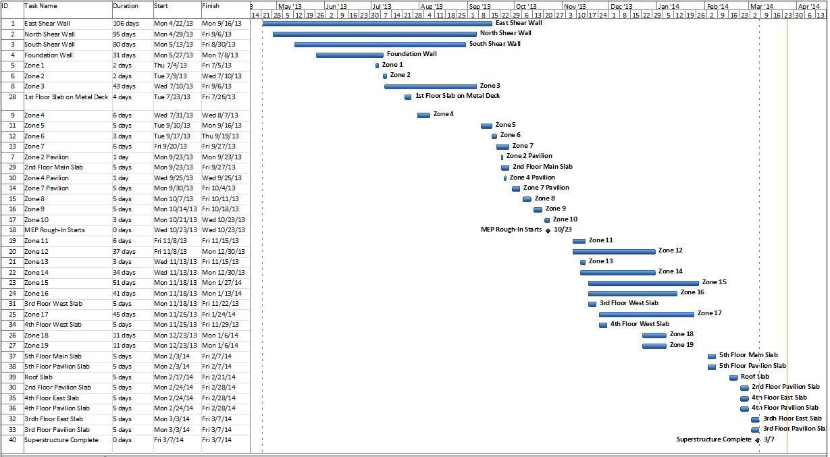
Structural Sequencing Analysis
18
Library In Metropolitan Washington, D.C.
Lowell Stine | Construction
Outline
  Project Introduction
  Early Involvement
  Caisson Rebar Cage Prefab Structural Sequencing
  Structural Breadth
  Mechanical Room
  Acoustical Breadth
  Summary of Conclusions
  Acknowledgments
Results
3 Week Schedule Savings (with shoring install)
$30,000 Savings
Better Productivity (Specific Zones)
Recommend the Shoring Sequence
Structure Duration Comparisons
Description | Planned | Top-Down Option | Shoring Option
Steel Erection Start | 6/25/13 | 7/4/13 | 7/4/13
Structure Complete Milestone | 1/1/14 | 3/7/14 | 2/13/14
Total Duration (weeks) | 28 | 33 | 30
Zone Delays
Shoring Cost Break Down
Description | Per Tower | Total
Minimum First 4 Weeks | $1357 | $24,430
Every Week After for 4 Weeks | $828 | $14,900
Tax (6%) | $131 | $2,360
Total | $2,316 | $41,690
IPEC vs. Mechanical Penthouse
Criteria & Categories | Top-Down | Shoring
Constructability | x | ✓
Schedule | x | ✓
Cost | ✓ | ✓
Site | ✓ | x
Safety | x | ✓
Other Trades | x | ✓
Cost Comparisons
Description | Per Tower
General Condition Savings | $72,000
Shoring Costs | $41,690
Total Estimated Costs Savings | $30,000

Slide 34
19
Library In Metropolitan Washington, D.C.
Lowell Stine | Construction
Outline
  Project Introduction
  Early Involvement
  Caisson Rebar Cage Prefab Structural Sequencing
  Structural Breadth
  Mechanical Room
  Acoustical Breadth
  Summary of Conclusions
  Acknowledgments
Mechanical Penthouse vs. IPEC
Analysis

Slide 35
Mechanical Penthouse vs. IPEC Analysis
20
Library In Metropolitan Washington, D.C.
Lowell Stine | Construction
Outline
  Project Introduction
  Early Involvement
  Caisson Rebar Cage Prefab Structural Sequencing
  Structural Breadth
  Mechanical Room
  Acoustical Breadth
  Summary of Conclusions
  Acknowledgments
Goals
IPEC & Penthouse Differences
How to Chose Which to Use
Gain Knowledge of Each

Slide 36
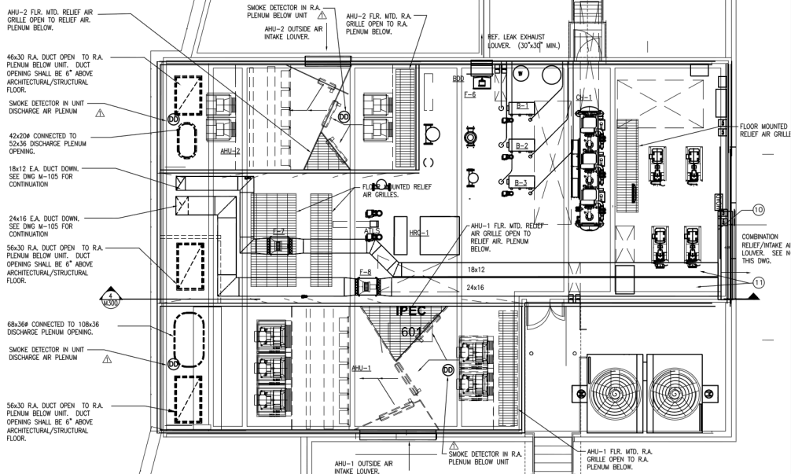
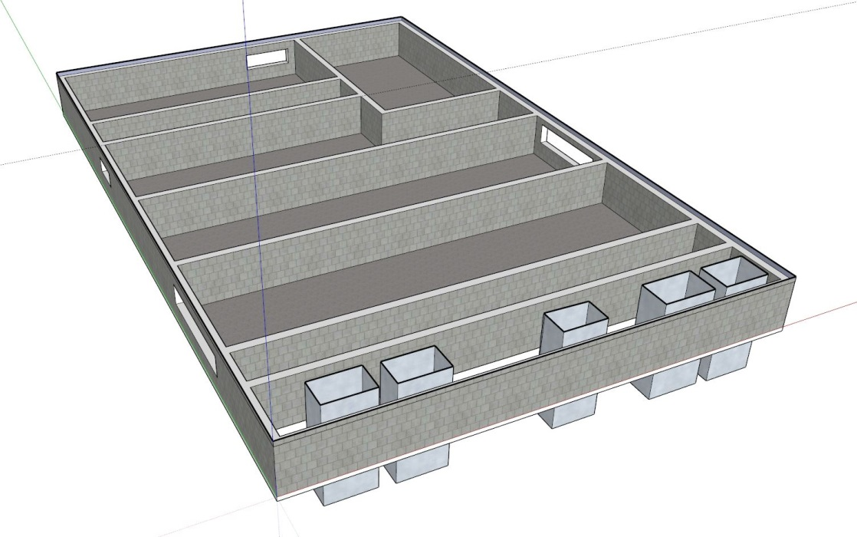
Mechanical Penthouse vs. IPEC Analysis
20
Library In Metropolitan Washington, D.C.
Lowell Stine | Construction
Integrated Packaged Equipment Center (IPEC)
Outline
  Project Introduction
  Early Involvement
  Caisson Rebar Cage Prefab Structural Sequencing
  Structural Breadth
  Mechanical Room
  Acoustical Breadth
  Summary of Conclusions
  Acknowledgments
Goals
IPEC & Penthouse Differences
How to Chose Which to Use
Gain Knowledge of Each
IPEC
Prefabricated Equipment Module
4’ CMU Base Wall
One Supplier
Provided by MBP (Construction Documents Courtesy of MBP)

Slide 37
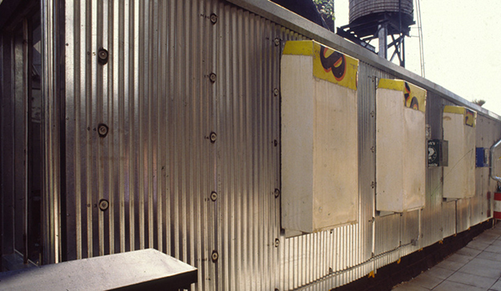
Mechanical Penthouse vs. IPEC Analysis
20
Library In Metropolitan Washington, D.C.
Lowell Stine | Construction
Mechanical Penthouse
Integrated Packaged Equipment Center (IPEC)
Outline
  Project Introduction
  Early Involvement
  Caisson Rebar Cage Prefab Structural Sequencing
  Structural Breadth
  Mechanical Room
  Acoustical Breadth
  Summary of Conclusions
  Acknowledgments
Goals
IPEC & Penthouse Differences
How to Chose Which to Use
Gain Knowledge of Each
IPEC
Prefabricated Equipment Module
4’ CMU Base Wall
One Supplier
Mechanical Penthouse
Site Constructed
On Concrete Structural Roof
Multiple Different Suppliers
Picture Provided by http://www.jetsongreen.com/

Slide 38
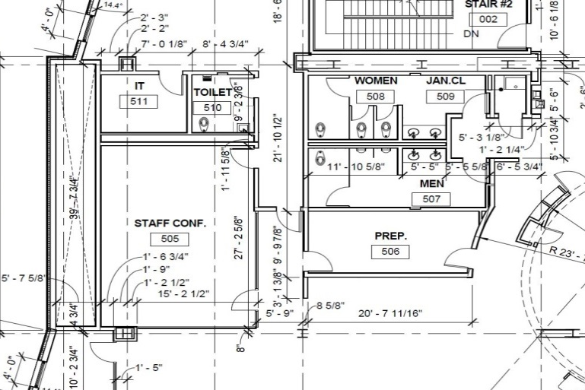
Acoustical Breadth
21
Library In Metropolitan Washington, D.C.
Lowell Stine | Construction
Outline
  Project Introduction
  Early Involvement
  Caisson Rebar Cage Prefab Structural Sequencing
  Structural Breadth
  Mechanical Room
  Acoustical Breadth
  Summary of Conclusions
  Acknowledgments
          Acoustical Impacts of IPEC and Penthouse
          Library Spaces
          Outdoor Environment
          Differences
          Similar Acoustical Properties
          Over Estimates
Kids Section
Provided by MBP (Construction Documents Courtesy of MBP)

Slide 39
Acoustical Breadth
21
Library In Metropolitan Washington, D.C.
Lowell Stine | Construction
Outline
  Project Introduction
  Early Involvement
  Caisson Rebar Cage Prefab Structural Sequencing
  Structural Breadth
  Mechanical Room
  Acoustical Breadth
  Summary of Conclusions
  Acknowledgments
          Acoustical Impacts of IPEC and Penthouse
          Library Spaces
          Outdoor Environment
          Differences
          Similar Acoustical Properties
          Over Estimates
          Recommendations
          IPEC Would Be More Desirable
Noise Levels
 | Limit | Actual
Conference Room | 35 dB | 37 dB
Property Line | 55 dB | 57 dB
Kids Section
Provided by MBP (Construction Documents Courtesy of MBP)

Slide 40
Mechanical Penthouse Vs. IPEC Analysis
22
Library In Metropolitan Washington, D.C.
Lowell Stine | Construction
Outline
  Project Introduction
  Early Involvement
  Caisson Rebar Cage Prefab Structural Sequencing
  Structural Breadth
  Mechanical Room
  Acoustical Breadth
  Summary of Conclusions
  Acknowledgments
IPEC vs. Mechanical Penthouse Schedule
System | Lead Time | Site Install Time
IPEC | 1 Long Lead Item (Months) | 1 Week
Penthouse | Multiple Shorter Lead Times (Weeks) | 10.5 Weeks
IPEC vs. Mechanical Penthouse
Criteria & Categories | IPEC | Penthouse
Acoustical | ✓ | ✓
Maintenance | x | ✓
Flexibility in Design | x | ✓
Responsibility | ✓ | ✓
Constructability | ✓ | ✓
Costs | x | ✓
Schedule | ✓ | x
Results
1 Week On Site vs. 10.5 Weeks On Site
Potential $1 Million Savings
Flexible Design
Penthouse
Design-Build Package
IPEC vs. Mechanical Penthouse Costs
System | Equipment | Enclosure/ Structure | Total
IPEC | $5,800,000 | $50,000 | $5,850,000
Penthouse | $4,880,000 | $100,000 | $4,880,000

Slide 41
Conclusions
23
Library In Metropolitan Washington, D.C.
Lowell Stine | Construction
Outline
  Project Introduction
  Early Involvement
  Caisson Rebar Cage Prefab Structural Sequencing
  Structural Breadth
  Mechanical Room
  Acoustical Breadth
  Summary of Conclusions
  Acknowledgments
Design (Early Involvement)
Foundation (100% Prefabrication Cage Length)
Structure (Shoring Sequence)
Building Systems (Mechanical Penthouse)
Early Involvement
Undetermined Cost Savings
Undetermined Schedule Savings
100% Prefabrication Cage Length
$0.00 Savings
Account for Caissons in Schedule
Shoring Sequence
$30,000 Savings
3 Week Schedule Savings
Mechanical Penthouse
Possible $1 Million Savings
Additional 9.5 Week Mechanical Schedule
Programming
Design
Procurement
Construction

Slide 42




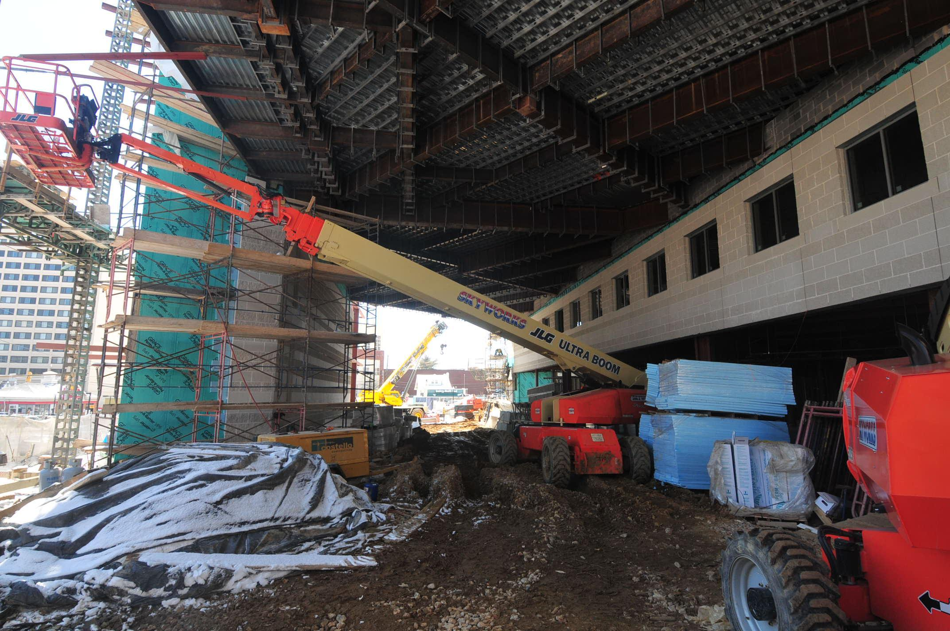





Acknowledgments
24
Library In Metropolitan Washington, D.C.
Lowell Stine | Construction
Outline
  Project Introduction
  Early Involvement
  Caisson Rebar Cage Prefab Structural Sequencing
  Structural Breadth
  Mechanical Room
  Acoustical Breadth
  Summary of Conclusions
  Acknowledgments
Questions?
Academic
Michelle Vigeant
Moses Ling
Dr. Robert Leicht
Kevin Parfitt
Ray Sowers
Special Thanks
Library’s Owner
PACE Industry Members
Matt Strevig
Friends and Family
Picture Provided by Multivista

Slide 43
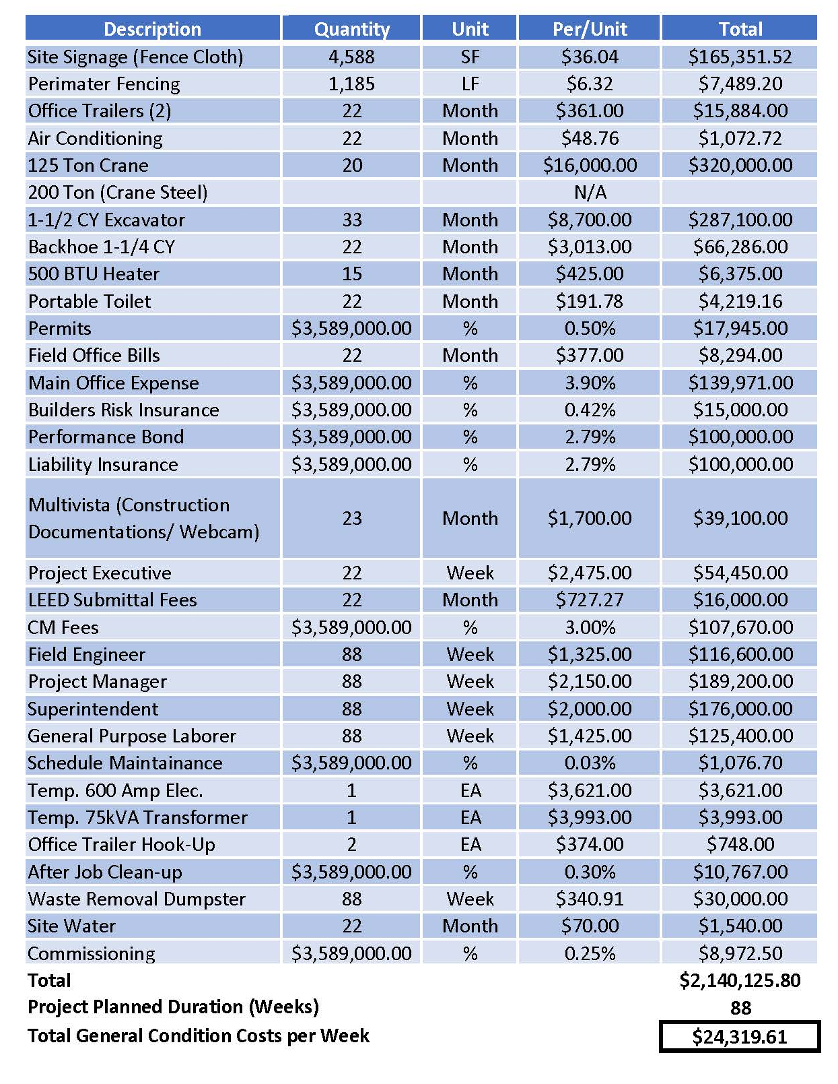
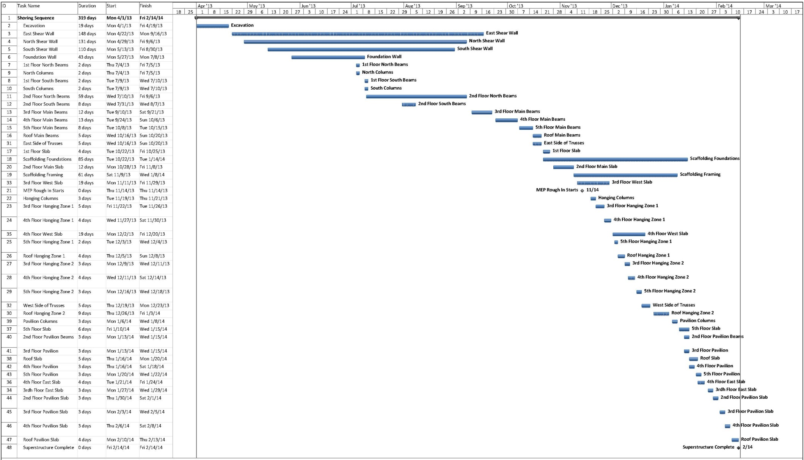
Structural Analysis
25
Library In Metropolitan Washington, D.C.
Lowell Stine | Construction
General Conditions Costs
Current Structural Schedule
Shoring Sequence Schedule

Slide 44
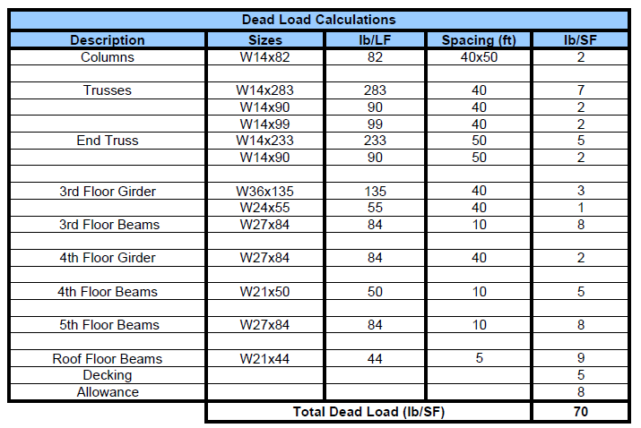
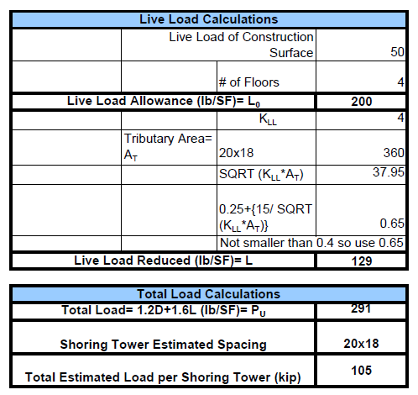
Structural Breadth - Shoring Load Calcs.
26
Library In Metropolitan Washington, D.C.
Lowell Stine | Construction
Dead Load Calculations
Live Load & Factored Loads
Live Load Assumptions
Started with 50 psf
Four floors is 200 psf
In live load reduction total is 129 psf
Factored live load would then be 206 psf
(This would be an acceptable live load on four floors of only structure)

Slide 45
Acoustical Breadth Calculations
27
Library In Metropolitan Washington, D.C.
Lowell Stine | Construction
Zone 2 Acoustics

Slide 46
Acoustical Breadth Calculations
28
Library In Metropolitan Washington, D.C.
Lowell Stine | Construction
Conference Room Acoustics

Slide 47
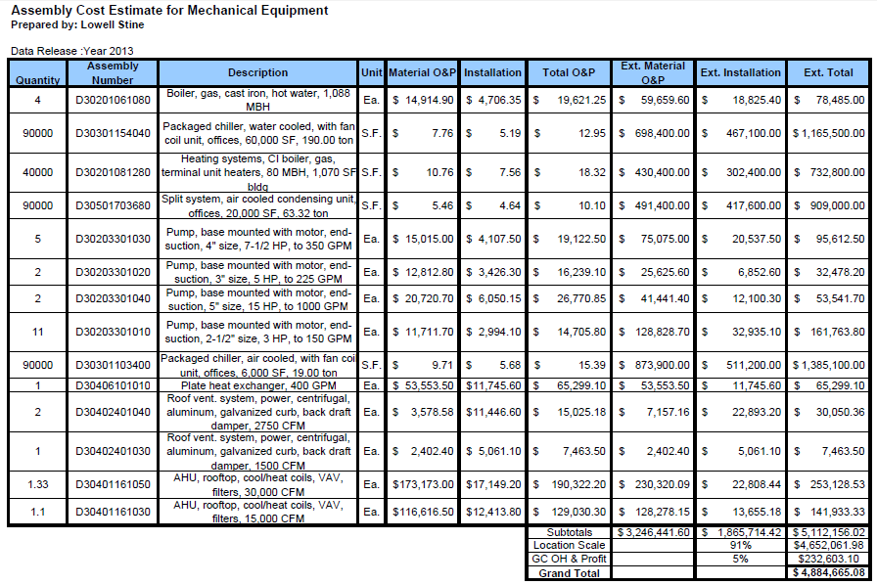
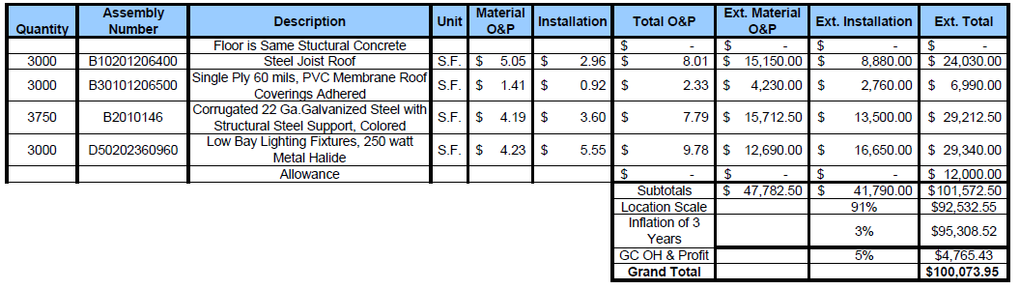
Penthouse Costs
29
Library In Metropolitan Washington, D.C.
Lowell Stine | Construction
Equipment
Enclosure

Slide 48
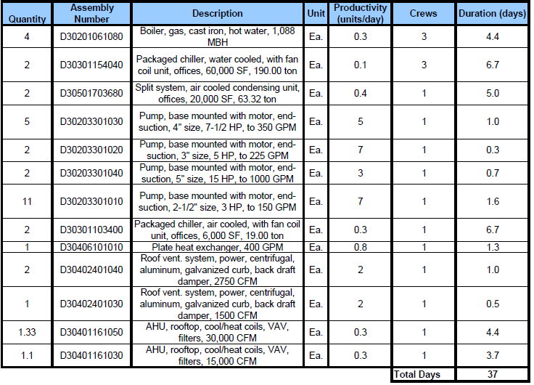
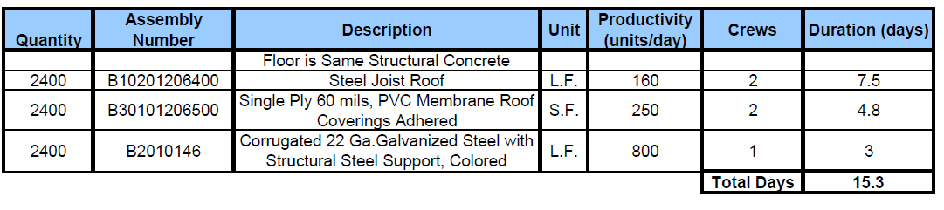
Penthouse Durations
30
Library In Metropolitan Washington, D.C.
Lowell Stine | Construction
Equipment
Enclosure

