Slide 1
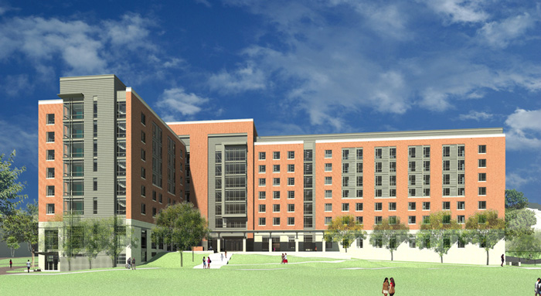
Prince Frederic Hall
Tech One
Lauren Kandt
PSU AE
Construction
Sowers
College Park, MD
9/16/2013

Slide 2
Client Information
University of Maryland
A Public Research University
Building to accommodate more students and camps
University Environment
Noise and Dust controls
Non-work days
High pedestrian traffic near site
University Master Plan
Architectural guidelines
LEED guidelines
Notes:
Owner: University of Maryland
Needs: More room for students and technology camps
Wants: To maintain an academic environment on campus
Site: To the above end, control noise/dust, adhere to non-work days around finals and commencement, and ensure safety of pedestrian traffic around site.
Keys: Follow University Master Plan for architecture and LEED, provide a focus on student safety and environment.

Slide 3
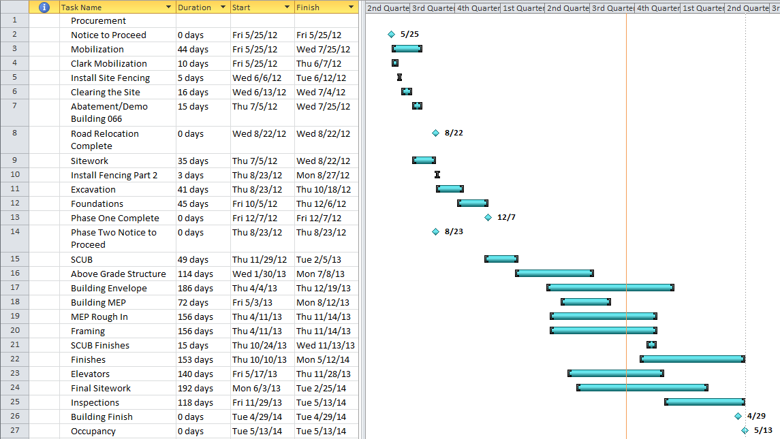
Schedule
Notes:
Notice to Proceed: 25 May 2012
Occupancy: 13 May 2014
Days of concern for University/Students: Final Exam weeks and Commencement Days
Focus on Safety: Fencing, well timed Demolition
Focus on Milestones: Take extra measures to be on time for occupancy.
Construction goes floor by floor after building is enclosed, hence the seeming long durations.

Slide 4
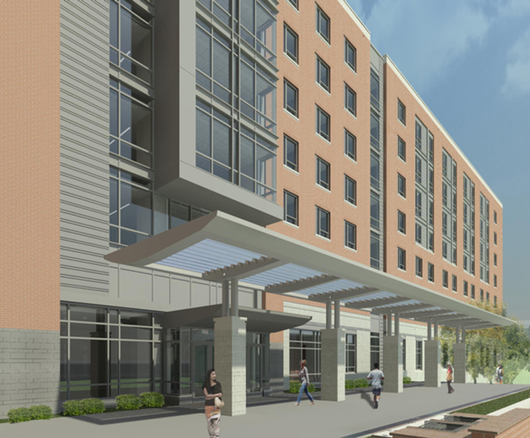
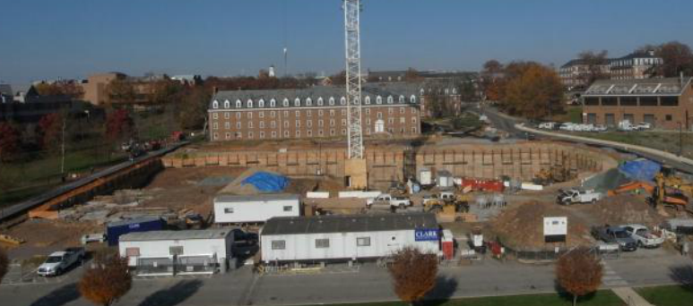
Building Systems
Telecom
Demolition
Cast in Place Concrete
Mechanical System
Electrical System
Masonry
Curtain Wall
Excavation
Notes:
Telecom – Lenel On Guard, building Security, card swipe and cameras
Demolition – Building 066, parking lot
Mechanical – High efficiency to provide comfort to students and meet LEED needs
Concrete – Precast, plywood, fiberglass and reinforced plastic formwork
Masonry – Interior walls and exterior, used structurally
Curtain Wall – Over architectural parts of building, insulated
Excavation – Extensive storm management due to slope on site, slate walls
Electrical - Requires uninterrupted supply, heavy load

Slide 5
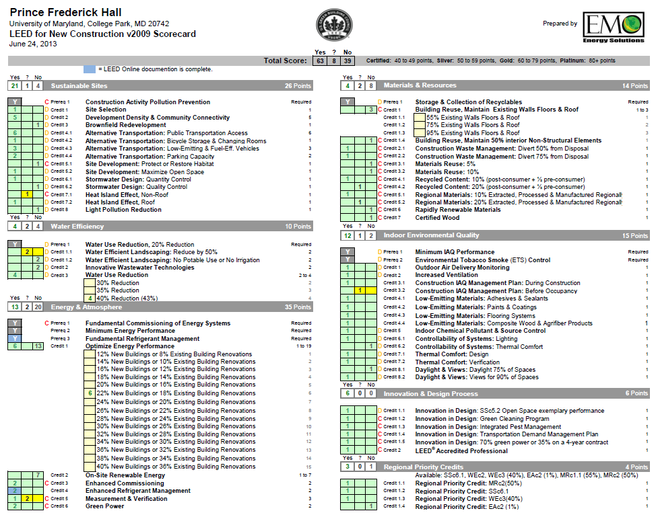
LEED
Notes:
Contracted to be Silver
Smart construction helped reach Gold with 63 credits.
Key Point Areas for Construction:
Construction Waste Management (Recycled Content and smart Disposal)
Regional Materials (though not recycled)
Low Emission Materials
Regional Priority Credits
Sustainable Site
Energy and Atmosphere (for construction and occupancy)

Slide 6
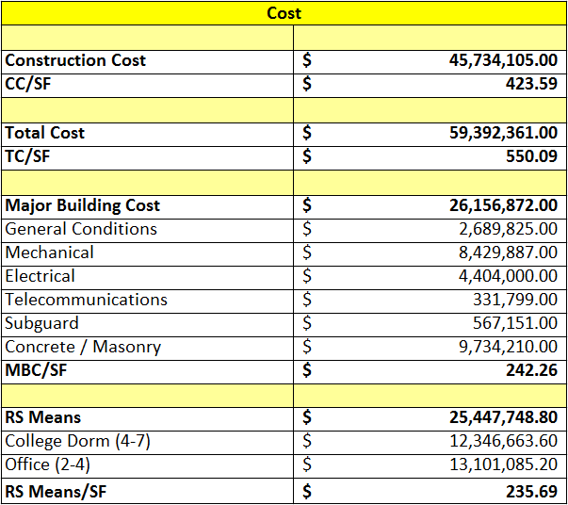
Project Cost
Notes:
Prince Frederick Hall is a mixed use dormitory. It has fairly lavish dorms in floors 3-7. However from ground to 2 is has classrooms, offices, lounges, and a computer lab. For simplicities sake this was all lumped into office since they had the greatest area on those floors.
Significant differences:
Did not account for high technology level or telecommunications
Grouped a large number of mixed use rooms as ‘Office’
Did not account for greed initiatives across building

Slide 7
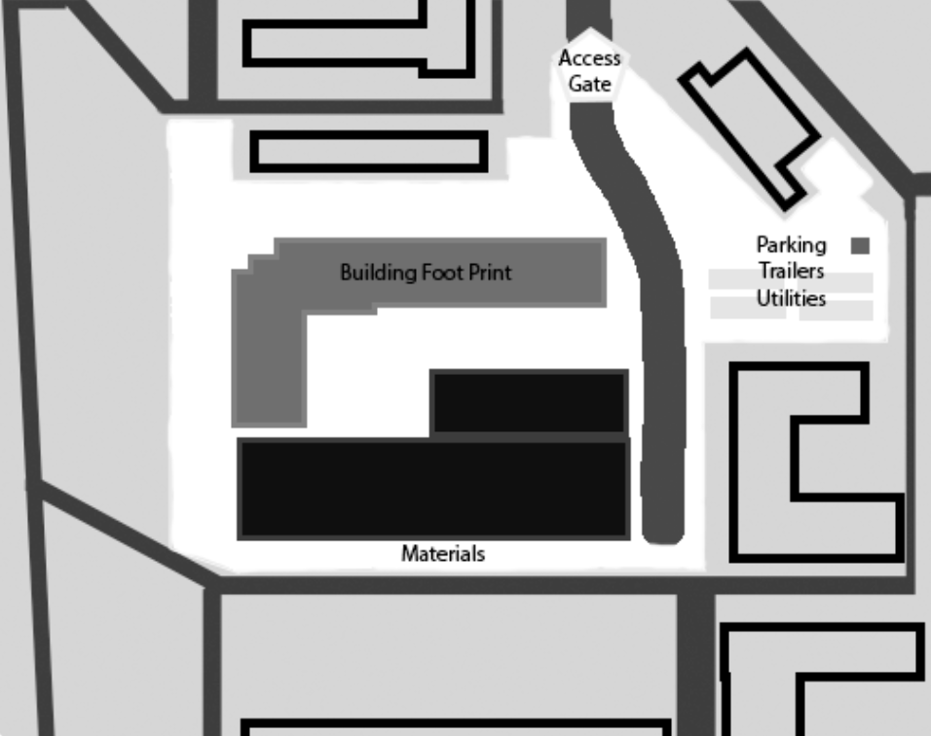
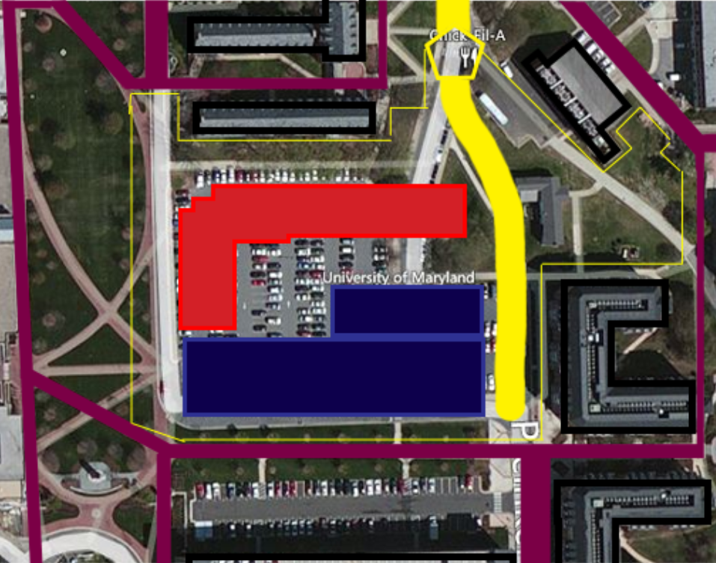
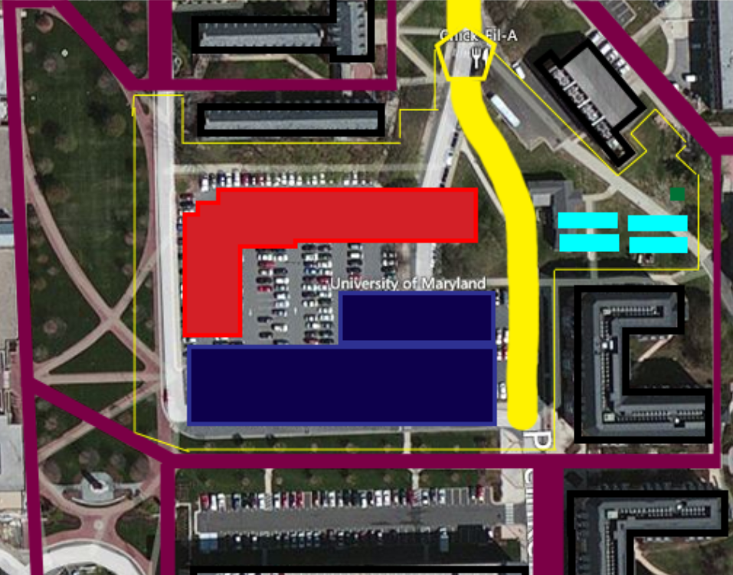
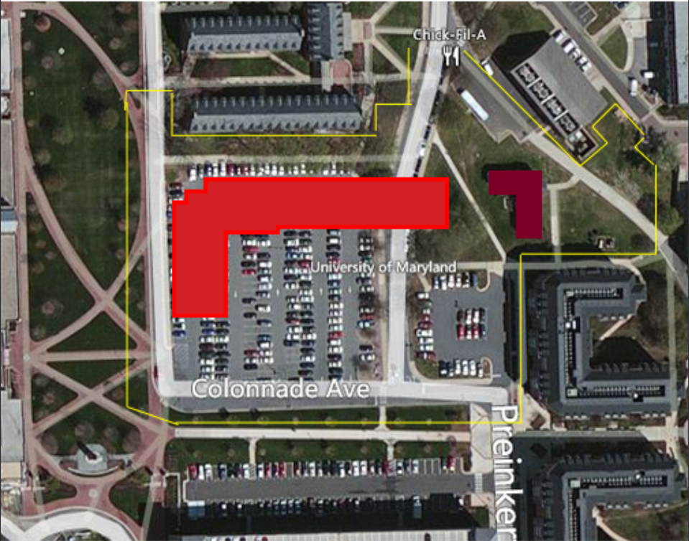
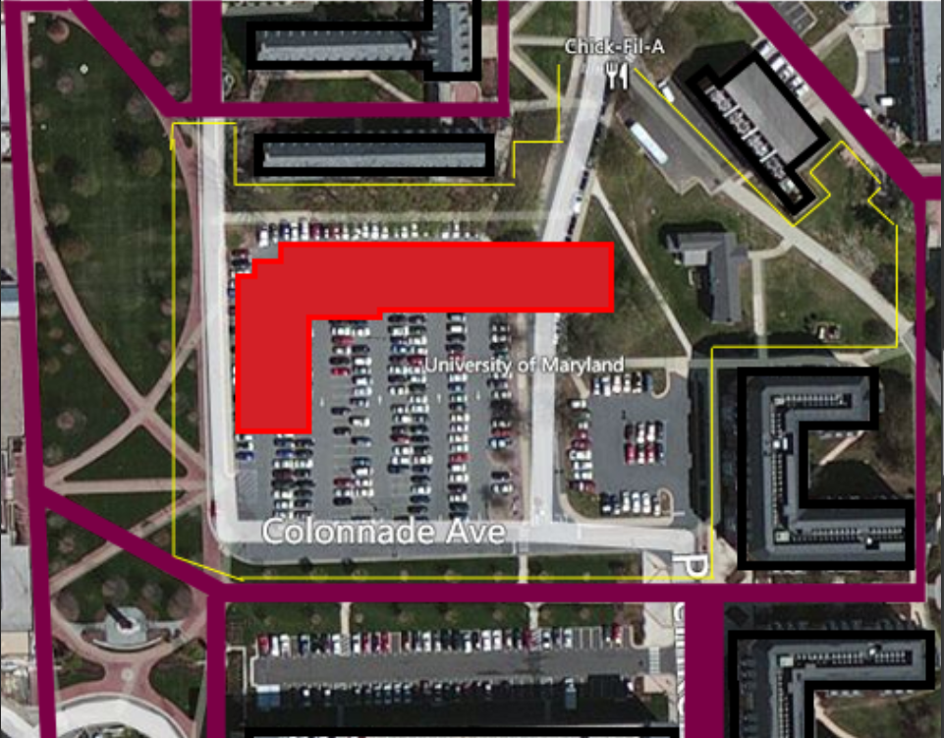
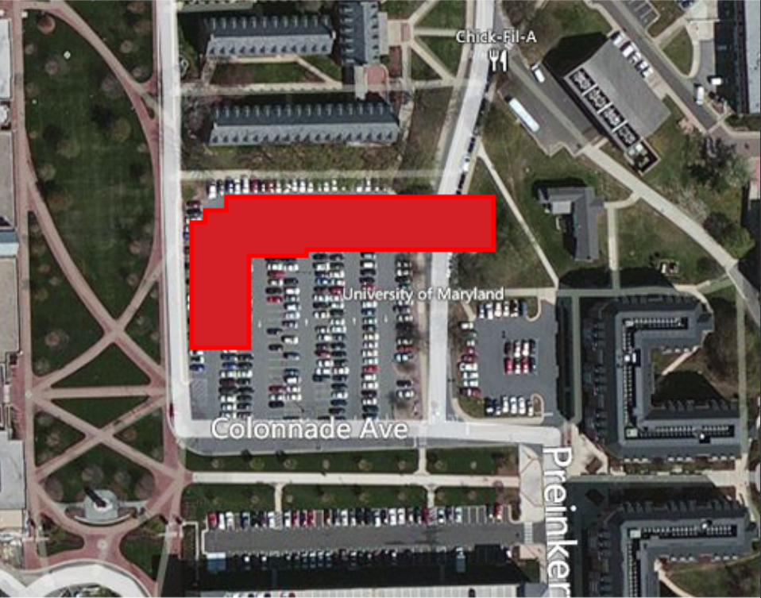
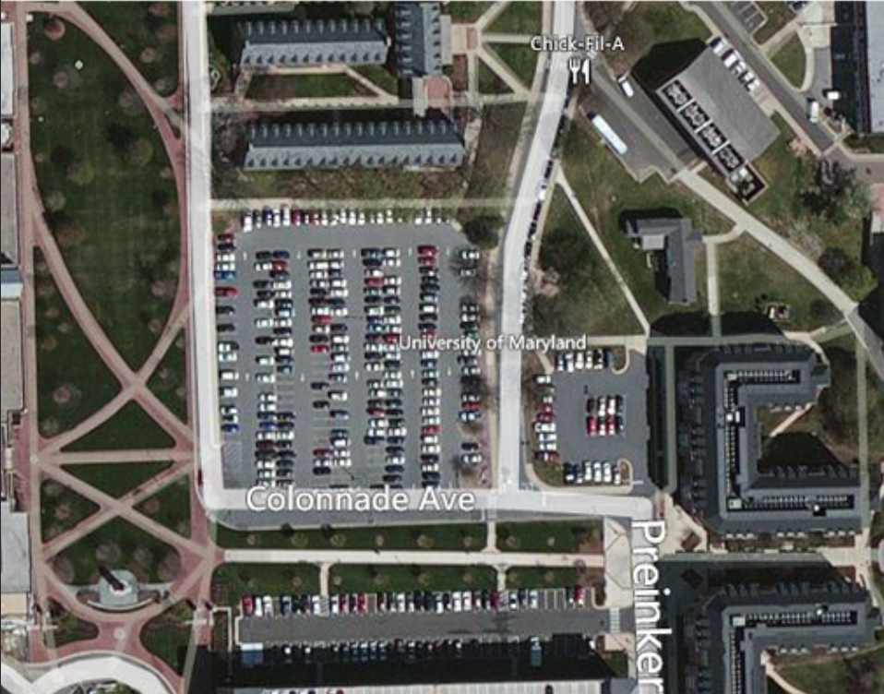
Site
Notes:
Soil Type: Coastal Plains Soil
of some concern for erosion due to sandy nature
Major Road Detour around site.
Pedestrian safety around site.
University desires:
Schedule truck deliveries
Don’t block roads or entrances
Adhere to limits of disturbance
Control dust and noise (partitions and fans)
Don’t interrupt utilities
Critical site controls:
Off-hours work coordinates with OSCR
Safety

Slide 8
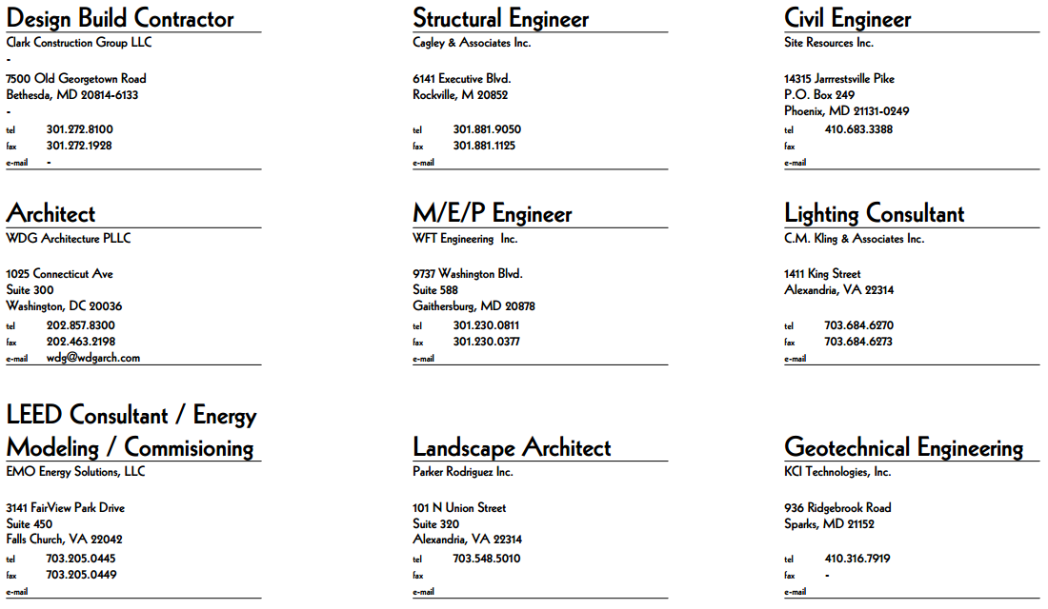
Project Delivery / Staffing Plan
Notes:
Owner: University of Maryland
Architect: WDG Architecture
Contractor: Clark Construction Group
Design/Build Contract
All contracts awarded to others must coordinate with university.
Clark construction must still coordinate on site with selected contractors.

Slide 9
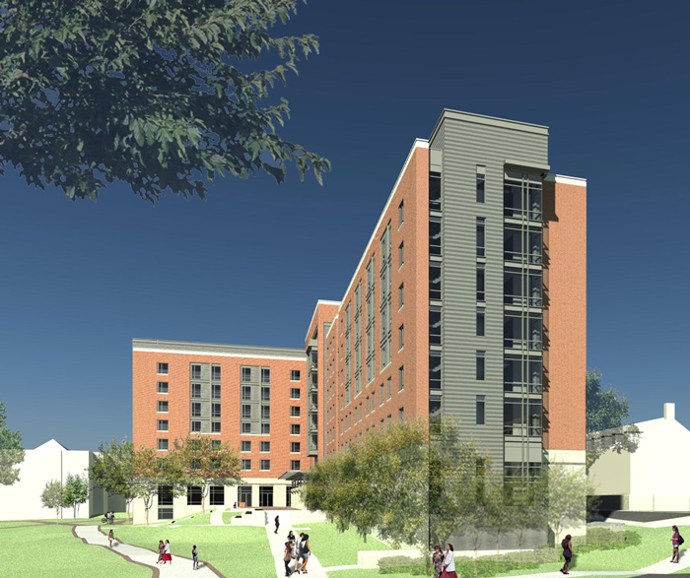
Questions?
Notes:
Images of Building provided from : http://www.resnet.umd.edu/princefrederick/renderings/
Image of Site provided from: http://oxblue.com/open/clarkconstruction/umprincefrederickhall

