Slide 1
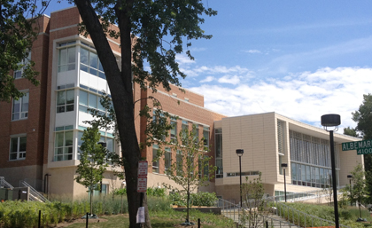
ELEMENTARY SCHOOL ONE
TOWN, MARYLAND
Jonathan Cann
Mechanical Option Advisor: Dr. Treado
BAE/MAE Integrated Program Spring 2015
www.nps.gov/nr/
www.janneyschool.org

Slide 2
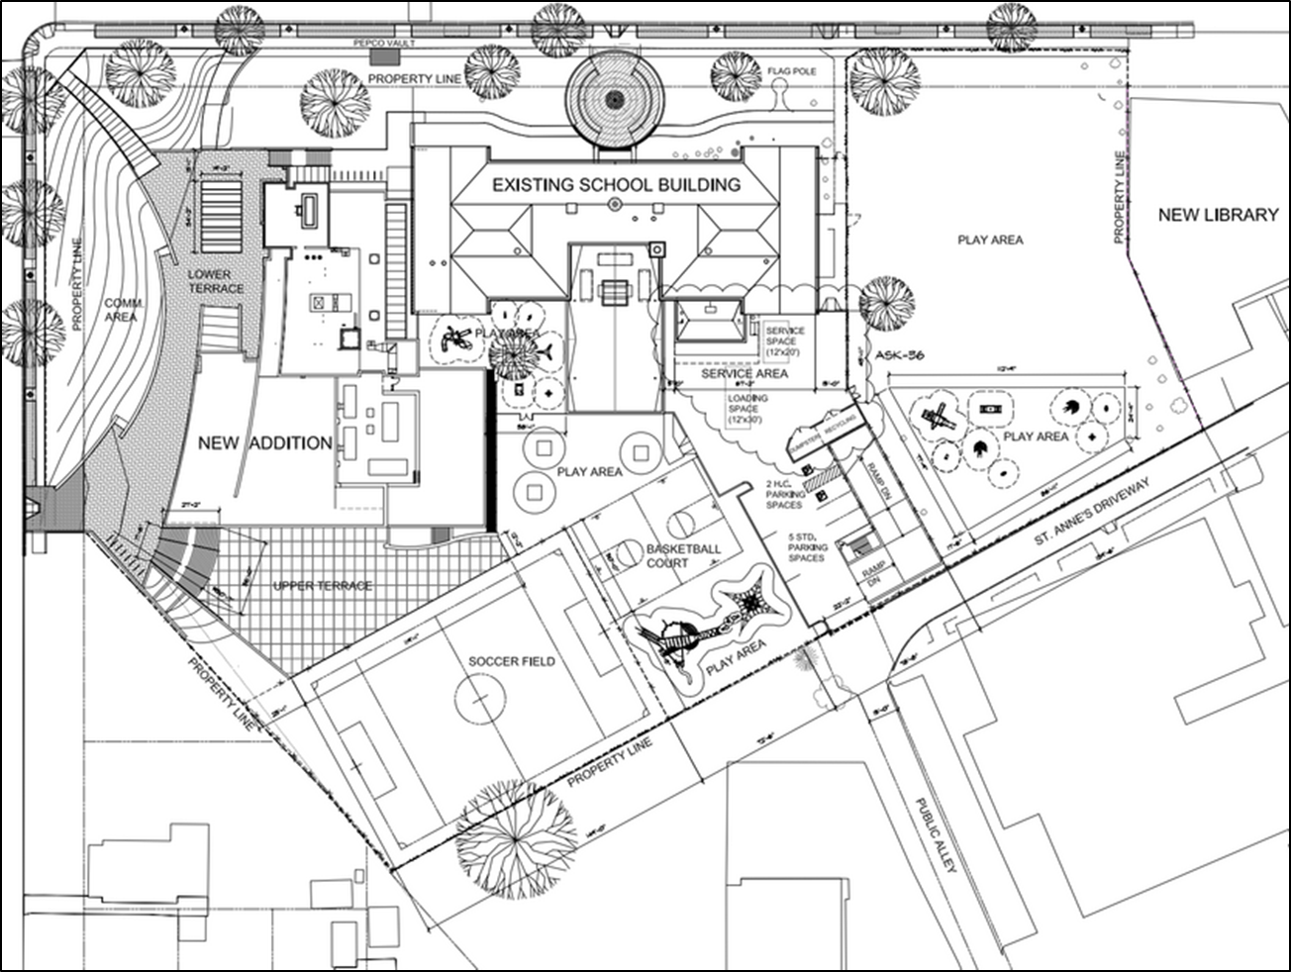
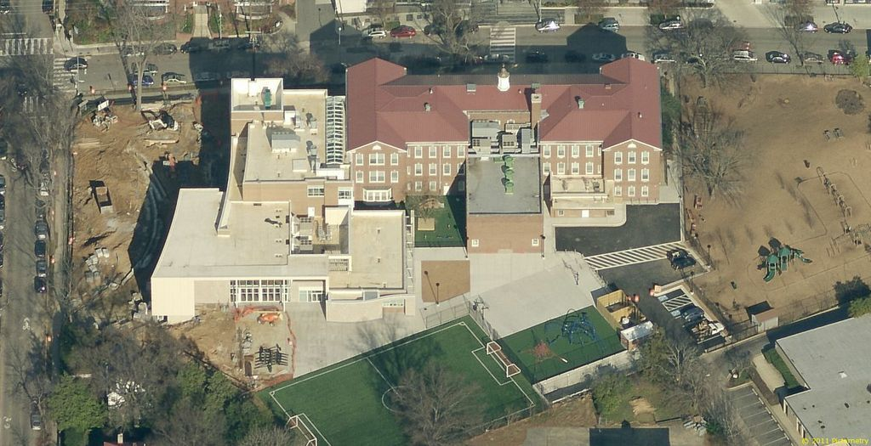
N
Presentation Outline
Building Statistics
Existing Building: Built 1925
National Register of Historic Places
Gross Square Feet : 84,400
Overall Project Budget: $25 Million
Completion Date: August 2011
3 stories above grade, 1 below
Function: Educational
Project Background
Existing Conditions
Proposal
Mechanical Depth
Acoustical Breadth
Conclusion
maps.google.com
Jonathan Cann
Elementary School One
Mechanical Option

Slide 3
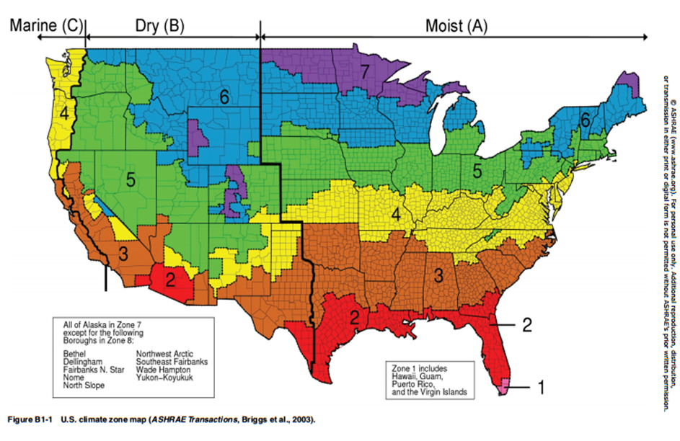
N
Presentation Outline
Location and Weather
Project Background
Town, Maryland
Relative Humidity – 50%
Existing Conditions
Proposal
 | Summer | Winter
Designed Dry Bulb (°F) | 91 | 13
Designed Wet Bulb (°F) | 77 | -
Indoor Air Temperature (°F) | 75 | 72
Mechanical Depth
Acoustical Breadth
Conclusion
Weather data based on Baltimore, Maryland
www.ashrae.org
Jonathan Cann
Elementary School One
Mechanical Option

Slide 4
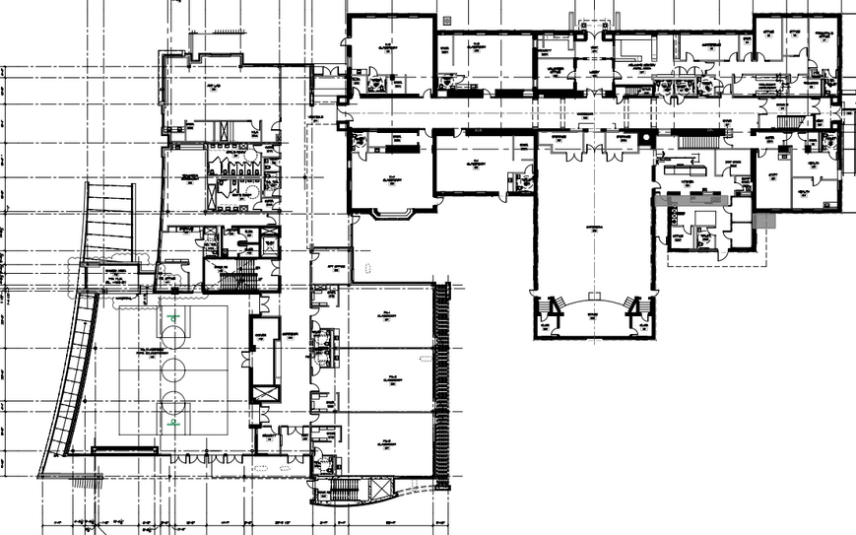
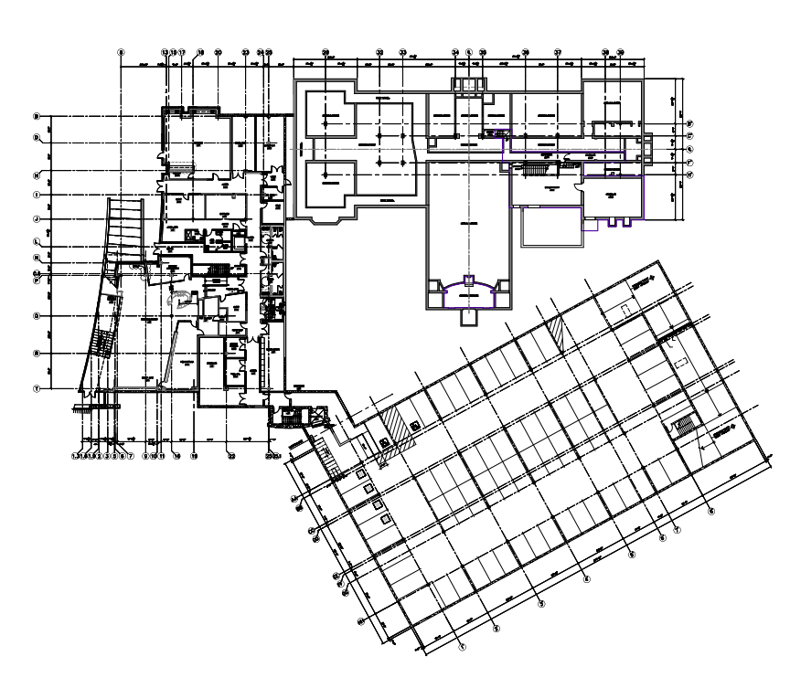
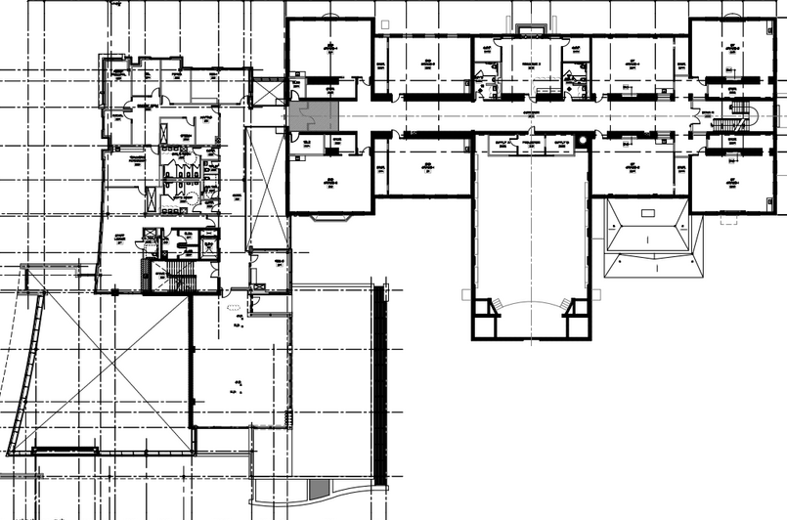
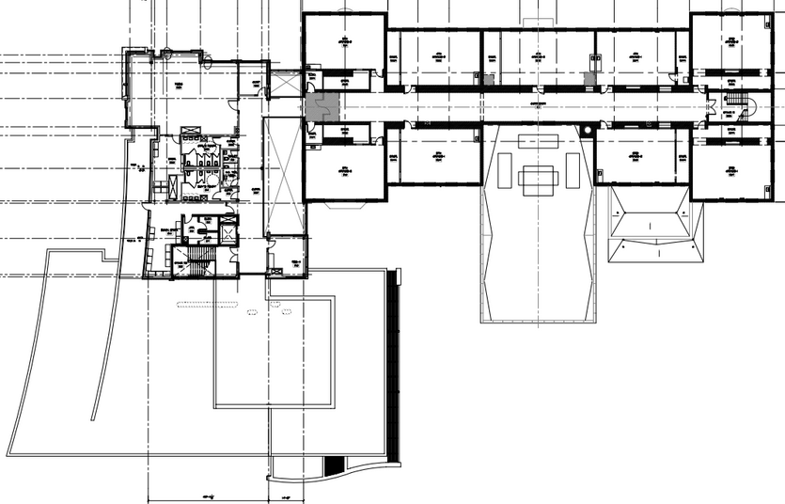
N
Presentation Outline
First Floor
Mechanical Layout
Blue: RTU-1 & 2 Cafeteria
Orange: RTU-3 &4 (DOAS) and VRF
Purple: RTU- 5 (DOAS) and VRF
Green: RTU-6 & 7 Multipurpose
Red: AHU-1 Administrative Offices
Basement
Project Background
Existing Conditions
Second Floor
Proposal
Mechanical Depth
Acoustical Breadth
Third Floor
Conclusion
Jonathan Cann
Elementary School One
Mechanical Option

Slide 5
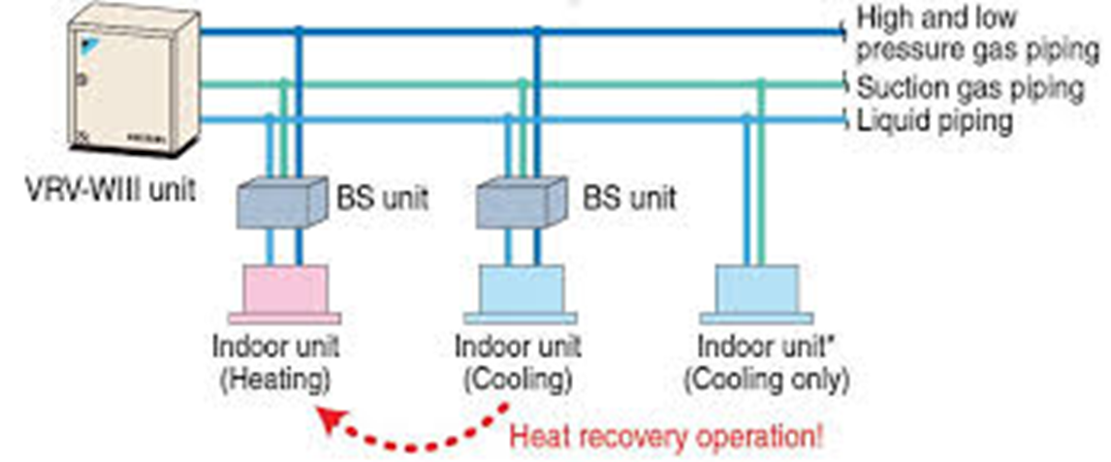
N
Presentation Outline
Mechanical Schedule
Air Cooled Condensing Units Schedules (VRF System)
Unit No. | Cooling (MBH) | Heating (MBH) | Condenser CFM
CU-VRF-1 | 439 | 494 | 20100
CU-VRF-2 | 343 | 386 | 20100
CU-VRF-3 | 305 | 343 | 13400
Project Background
Rooftop Unit Schedule
Unit No. | Area Served | Supply CFM | Total Load (MBH)
RTU-1 | Cafeteria | 7500 | 227
RTU-2 | Cafeteria | 7500 | 227
RTU-3 | Exist. Bldg. | 8300 | 350
RTU-4 | Exist. Bldg. | 5600 | 236.9
RTU-5 | Addition | 10650 | 538
RTU-6 | Multi-purpose | 7500 | 235
RTU-7 | Multi-purpose | 7500 | 235
Existing Conditions
Proposal
Mechanical Depth
Acoustical Breadth
Conclusion
www.daikin.com
Jonathan Cann
Elementary School One
Mechanical Option

Slide 6
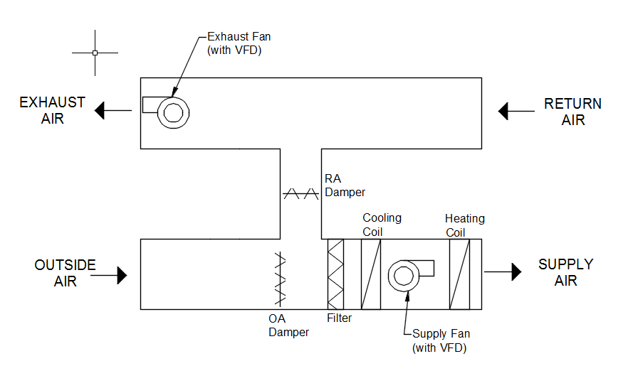
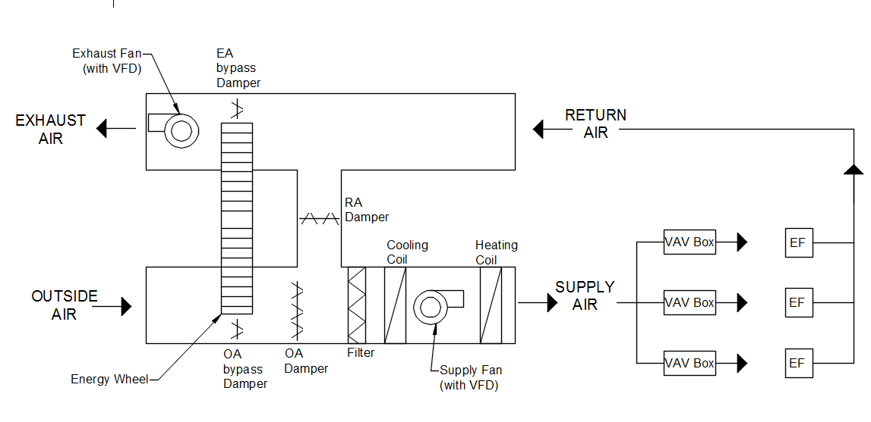
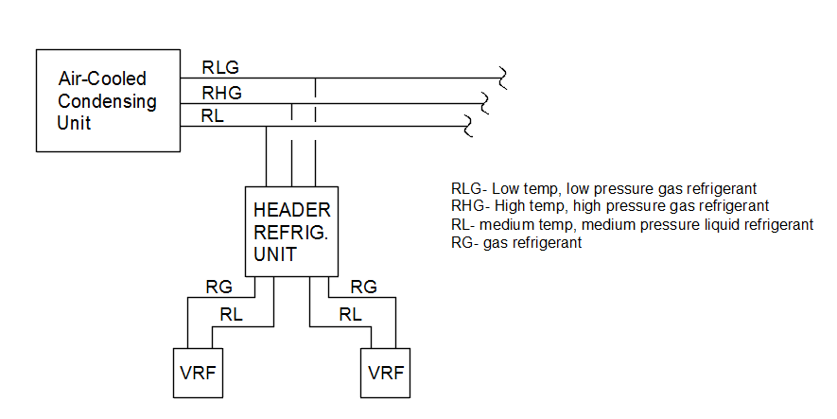
N
Presentation Outline
Mechanical Schematics
Project Background
Existing Conditions
Proposal
Mechanical Depth
Acoustical Breadth
Conclusion
RTU- 1, 2, 6 & 7
RTU- 3, 4, & 5
DOAS
VRF System
Jonathan Cann
Elementary School One
Mechanical Option

Slide 7
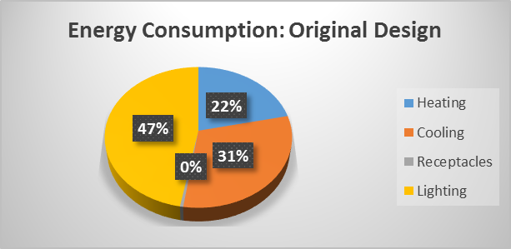
N
Presentation Outline
Energy Use & Emissions
Project Background
 | % of Total Building Energy | Total Building Energy (kBtu/yr)
Heating | 21.56% | 894,258
Cooling | 30.80% | 1,277,511
Receptacles | 0.51% | 21,069
Lighting | 47.13% | 1,954,985
Total | 100% | 4,147,823
Existing Conditions
Proposal
Mechanical Depth
Acoustical Breadth
 | CO2 (lbm/year) | SO2 (gm/year) | NOx (gm/year)
Building Emissions | 1,626,597.0 | 14,638.5 | 2,801.8
Conclusion
Jonathan Cann
Elementary School One
Mechanical Option

Slide 8
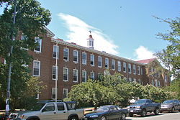
N
Presentation Outline
Proposal Goals
Project Background
Depth: Implement a geothermal system to improve the buildings energy use.
Existing Conditions
Proposal
Breadth: The impact of a geothermal system on the construction management of the project.
Mechanical Depth
Acoustical Breadth
Breadth: Perform acoustical analysis to insure the comfort of the spaces
Conclusion
www.nps.gov/nr/
Jonathan Cann
Elementary School One
Mechanical Option

Slide 9
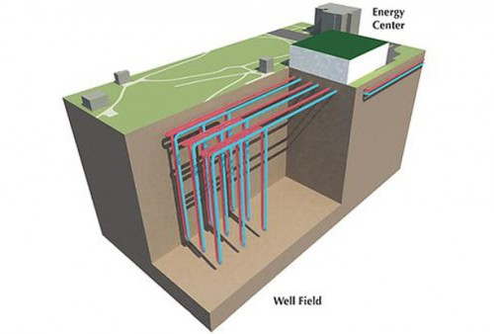
N
Presentation Outline
Proposed System
Project Background
Water-cooled VRF units coupled with closed loop ground coupled heat pump
More efficient than air-cooled condensers
Constant thermal properties
Reduces noise pollution
Minimal site area loss
High initial cost (long term owners)
Renewable energy source (earth)
Low maintenance
Existing Conditions
Proposal
Mechanical Depth
Acoustical Breadth
Conclusion
Ball State University
Jonathan Cann
Elementary School One
Mechanical Option

Slide 10
N
Presentation Outline
Site & Well Properties
Project Background
Soil Properties | Wet dense sand
Dry Density | 120 lb/ft^3
Conductivity (k) | 1.63 Btu/h*ft*°F
Diffusivity (α) | 0.91 ft^2/day
Existing Conditions
Proposal
Annual Average Ground Temperature - 55ºF
Well Design Details
Radius of bore | 0.42 | ft
SDR 11 | 1.00 | in
Rpipe | 0.10 | ft*hr*°F/Btu
Rgrout | 0.05 | ft*hr*°F/Btu
Rbore | 0.15 | ft*hr*°F/Btu
Mechanical Depth
Acoustical Breadth
Conclusion
Geothermal Heat Pump Design Manual by McQuay Air Conditioning
Jonathan Cann
Elementary School One
Mechanical Option

Slide 11
N
Presentation Outline
Geothermal Calculations
 | Symbol | Cooling | Heating | Units
Net annual average heat transfer to the ground | Qa | 251,250 | 150,000 | Btu/h
Building design cooling block load (or heating) | Qlc (or Qlh) | 2,010,000 | 1,200,000 | Btu/h
Power input at design cooling load (or heating) | Wc (or Wh) | 130,000 | 130,000 | W
Effective thermal resistance of ground annual pulse | Rga | 0.2438 | 0.2438 | ft*hr*°F/Btu
Effective thermal resistance of ground monthly pulse | Rgm | 0.223 | 0.223 | ft*hr*°F/Btu
Effective thermal resistance of ground daily pulse | Rgd | 0.131 | 0.131 | ft*hr*°F/Btu
Thermal resistance of bore | Rb | 0.15 | 0.15 | ft*hr*°F/Btu
Short circuit heat loss factor | Fsc | 1.04 | 1.04
Part load factor during design month | PLFm | 1.00 | 1.00
Undisturbed ground temperature | tg | 55 | 55 | °F
Liquid temperature at heat pump inlet | twi | 74 | 44 | °F
Liquid temperature at heat pump outlet | two | 83 | 36 | °F
Temperature penalty | tp | 2.00 | 2.00 | °F
 | Length | 33,689 | 32,454 | ft
 | # of wells | 84.2 | 81.1
Project Background
Required Bore Length for Cooling (ft)
Existing Conditions
Proposal
Required Bore Length for Heating (ft)
Mechanical Depth
Acoustical Breadth
Conclusion
Equations from ASHRAE Handbook
Jonathan Cann
Elementary School One
Mechanical Option

Slide 12
N
Presentation Outline
Well Layout
Project Background
85 wells
400 ft deep wells
15 ft well spacing
Area used 19,125 sq. ft.
Pump located in East Mechanical Room
Direct return piping
Existing Conditions
1
Proposal
Mechanical Depth
2,3
Acoustical Breadth
maps.google.com
Conclusion
Jonathan Cann
Elementary School One
Mechanical Option

Slide 13
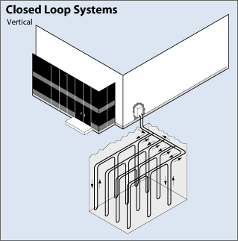
N
Presentation Outline
Pipe & Flow Design
Project Background
480 GPM
2.9 GPM/ton design
6” header pipe
2” row pipe
1” well U-tube
5” bore diameter
Existing Conditions
Proposal
Mechanical Depth
Acoustical Breadth
Conclusion
www.kochergeowelldrilling.com
Jonathan Cann
Elementary School One
Mechanical Option

Slide 14
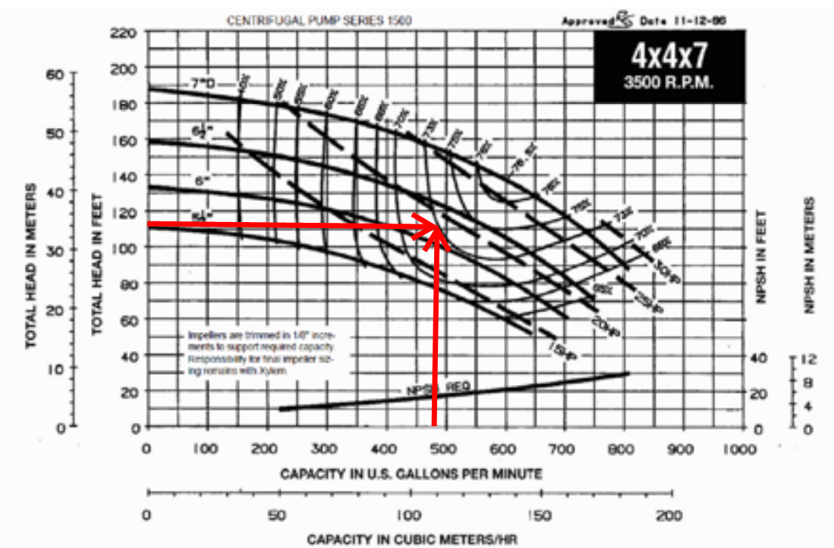
N
Presentation Outline
Well Pump Selection
Project Background
Table 22- Head Loss
Friction Loss | 6.8 ft
Fixture Loss | 109 ft
Velocity Loss | 0.4 ft
Total head loss | 116.2 ft
Existing Conditions
Proposal
Mechanical Depth
www.goulds.com
Acoustical Breadth
Size | Head | Flow Rate | RPM | HP | Manufacturer | Model
4x4x7 | 116.2 ft | 480 gpm | 3500 | 20 | Goulds | AC-135.3F
Conclusion
www.goulds.com
Jonathan Cann
Elementary School One
Mechanical Option

Slide 15
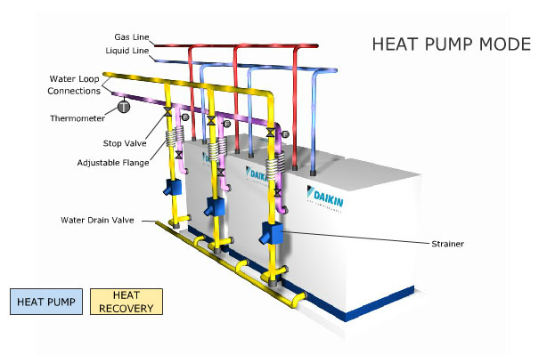
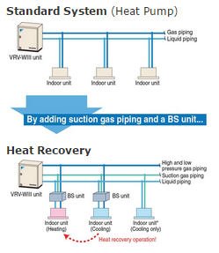
N
Presentation Outline
Water-Cooled VRF Unit Selection
 | Units
CU-VRF-1 | (3)x 21 ton + 12 ton
CU-VRF-2 | (2)x 21 ton + 7 ton
CU-VRF-3 | 21 ton + 18 ton + 6 ton
Project Background
Unified heat pump and heat recovery
Units in series to reach needed capacity
Self heat recovery between modules
Existing Conditions
Proposal
 | Daikin | VRV-WIII Series
 | Unit | 21 ton | 18 ton | 12 ton | 7 ton | 6 ton
Cooling | Capacity (Btu/h) | 252,000 | 216,000 | 144,000 | 84,000 | 72,000
 | EER | 15.0 | 15.3 | 15.3 | 15.0 | 15.3
Heating | Capacity (Btu/h) | 283,500 | 243,000 | 162,000 | 94,000 | 81,000
 | COP | 4.7 | 5.3 | 5.3 | 4.7 | 5.3
Mechanical Depth
Acoustical Breadth
Conclusion
www.daikin.com
Jonathan Cann
Elementary School One
Mechanical Option

Slide 16
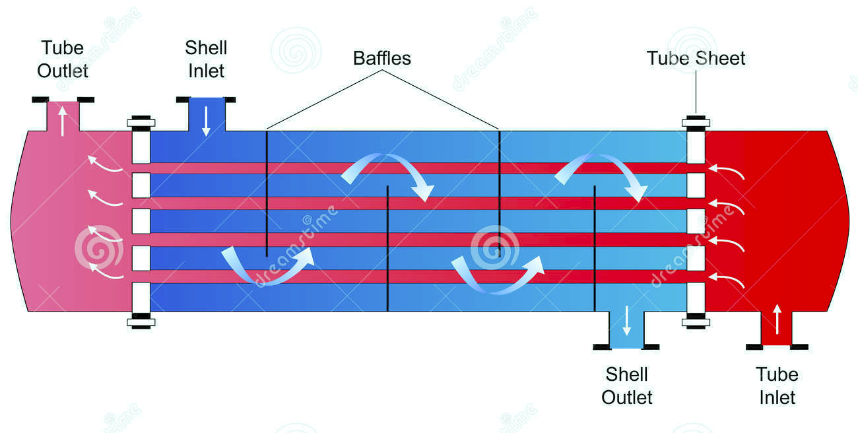
N
Presentation Outline
Heat Exchanger Details
Ground Temperature 55ºF
Project Background
Existing Conditions
Proposal
Ground Coupled Side
20% glycol / 80% water
VRF Side
R140a
Mechanical Depth
www.dreamstime.com
 | Water |  |  | Refrigerant |  |  | Indoor Units Air
 | Tin | Tout | GPM | Tin | Tout | GPM | Supply | Return
Cooling | 74°F | 83°F | 480 | 76°F | 50°F | 280 | 53-55°F | 78-80°F
Heating | 44°F | 36°F | 480 | 105°F | 89°F | 280 | 78-81°F | 68-70°F
EA Credit 6
Acoustical Breadth
Refrigerant | Q (tons) | Refrigerant Impact per ton | Credit (<100)
R-410a | 324 | 95.7 | Yes
Conclusion
Jonathan Cann
Elementary School One
Mechanical Option

Slide 17
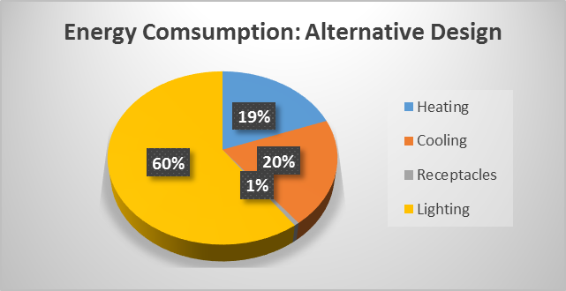
N
Presentation Outline
Alternative System Energy Use
Project Background
Table 25- Alternative Yearly Energy Consumption
 | Building | Building | Source
 | kWh | kBtu/yr | kBtu/yr
Heating | 185,431 | 632,320 | 1,896,960
Cooling | 192,269 | 656,215 | 1,968,843
Lighting | 572,805 | 1,954,985 | 5,865,541
Receptacle | 6,173 | 21,069 | 63,213
Total | 956,678 | 3,264,589 | 9,794,557
Cost | $131,064.90
Existing Conditions
Proposal
Mechanical Depth
Acoustical Breadth
Conclusion
Jonathan Cann
Elementary School One
Mechanical Option

Slide 18
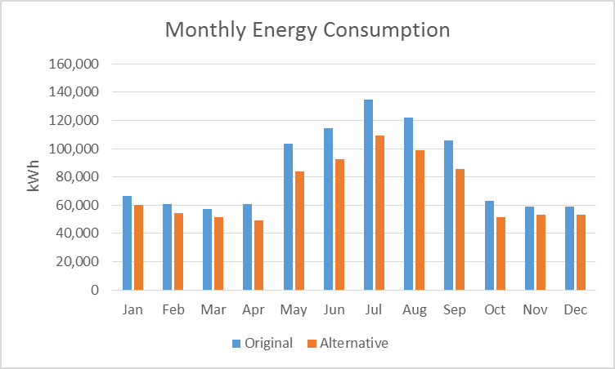
N
Presentation Outline
Energy & Emissions Comparison
Project Background
Table 26- Yearly Energy Breakdown
 | Building (kWh) | Building (kBtu/yr) | Source (kBtu/yr) | Cost
Original System | 1,215,300 | 4,147,823 | 12,444,711 | $166,496.09
Alternative System | 956,678 | 3,264,589 | 9,794,557 | $131,064.90
Yearly Savings | 258,622 | 883,234 | 2,650,154 | $35,431.19
Existing Conditions
Proposal
Mechanical Depth
Emissions Comparison- 21.3% less
 | CO2 (lbm/year) | SO2 (gm/year) | NOx (gm/year)
Original Design | 1,626,597.0 | 14,638.5 | 2,801.8
Alternative Design | 1,280,231.0 | 11,521.4 | 2,205.2
Acoustical Breadth
Conclusion
Jonathan Cann
Elementary School One
Mechanical Option

Slide 19
N
Presentation Outline
Payback Period
Table 28- Payback Period
 | Cost
Original System | $56,348.44
Alternative System | $692,071.26
With 10% Rebate | $622,564.13
System Difference | $566,215.69
Yearly Energy Savings | $35,431.19
Payback Period | 15.98 | Years
 | 191.77 | Months
Project Background
Federal Tax Rebate
10 % of initial material and labor cost
EER ≥ 14.1
COP ≥ 3.3
Without rebate Payback Period = 19.53 years
Existing Conditions
Proposal
Mechanical Depth
Acoustical Breadth
Conclusion
Jonathan Cann
Elementary School One
Mechanical Option

Slide 20
N
Presentation Outline
Cost Comparison
Original
Material | Condensers | $42,377.00
 | Controls | $823.00
Labor | Condensers | $11,985.00
 | Controls | $1,163.00
Total Cost |  | $56,348.00
Alternative
Material | Pump | $19,200
 | Antifreeze | $6,786
 | Water | $14
 | Controls | $1,475
 | Investigation | $915
 | Loop | $424,521
 | Sub-total | $452,911
Labor | Pump | $1,842
 | Controls | $2,952
 | Investigation | $3,993
 | Loop | $230,373
 | Sub-total | $239,160
Total Cost |  | $692,071
Project Background
 | Mechanical Cost | Total Construction Cost
Original Design | $3,461,864 | $20,969,617
Alternative Design | $4,028,079 | $21,535,833
Percent Increase | 16.4% | 2.7%
Existing Conditions
Proposal
Mechanical Depth
Original Building cost is based on 2015 using inflation from 2010.
Acoustical Breadth
maps.google.com
Conclusion
Jonathan Cann
Elementary School One
Mechanical Option

Slide 21
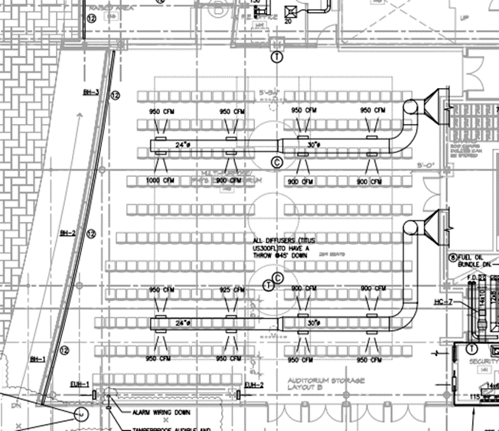
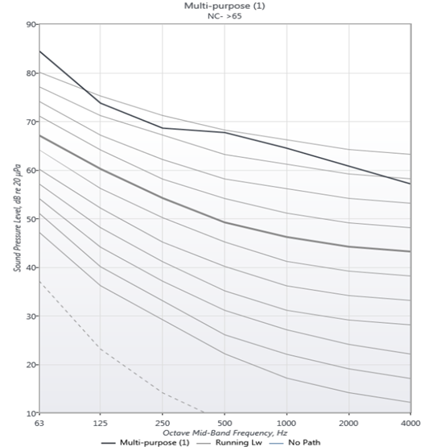
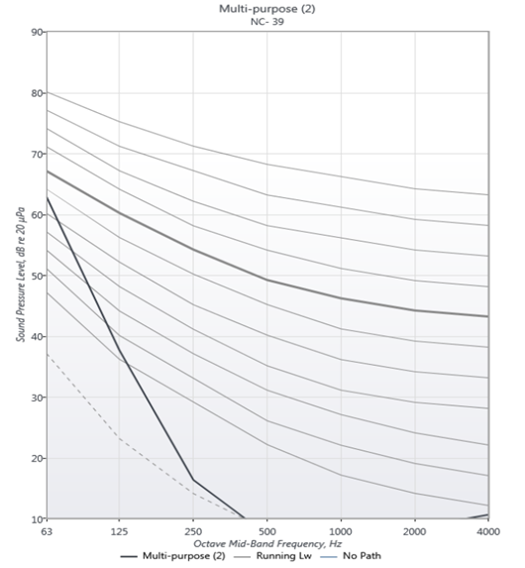
Presentation Outline
Multi-purpose Room Acoustical Treatment
Before: NC > 65 After: NC – 39
Added Treatment:
2” duct lining (60 ft each)
One duct silencer each
Cost Breakdown
Duct lining = $11,457
Duct Silencers= $4,700
Total Cost = $16,157
Goal NC-45
Project Background
Existing Conditions
Proposal
Mechanical Depth
Acoustical Breadth
Conclusion
Jonathan Cann
Elementary School One
Mechanical Option

Slide 22
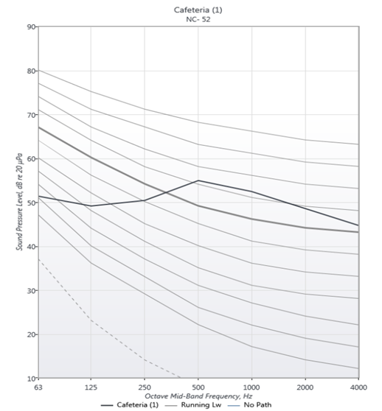
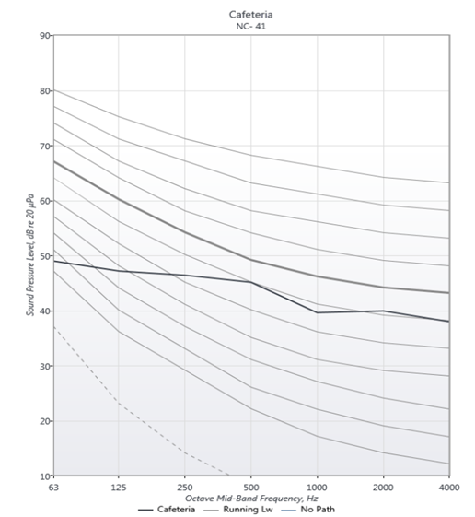
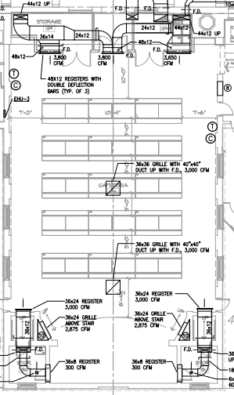
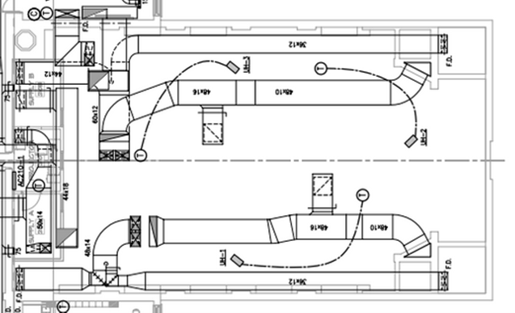
Presentation Outline
Cafeteria Acoustical Treatment
Before: NC - 52 After: NC – 41
Added Treatment:
One duct silencer each (36”x12”x50”)
Cost Breakdown
Duct Silencers= $4,000
Total Cost = $4,000
Not recommended extra cost
Goal NC-45
Project Background
Existing Conditions
Proposal
Mechanical Depth
Acoustical Breadth
Conclusion
Jonathan Cann
Elementary School One
Mechanical Option

Slide 23
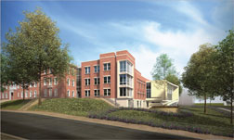
Presentation Outline
Conclusion
System Initial Cost - $692,071.26
Monthly Savings - $2952.60
Payback Period of System – 15.98 years
EUI Reduction – 21.3%
Project Background
Existing Conditions
Proposal
Mechanical Depth
Acoustical Breadth
Conclusion
www.nps.gov/nr/
ww.nbm.org
Jonathan Cann
Elementary School One
Mechanical Option

Slide 24
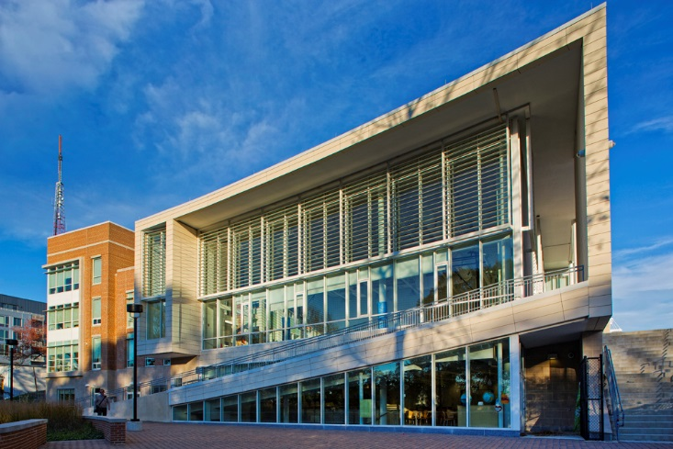
Acknowledgements
Penn State Faculty
JVP Engineers
Dr. Stephen Treado
All my peers that helped during the process
All my friends and family for their support
www.kumicm.com
www.nps.gov/nr/
Jonathan Cann
Elementary School One
Mechanical Option

Slide 25
Questions?
www.kumicm.com
www.nps.gov/nr/
Jonathan Cann
Elementary School One
Mechanical Option

